Slide 1
Unit 2
This is my sister.
Section B (1a-1d)
人教版七年级(初中)英语上册
0

Slide 2
Learning objectives
1）To learn the names of family members：son; cousin; grandpa; mom; aunt; grandma; dad; uncle; daughter; a photo of my family. 2）To listen and understand the conversation about family members.
3）To know your family members better, and to love your family.
0

Slide 3
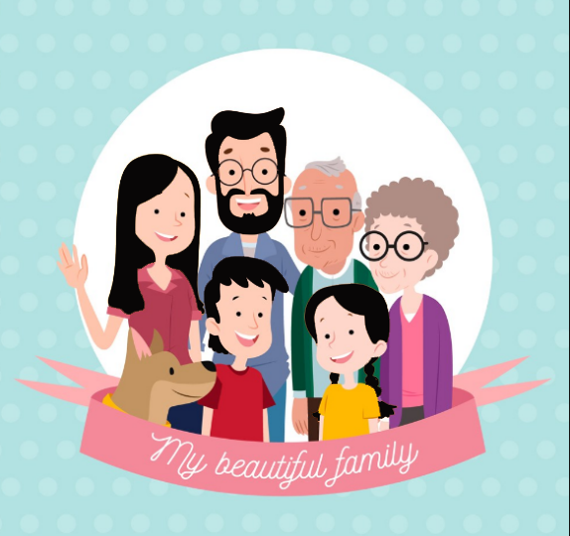
Lead in
Let's talk about the picture with your partners.
These/Those are…
This/that is …
Who is/are …
He/She is …
They are …

Slide 4
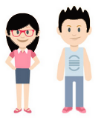
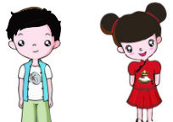
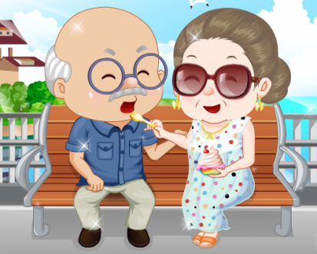
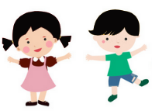
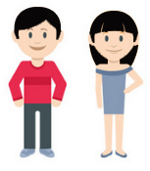
Presentation
My family
son
daughter
状元成才路
grandmother
aunt
状元成才路
uncle
状元成才路
cousin
cousin
状元成才路
状元成才路
状元成才路
状元成才路
状元成才路
状元成才路
状元成才路
状元成才路
状元成才路
状元成才路
状元成才路
daughter
状元成才路
son
状元成才路
状元成才路
状元成才路
father
mother
状元成才路
状元成才路
状元成才路
grandfather
me
brother

Slide 5
Presentation
1a Add the words in the box to the family tree.
sister son cousin grandpa mom aunt
grandpa
grandma
dad
mom
uncle
aunt
daughter
daughter
son
cousin
sister
brother

Slide 6
Presentation
Can you fill in the blanks?
1. Linda is my mother. I’m Linda’s __________.
2. Helen is my mother’s sister. She is my __________.
3. Helen is the boy’s mother. The boy is my __________.
4. This is my father’s brother. He’s my __________.
5. Jim is his father’s ________.
6. His parents are his _______ and _______.
daughter
aunt
cousin
uncle
son
mother
father

Slide 7
Presentation
1b Listen and check ( ) the words you hear.
√
grandpa ____ grandma ____ cousin ____ dad ____ mom ____
uncle ____ aunt ____ brother ____ sister ____ friends ____
√
√
√
√
√
√

Slide 8
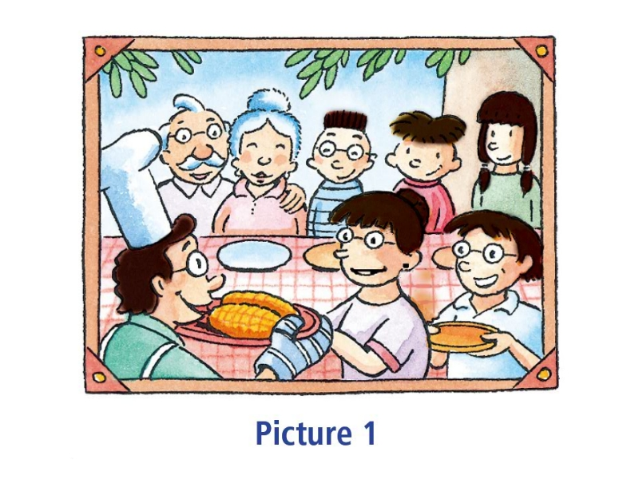
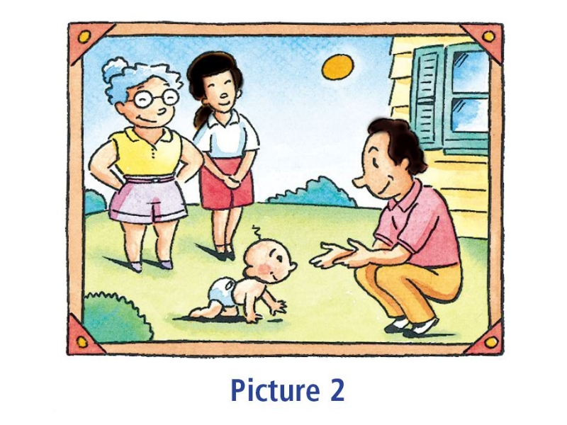
Presentation
Look at the pictures. Who are they?
1
2
grandparents
aunt
uncle
cousin
cousin's friends
grandmother
parents
son

Slide 9
Presentation
1c Listen again. Which picture are Jiang Tao and Tom talking about?
1
2

Slide 10
Presentation
Listen again and fill in the blanks.
A: This is a _____ of my family. This is my ______.
B: __________ he?
A: __________ my uncle.
B: And is _________ your cousin?
A: Yes, she's my cousin Jiang Shan. And _____ _____
her friends.
B: _________ they?
A: They're my ___________ and ___________.
photo
aunt
Who's
He's
she
these
are
Who're
grandpa
grandma

Slide 11
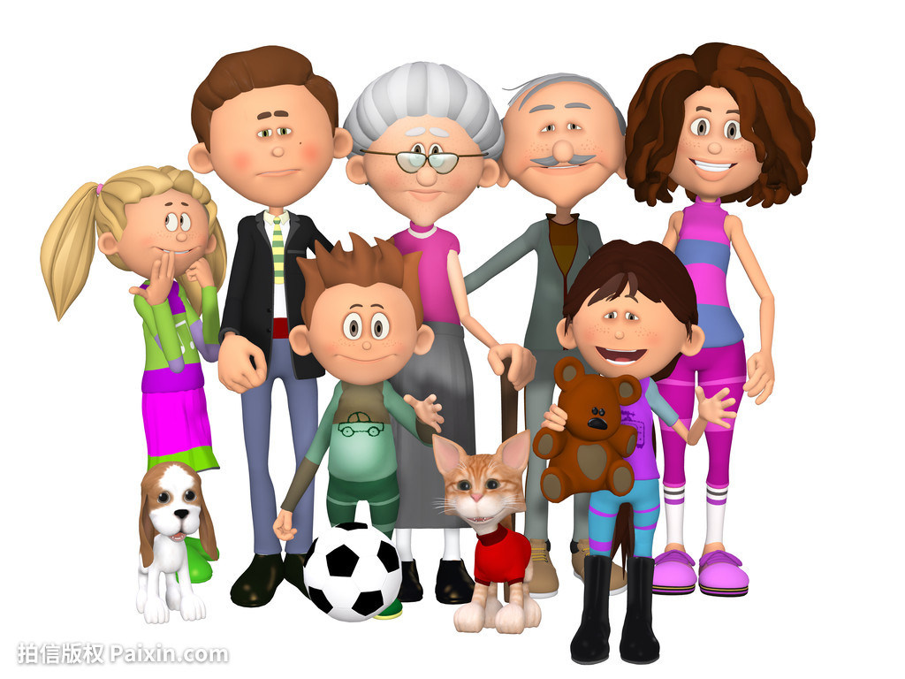
Presentation
1d Draw a picture of your family and friends. Tell your partner about your picture.
Look! This a p___________ of my brothers. This is my a_______, Mary. She’s my father’s s________.
icture/hoto
unt
ister

Slide 12
Language points
1. aunt/uncle
aunt 指父母那一辈除母亲之外的所有女性长辈，相当于汉语中
的“姑母；姨母；伯母；婶母；舅母”。前面有不定冠词修饰时，
应用an。注意：a+读音以辅音音素开头的词；an+读音以元音
音素开头的词。
aunt
姑母
姨母
伯母
婶母
舅母

Slide 13
Language points
uncle 指父母那一辈除父亲之外的所有男性长辈，相当于汉语
中的“舅父；叔父；伯父；姑父；姨父”。前面有不定冠词修饰时，
应用an。
uncle
舅父
叔父
伯父
姑父
姨父

Slide 14
Language points
aunt与uncle与人名连用的时候， 书写与汉语习惯相反，
要将称呼写在人名前， 且首字母要大写。
I like Uncle Sam. 我喜欢萨姆叔叔。
Aunt Amy is my mother’s sister. 埃米姨妈是我妈妈的姐姐。

Slide 15
Exercise
一、完成句子：
1. This is Mrs. Brown’s _________.
这是布朗夫人的儿子。
2. ________ are my _______ and _______.
这是我的姨母和姨父。
3. Is ______ your ________?
他是你的表哥吗？
son
These
aunt
uncle
he
cousin

Slide 16
Exercise
二、单项选择：
1. This isn’t my brother and he is my .
A. sister B. mother C. cousin D. parent
2. — Is that your friend Tom?
— .
A. Yes, that is B. No, he’s my brother
C. Yes, she is D. No, she’s my brother

Slide 17
Exercise
3. — I’m Tom and my father is Mike.
— Oh, you’re Mike’s __________.
A. brother B. uncle C. cousin D. son
4. Look at ___________. These are my parents and this is my sister.
A. picture 1 B. Picture 1
C. Picture two D. picture two

Slide 18
Homework
1. Cope the key words in 1a for three times.
2. Preview 2b and complete 2c.

