Slide 1
R·九年级全一册
Unit 5 What are the shirts made of?
第一课时

Slide 2
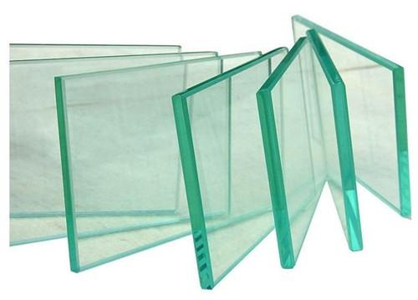
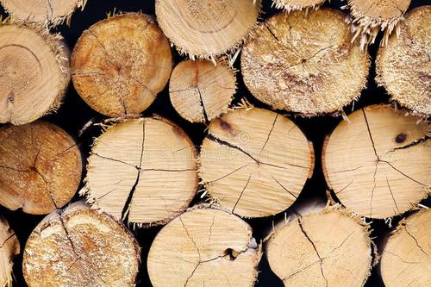
Lead in
glass
wood

Slide 3
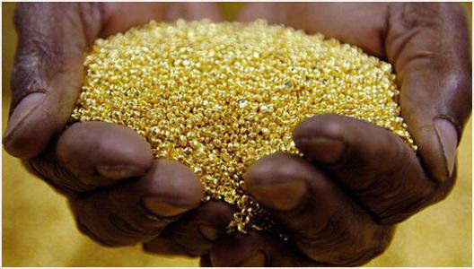
silk
gold

Slide 4
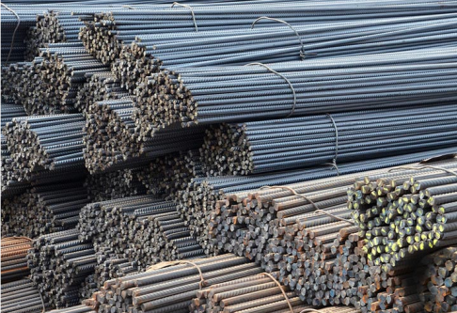
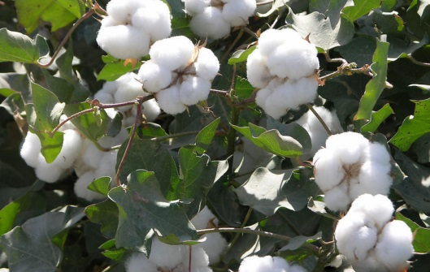
steel
cotton

Slide 5
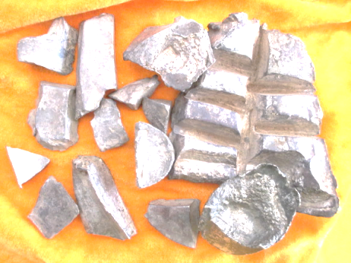
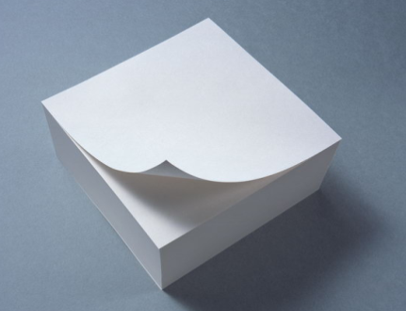
silver
paper

Slide 6
What are these things usually made of? Match them with the materials.

Slide 7
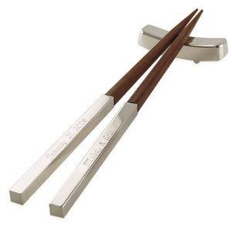
Language points
What’s the ___________ usually made of ?
It’s made of _________.
chopstick
wood

Slide 8
What’s the ________ usually made of ?
It’s made of _________________.
window
wood and silver

Slide 9
What’s the ________ usually made of ?
It’s made of _________.
stamp
paper

Slide 10
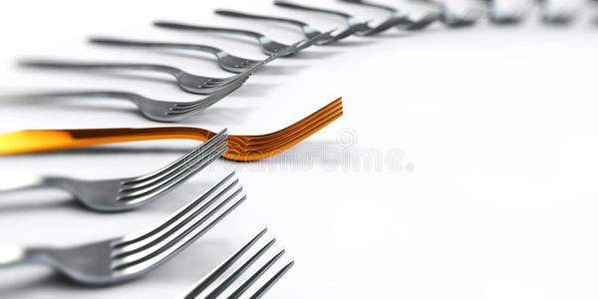
What’s the ________ usually made of ?
It’s made of _________.
fork
gold or silver

Slide 11
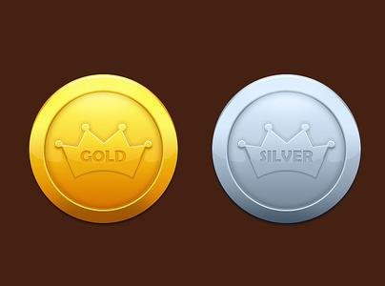
What’s the ________ usually made of ?
It’s made of _________.
coin
gold or silver

Slide 12
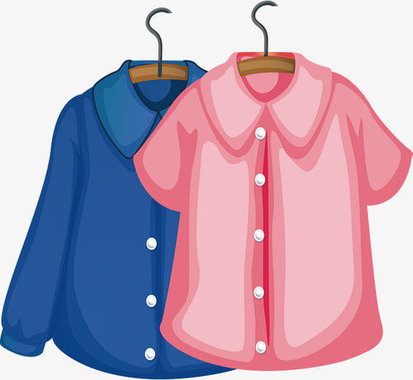
What’s the ________ usually made of ?
It’s made of _________.
blouse
silk

Slide 13
be made…的词组
1. be made of …由……制成
强调从制成品中仍可以看出它的原材料。
2. be made from … 由……制成
强调从制成品中看不出它的原材料。

Slide 14
3. be made in … 在……制造
介词in后常接产地

Slide 15
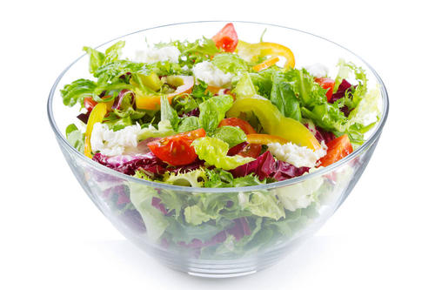
The salad
is made of vegetables.
看得出原材料
The wine
is made from grapes.
看不出原材料

Slide 16
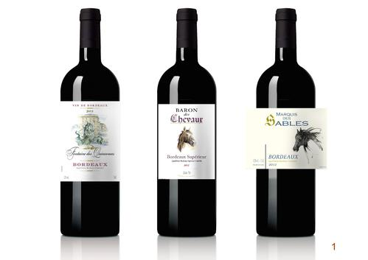
Where was the wine made?
It was made in France.
France

Slide 17
Role play
This picture is very special. What is it made from?
It is made from grass and flowers.

Slide 18
This ring looks nice. Is it made of silver?
Yes, and it was made in Thailand.

Slide 19
No matter what you buy, you might think those products were made in those countries.

Slide 20
二、no matter 无论；不论
与“what, who, which, where, how”等疑问词连用，引导让步状语从句。
no matter what = whatever 无论什么

Slide 21
no matter who = whoever 无论谁
no matter where = wherever 无论哪里
no matter when = whenever 无论什么时候
no matter which = whichever 无论哪一个
no matter how = however 无论如何

Slide 22
Practice
1. 他的新手机是中国制造的。
His new mobile phone __________ China.
2. 这台电视机是由工厂的工人们制造的。
The TV set is ________ the workers in the factory.
3. 这种沙拉是用香蕉和苹果做的。
The salad is _________ bananas and apples.
is made in
made by
made of

Slide 23
Summary
1. be made of …由……制成
强调从制成品中仍可以看出它的原材料。
2. be made from … 由……制成
强调从制成品中看不出它的原材料。
3. be made in … 在……制造
介词in后常接产地
4. No matter what you made buy, you might think those products were made in those countries.

Slide 24
THANKS

