Slide 1
Unit 4
What’s the best movie theater?
Section A (1a-1c)

Slide 2
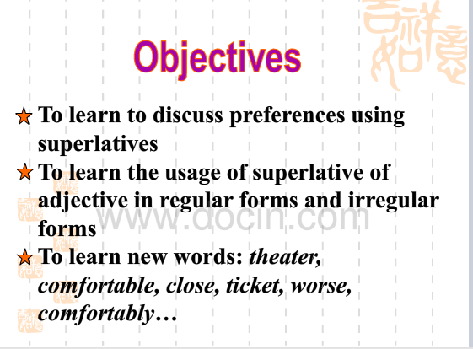

Slide 3
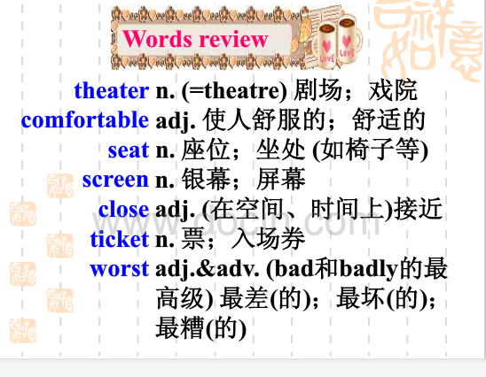

Slide 4
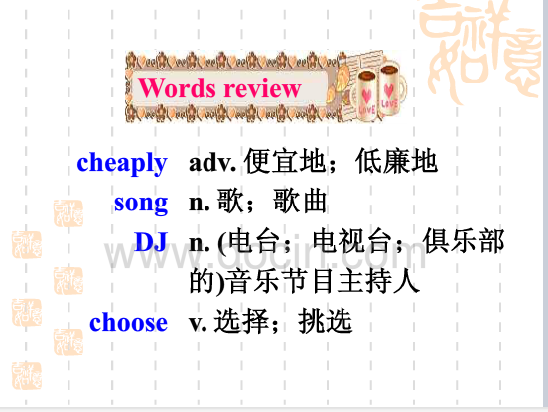

Slide 5
Learn by yourself(自主学习)
1.离……近的____________
2.有最舒适的座位____________
3.最好的音响____________
4.最短的等待时间____________
5.the biggest screens____________
6.in town____________
7.快速地买票________________

Slide 6

英
文
顺
口
溜
GOOD, BETTER, BEST
Good, better, best,
Never let it rest,
Till good be better,
And better best.
Bad, worse, worst,
Never fight against,
Get better and better,
And you’ll be the best.
Notes:
本资料来自于资源最齐全的２１世纪教育网www.21cnjy.com

Slide 7
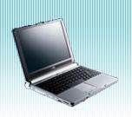

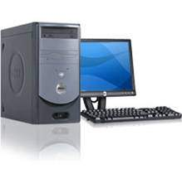
¥3999
This computer is cheap.
¥2999
This computer is cheaper than
that one.
This one is the cheapest of all.
¥1999

Slide 8
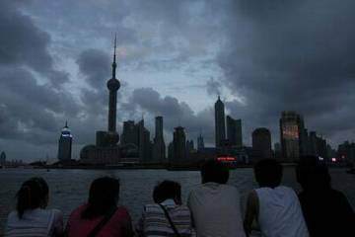
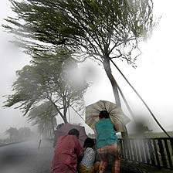
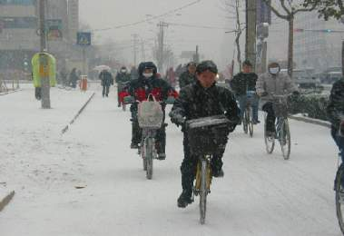
The weather is bad.
The weather is worse.
The weather is the worst.

Slide 9
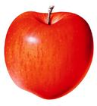
big
bigger
This apple is the biggest of all.

Slide 10

expensive
10 yuan
more expensive
20 yuan
This pen is the most expensive of the three.
50 yuan

Slide 11
Discuss
1.Do you like to go to the movies?
2. There are three movie theaters near my home. Could you please help me find out which one I should choose?
3. Why should I choose that one?

Slide 12
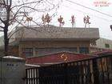

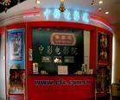
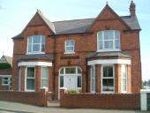
Super Cinema
Red Star
500m
400m
Blue Moon
300 m
my home

Slide 13
Super Cinema
is close to my home.
Red Star
is closer to my home.
Blue Moon
is the closest to my home.

Slide 14
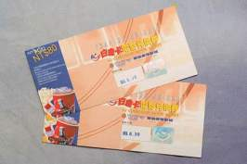
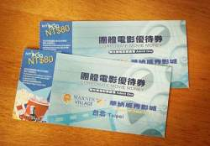
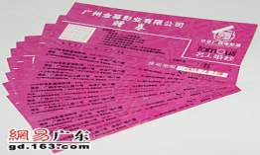
Blue Moon
is cheap.
¥40
Super Cinema
is cheaper.
¥20
Red Star
is the cheapest.
¥10

Slide 15
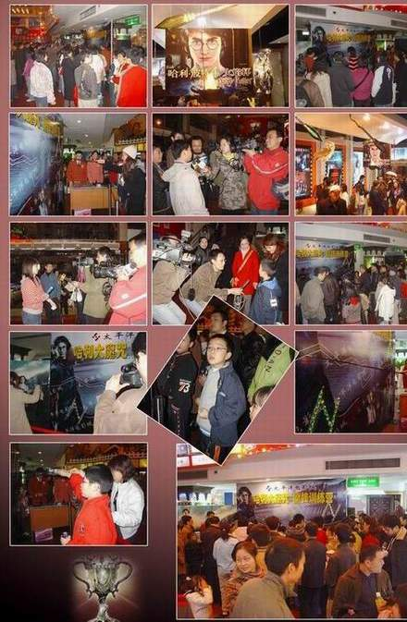
Red Star
is popular.
Blue Moon
is more popular.
Super Cinema
is the most popular.

Slide 16
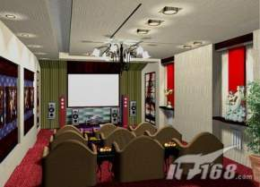
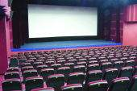
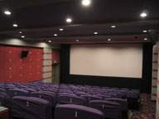
Red Star
has big screens.
Super Cinema
has bigger screens.
Blue Moon
has the biggest screens.

Slide 17
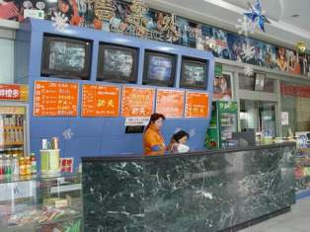
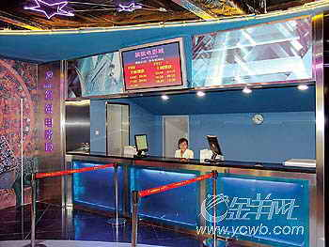
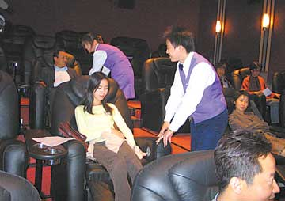
Red Star
has friendly service.
Super Cinema
has friendlier service.
Blue Moon
has the friendliest service.

Slide 18



Red Star
has comfortable seats.
Super Cinema
has more comfortable seats.
Blue Moon
has the most comfortable seats.

Slide 19
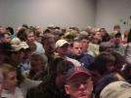
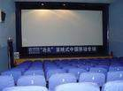
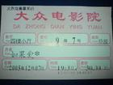
good quality
big screens
popular
comfortable seats
qualities
cheap
friendly service

Slide 20




How do you choose a cinema to go to?
Which is important?Which is not important?
comfortable
seats
friendly
service
distance
from home
big screens
in a fun part
of town
new movies
popular
cheap

Slide 21
1a How do you choose which movie theater
to go to? Write the things in the box
under “Important” or “Not important”.
comfortable seats big screens best sound
cheap new movies close to home
buy tickets quickly popular
Important | Not Important
big screens
comfortable seats
best sound
popular
close to home
cheap
new movies
buy tickets quickly

Slide 22






1b Listen and match the statements with the movie theaters.
Qualities | Movie Theater
It has the biggest screens.
It’s the most popular near here.
It’s the closest to home. | Town Cinema
It has the shortest waiting time.
It has the best sound.
It has the most comfortable seats.
Movie World
Screen City
Town Cinema
Screen City
Movie World

Slide 23

1c
Talk about the movie theaters you know.
A: What’s the best movie theater?
B: Sun Cinema. It’s the cheapest.
C: But I think Moon Theater has the most
comfortable seats.
D: For me, …
F: In my opinion, …
It has the biggest screens.
It’s the most popular.
It’s the closest to home.
It’s the cheapest.
It has the friendliest service.
It has the most comfortable seats.

Slide 24
Exercises
1. Tom is quiet enough. Jim is ______ (quiet).
Jack is the_____ (quiet).
2. Dale was the ______ (early) in our class
yesterday.
3. Which boy is the ______ (thin) in your class?
4. I think English is the ______ ______
(important) of all the subjects.
5. Sharks are the ______ ______(danger)
animals in the sea.

Slide 25
Homework:
预习27页Grammar Focus 和书本114页，总结形容词和副词最高级的规律。

Slide 26
Thank You!

