Slide 2
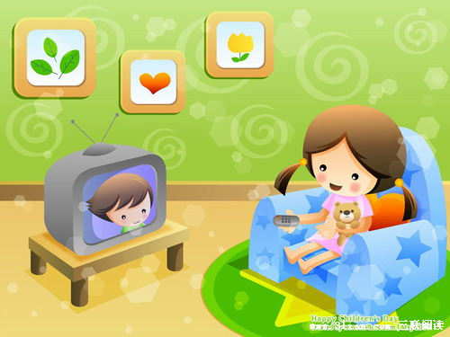
I'm watching TV.

Slide 3
Section A 2
Grammar focus-3c

Slide 4
Grammar focus
阅读Grammar focus部分，完成下列句子。
1. 你在做什么？ _____________________
2. 我在看电视。 __________________
她在做什么？ ___________________
4. 她在洗衣服。 ____________________
5. 他们在做什么？___________________
他们在听CD。 __________________________
你在做作业吗？__________________________
是的。/ 不是。 __________________________
What are you doing?
I’m watching TV.
What’s she doing?
She’s washing her clothes.
What are they doing?
They’re listening to a CD.
Are you doing your homework?
Yes, I am. / No, I’m not.

Slide 5
9. 我在打扫我的房间。_____________________
10. 他在读报纸吗？_______________________
10. 是的。/ 不是。他在打篮球。
__________________________________________
11. 他们在用电脑吗？
_____________________________
12. 是的。 / 不是。他们在锻炼。
__________________________________________
I’m cleaning my room.
Is he reading a newspaper?
Yes, he is./No, he isn’t. He’s playing basketball.
Are they using the computer?
Yes, they are./No, they aren’t. They’re exercising.

Slide 6
现在进行时态
一、用法：1. 表示现在（说话瞬间）正在进行或发生的动作。例如：
我正在做作业。I’m _____ my homework now.
他们在操场上踢足球。
They’re _______ soccer on the playground.
2. 也可表示当前一段时间内的活动或现阶段正在
进行的动作。例如：
这些天来，我们在做一架模型飞机。
We are ____________________ these days.
doing
playing
making a model plane

Slide 7
这个月我们一直在为英语考试而学习。
We ___________ for the English test this month.
二、句子结构：
1. 陈述句：主语+ be (am, is, are) not + V. –ing +…
我正在洗衣服。________________________
他正在打电话。 ___________________________
他们没在下象棋。______________________
彼特没在打篮球。_________________________
are studying
I’m washing the clothes.
He is talking on the phone.
They are not playing chess.
Peter isn’t playing basketball.

Slide 8
2. 一般疑问句：
Be (Am, Is, Are) + 主语 + V.-ing …
她正在弹钢琴吗？_______________________
你们正在做作业吗？ _____________________________
3. 特殊疑问句
特殊疑问词+ be (am, is, are) +主语+ V. –ing…
杰克正做什么事情？ __________________
他们正在做什么事情？ ____________________
Is she playing the piano?
Are you doing your homework?
What is Jack doing?
What are they doing?

Slide 9
三、常用时间状语：
now, right now或表示现在情景的look, listen等。
格林先生现在正在写一个故事。
______________________________
看！他们正在吃早饭。 _______________________________
Mr. Green is writing a story now.
Look! They’re eating breakfast.

Slide 10
四、与一般现在时态的区别
一般现在时态表示经常性、习惯性的动作；谓语动词为原形或第三人称单数形式；时间状语常为usually, often, sometimes, on Monday, every day。
琳达通常在早上冲个澡。 _____________________________________
Linda usually takes a shower in the morning.

Slide 11
3a
Write sentences following the examples.
1. Jenny/ clean the house/ now
Jenny is cleaning the house now.
2. Bob/ make dinner/ every Saturday
Bob makes dinner every Saturday.
3. Mary’s parents/ drink tea/ after dinner
_________________________________
4. Bill/ talk on the phone/ now
_________________________________
5. Susan and Bob/watch TV / on weekends
__________________________________

Slide 12
本题主要是考查现在进行时态的句子与一般现在时态的句子的区别用法。
2. 首先，应根据句意及所提供的时间状语来确定本句话用什么时态。3小题由时间状语after dinner可知应用一般现在时态；4小题由now，可知应用现在进行时态。5小题由on weekends可知应用一般现在时态。
然后，根据每种时态的句子结构来造句。
注意根据句子主语的单复数来确定谓语动词。

Slide 13
3. Mary’s parents/ drink tea/ after dinner
_______________________________________
4. Bill/ talk on the phone/ now
_________________________________
5. Susan and Bob/watch TV / on weekends
______________________________________
Mary’s parents usually drink tea after dinner.
Bill is talking on the phone now.
Susan and Bob watch TV on weekends.

Slide 14
Number the sentences in order to make a telephone conversation. Then practice it with a partner.
3b
____ Do you want to go tomorrow then?
____ OK. See you tomorrow evening!
____ I’m reading a book.
____ Let’s go at seven o’clock.
____ No, this book is really interesting.
____ What are you doing?
____ Do you want to go to the movies now?
____ Sure, what time?

Slide 15
先通读一下所有句子, 弄清楚对话的主旨大意。
根据对话的大意，比较各个句子的意思，先找出第一句话或最后一句话，这是最关键一环。然后顺藤摸瓜，确定整个对话的顺序。
比较可知What are you doing?是对话的第一句;而OK. See you tomorrow evening是最后一句。
特别注意部句与答语之间在意思上联系。
4. 最后, 通读一遍整个对话，看整个对话的意思是否通顺。

Slide 16
____ Do you want to go tomorrow then?
____ OK. See you tomorrow evening!
____ I’m reading a book.
____ Let’s go at seven o’clock.
____ No, this book is really interesting.
____ What are you doing?
____ Do you want to go to the movies now?
____ Sure, what time?
5
8
2
7
4
1
3
6

Slide 17
Pairwork
Practice the conversation with your partner.

Slide 18
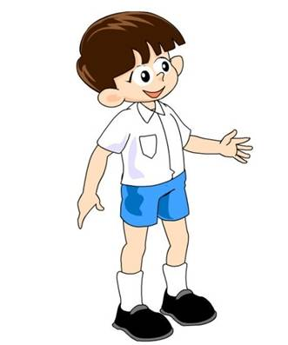
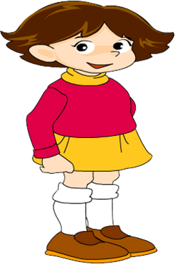
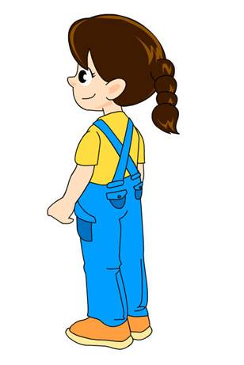
Take turns miming different activities in your group. The others in the group guess what the activities are.
3c
Are you making soup?
Are you cleaning?
No, I’m not.
Yes, you’re right.

Slide 19
Are you writing?
No, I’m not.
Are you drawing?
Yes, you’re right.
Are you reading a book?
No, I’m not.
Are you singing?
Yes, you’re right.

Slide 20
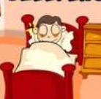
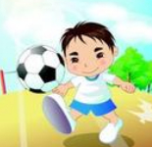
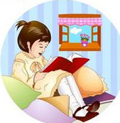
根据示例和图片提示谈一谈你在星期六经常做的事以及你这个星期六正在做的事情。
I usually sleep in the morning.
But I’m playing soccer this morning.
I usually __________________________.
But ______________________.
use the computer at 10:00
I’m reading a book now

Slide 21
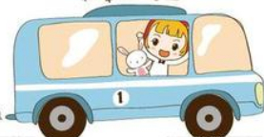
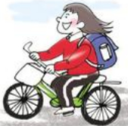
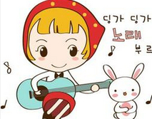
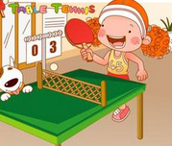
I usually ______________________
But ______________________
take the bus to the park.
I’m riding my bike now.
I usually __________________________
But _______________________
play the guitar after dinner.
I’m playing ping pong now.

Slide 22
句型转换
The tigers are swimming in the river.
(变否定句)
__________________________________
His grandpa is drinking now.
(变为一般疑问句)
______________________________
The tigers aren’t swimming in the river.
Is his grandpa drinking now?

Slide 23
3. The dog is walking on two legs.
(对划线部分提问)
_______________________
4. Linda usually gets up at six.
(用now替代usually改写句子) ___________________________
5. They usually watch TV in the evening.
(用now替代usually)
___________________________
What is the dog doing?
Linda is getting up now.
They are watching TV now.

Slide 24
Remember the sentences in the
Grammar focus.
2. Write five sentences about what your
family members are doing now.

