Slide 1
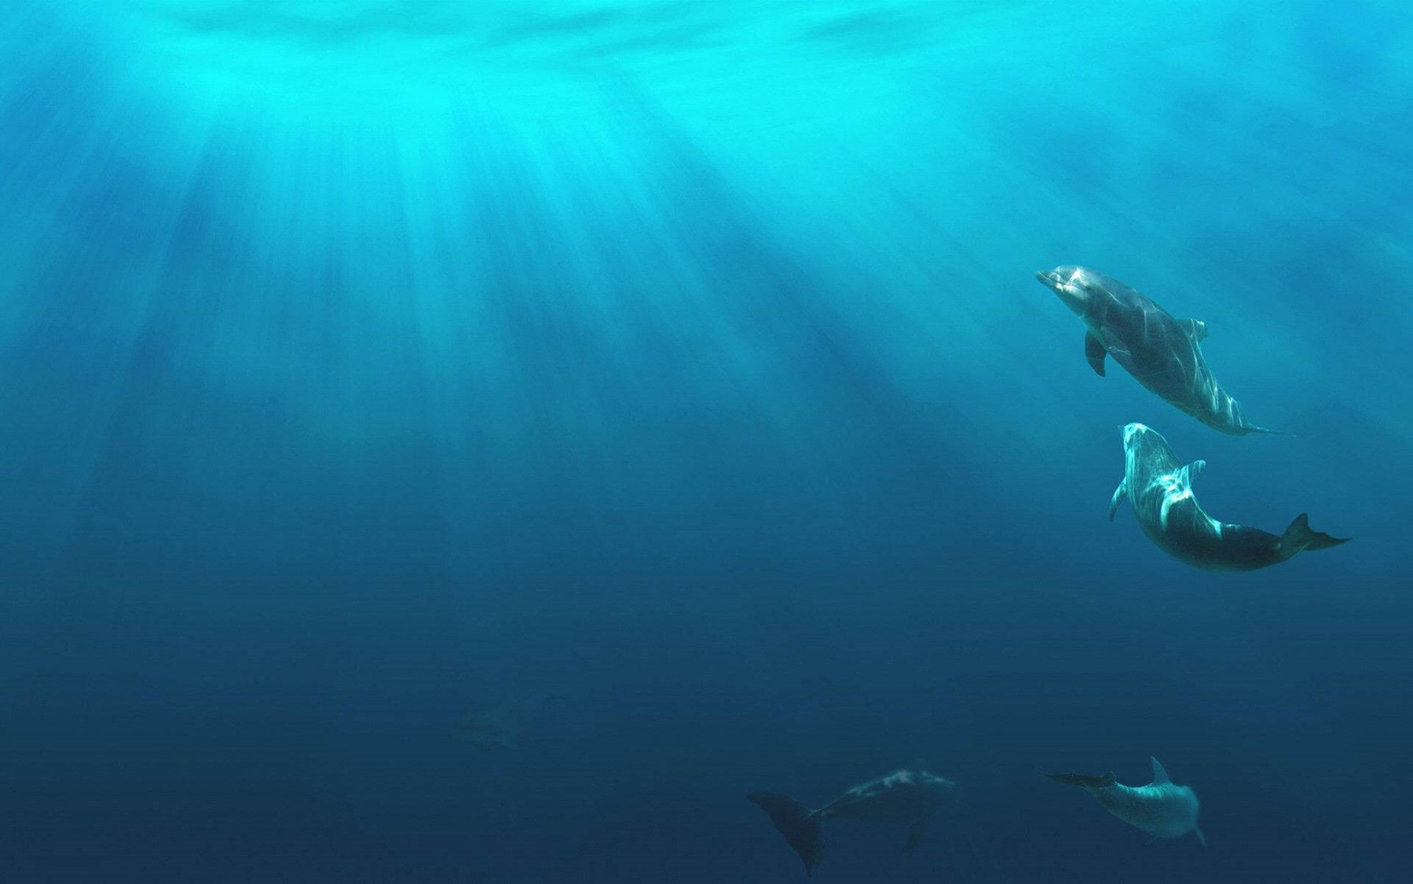
Unit 2
Iconic Attractions

Slide 2
单
元
主
题
语
境
人与自然
Travel is the greatest source of true knowledge.
旅行是真知的最伟大的发源地。

Slide 3
话题导入
Australia^{①}is located in the southern hemisphere which is surrounded by ocean.It is the largest island but also the smallest, flattest and driest continent in the world.The country also includes Tasmania, the Torres Strait and a small number of islands in the Pacific and the Indian Ocean.

Slide 4
Australia is a highly developed country.It is experienced in agriculture, animal husbandry(畜牧业) and abundant in natural resources; it also wins many slogans, such as “the country on the back of the sheep”，“the country in the mining car” and “the country with the ears of wheat”．There is even a phrase specifically describing Australia as “the lucky country”，which means the climate, history, way of life and many other aspects are all very lucky; citizens don’t need to work hard, as long as they let the cattle and sheep eat grass or dig in the earth for mineral.For a long time, Australia makes much fortune for its high-quality export agricultural products and mineral resources which establish a status of one of the most strong countries in the world.

Slide 5
The seasons in Australia are quite the opposite of the Chinese.The four seasons of it are distinctive.Varieties of plants are covered here and animals such as koala, kangaroo also share their marvellous time here.Australia’s diverse landscape is home to astounding natural attractions, sprinkled all over the country.Bring out your inner cowboy in the outback.Dive with sharks at Ningaloo Reef.Hug a koala.Confronted with the exquisite landscape, you are bound to forget all the daily things which trouble you a lot.
All the local people enjoy an optimistic and active life.They also show their kindness and enthusiasm to the tourists.^{②}To sum up, Australia has a decent environment for people to live in.

Slide 6
靓句运用于写作
①We have three indoor activity rooms as well, located in the east of our campus.(2017·全国Ⅲ，书面表达)
②To sum up，I wish you could live up to the expectations of our school.
(2019·全国Ⅱ，书面表达)

Slide 7
内容索引
Period One Reading and Thinking—Comprehending
读前清障 识记单词 快速顺畅阅读
语篇理解 精读演练 萃取文本精华

Slide 8
读 前 清 障
识记单词 快速顺畅阅读
品句猜词——请预读下列课文原句，并猜测句中加颜色词汇的意思。
1.The foundation of Australia __________
2.Political divisions ______
3.Located to the south of the equator，below many other countries on the globe，it’s often informally referred to as “down under”. ____
4.Bakeries，fast-food joints，butcher shops，cafes，and restaurants everywhere provide some of the premier food experiences in the world.
____________________
________
_________________
创建；基础
政治的
位于
赤道
面包(糕饼)店；面包厂
公共场所
肉贩；屠夫
最著名的；第一的

Slide 9
5.The influence of Asian cultures，on the other hand，led to the introduction of bean curd and Asian herbs，along with Australian versions of foods like the Chinese-inspired dim sim. ________________
6.They have a straightforward and free-and-easy attitude towards life，and their friendliness and warmth made me feel at home wherever I went.
______________
药草；香草；草本
坦率的；简单的
返 回

Slide 10
语 篇 理 解
精读演练 萃取文本精华
Step 1 Fast-reading
1.What’s the main idea of the passage?
A.The author’s impression of the food and music of Australia.
B.The author’s impression of the people and culture of Australia.
C.The author’s experiences in Australia.
D.The author’s impression of the attractions of Australia.
√

Slide 11
2.Read the passage and match the main idea of each paragraph.
Para.1 A.Life and customs of native Australian
Para.2 B.Location of Australia
Para.3 C.Iconic sites of Australia
Para.4 D.Food of Australia
Para.5 E.Impression of Australia
Para.6 F.Music of Australia
Para.7 G.Instruments of Australia
Para.8 H.Tourism slogan of Australia
Para.9 I.People of Australia

Slide 12
Step 2 Careful-reading
Read the passage carefully and choose the best answer.
1.How many days did the writer stay in Australia?
A.About 4 days. B.About 6 days.
C.About 7 days. D.About 12 days.
√

Slide 13
2.What impressed the writer most in Australia?
A.The different but yummy food.
B.The amazing instrument didgeridoo.
C.The mix of peoples and cultures.
D.The iconic sites.
√

Slide 14
3.What can we know about the didgeridoo according to the passage?
A.It has no finger holes.
B.It is an amazing instrument.
C.Its player has to change the shape of his mouth to change pitch.
D.All of the above.
√

Slide 15
4.What can we infer from the passage?
A.The writer and his friend ate Sunday roast.
B.The writer visited Sydney Opera.
C.The writer was able to play the didgeridoo.
D.The writer likes the food of Australia most.
√

Slide 16
Step 3 Post-reading
After reading the passage，please fill in the following blanks.
I arrived in Australia on 1st October to visit my friend there.Australia，
1. (locate) to the south of the equator，is often informally referred to
2. “down under”.
My first impressions of Australia have been all about food！3.__________
(bakery)，fast-food joints，butcher shops，cafes，and restaurants everywhere provide some of 4. premier food experiences in the world.
located
as
Bakeries
the

Slide 17
I learned to play the local instrument—didgeridoo.I put my mouth on one end and blow while 5. (vibrate) my lips but failed.A skilled player can play for a long time by 6. (continue) breathing in through his nose while breathing out through his mouth and into the didgeridoo.
After 7. (experience) Australia，personally speaking，8. I like most about Australia is the people 9. (they).Their friendliness and 10. (warm) made me feel at home wherever I went.
vibrating
continually
experiencing
what
themselves
warmth

Slide 18
Step 4 Sentence-learning
1.To survive in this vast land on the ocean，the Aborigines had to be in close contact with nature.
[句式分析] 此句是简单句，动词不定式短语___________________________
作目的状语。
[自主翻译]
________
To survive in this vast land on
the ocean
为了在这片广阔的海洋陆地上生存，土著居民必须与大自然亲密接触。

Slide 19
2.Most of their musical instruments are really just sticks found on the ground，among which there is an amazing instrument called the didgeridoo.
[句式分析] 该句为复合句。主干部分是Most of their musical instruments are really just sticks found on the ground，为主系表结构；
为过去分词短语作定语，修饰sticks；among which there is...为“介词＋关系代词”引导的非限制性定语从句，which代指前面的 ；定语从句里面又含有一个there be句型，其中的called the didgeridoo为过去分词短语作定语，修饰instrument。
[自主翻译]
found on the
ground
musical
instruments
他们绝大多数的乐器其实就是地上找到的树枝，其中就有一种令人惊叹的乐器叫作迪吉里杜管。

Slide 20
3.It is said that now nearly half of all Australian citizens were either born overseas or have parents who were born overseas.
[句式分析] 该句为主从复合句。 为形式主语，that从句为真正的主语。who引导 从句，修饰先行词parents。
[自主翻译]
It
定语
据说，现在近一半的澳大利亚公民要么是在海外出生的，要么父母是在海外出生的。

Slide 21
4.Personally speaking，what I like most about Australia is the people themselves.
[句式分析] 该句为复合句。what I like most about Australia为what引导的 从句。
[自主翻译]
主语
就我个人而言，我最喜欢的是澳大利亚人。
返 回

Slide 22
本课结束

