Slide 1
R·九年级全一册
Unit 11 Sad movies make me cry.
第三课时

Slide 2
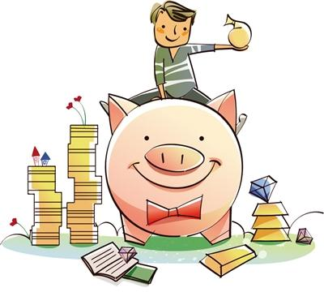
Lead in
What makes you happy? Why?
Money
Buying something
Going somewhere

Slide 3
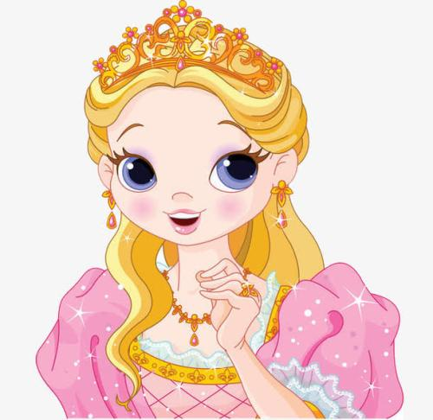
What makes her happy? Why?
Beauty
Becoming a popular star

Slide 4
What makes you unhappy? Why?
Worry
Losing something

Slide 5
Language points
What’s wrong? You look sad.
I missed scoring a goal. I made my team lose the game.

Slide 6
How could he have missed scoring that goal?
He had let his whole team down.

Slide 7
could have done: “过去本能够做某事但未做”，含责备语气。
let...down近义词为 disappoint.
let sb. down “使某人失望”
=disappoint sb.
=make sb. disappointed.

Slide 8
I was really worried that my coach might kick me off the team.

Slide 9
But whatever it was, don’t be too hard on yourself. Besides, winning or losing is only half the game.
be hard on sb. 过于严格地要求某人；对某人过
于严厉；以刻薄的方式批评、对待某人

Slide 10
besides
except
除……以外还有
包括后面提到的人或物
除去
不包括后面提到的人或物
All the students went to the park except Jim.
Lucy went to the cinema besides Lily.
(Jim没去)
(Lily 也去了)

Slide 11
VS
The red group tells the sad experiences, while the blue group tells the happy experiences.
Let’s see which group is more productive.

Slide 12
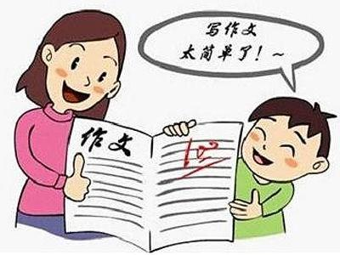
Getting good grades on an
exam makes me very happy.

Slide 13
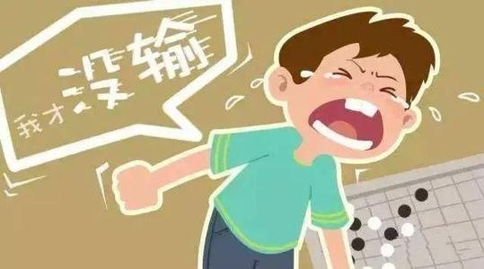
Losing a competition makes me very sad.

Slide 14
Performing something well in front of a big group of people makes me very happy.

Slide 15
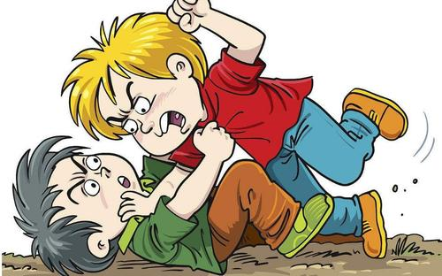
Getting into a fight with my best friend makes me very sad.

Slide 16
Let's write
What happened?
When did it happen?
How did it make you feel?
My day
Where did it happen?
Why?
What did you learn from the experience?

Slide 17
An experience that made me very happy was winning the nationwide English speech competition last year.
At first, I didn’t know what to write for my speech, but after talking to my teacher and reading some books, I had some ideas and started writing. Then I practiced my speech many times.

Slide 18
On the day of the competition, I saw many people there. This made me feel very nervous. I started to worry that I would forget my speech. Then I remembered what my teacher told me – close my eyes and take deep breaths. I did that and it made me feel much better. When my turn came, I gave my speech with confidence.

Slide 19
I waited anxiously for the results, and when I heard that I was the first prize winner, I jumped up and down in joy.
This experience taught me that being well-prepared is very important. It helps to read a lot, and also to ask people around you for advice. Most importantly, have confidence in yourself !

Slide 20
Practice
Number the things[1-6](1=least important,
6=most important). Write a reason for each choice.
____fame ____power ____friendship
____wealth ____health ____family
1
2
5
3
4
6
e.g. Fame is not very important. It can make me nervous if too many people follow me around.

Slide 21
Summary
1. How could he have missed scoring that goal?
2. He had let his whole team down.
3. I was really worried that my coach might
kick me off the team.
4. But whatever it was, don’t be too hard on
yourself. Besides, winning or losing is only
half the game.

Slide 22
THANKS

