Slide 1

Unit 3

Slide 2
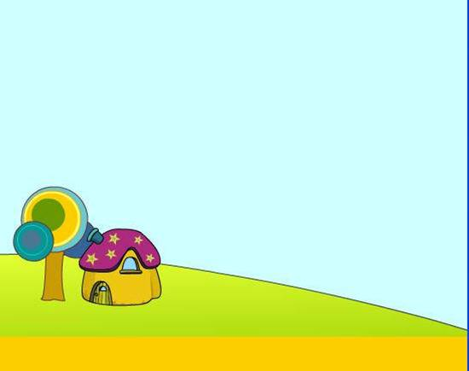

Unit 3
How do you get to school?

Slide 3


Section A 2
Grammar focus-3c

Slide 4


1. ride a bike = by bike 骑自行车
2. take the subway = by subway 乘坐地铁
3. take the train = by train 乘坐火车
4. take a plane = by plane 乘坐飞机
5. take the bus = by bus 乘坐公车
6. walks = on foot 走路、步行
7. get to 到达

Slide 5
8. How far is it from … to …?
从……到……多远？
9. How long does it take…?
……需要多长时间？
10. It takes sb. some time to do sth.
花某人多长时间做某事

Slide 6

Grammar focus
How do you get to school?
I ride my bike.
How does she get to school?
She usually takes the bus.
How long does it take to get to school?
It takes about 15 minutes.

Slide 7
How far is it from your home to school?
It’s only about two kilometers.
Does Jane walk to school?
No, she doesn’t. She goes by bike.
Do they take the bus to school?
No, they don’t. They walk.

Slide 8
归纳总结
get to 某地
1. How do/does + 某人 + ___________ ?
某人怎么去某地?
how是疑问副词, 本句中用来提问__________ 等。
如: 你叔叔通常怎样去香港？
___________________________________
出行方式
How does your uncle get to Hong Kong?

Slide 9
2. 回答方式有两种:
A: 某人 + take(s) + ____________ + to 某地。
B: 某人 + get(s) to 某地 + _____________
如: 我叔叔乘飞机去香港。
___________________________________
___________________________________
the 交通工具
by 交通工具
My uncle takes the plane to Hong Kong.
My uncle gets to Hong Kong by plane.

Slide 10
3. it takes sb. some time to do sth.
意为：___________________________
如: 步行大约要花我15 分钟的时间。
_________________________________
做作业大约花费简30分钟的时间。
_________________________________
_________________________________
某事花费某人……时间
It takes me about 15 minutes to walk.
It takes Jane 30 minutes to do her homework.

Slide 11
4. 如果对时间段提问的话，就用
_________ + does it take sb. to do sth.? 句型。
How long
e.g. How long does it take to walk to
school?
How long does it take to do her homework?

Slide 12
5. 对两地间的距离提问下列句型：
_______ + is it _____ 某地 ___ 某地？
如: 从他家到服装店多远？
_______ is it _____ his home __ the clothes store?
从北京到上海有多远？
_______ is __ from Beijing ___ Shanghai?
How far
from to
How far
from to
How far it
to

Slide 13

Match the questions with the answers. Then practice them.
3a
How does Mike get to school? ___
How long does it take to get home? ___
How far is it from here? ___
Do your friends go to school by bus? ___
Does your dad drive to work? ____
a. Yes, they do. b. No, he doesn’t.
c. He rides his bike. d. It’s five kilometers.
e. About 15 minutes.

Slide 14
方法指导
1. 特殊疑问句, 对出行方式提问, 故用c作答。
2. 特殊疑问句, 对时间提问, 故用e作答。
3. 特殊疑问句, 对距离提问, 故用d作答。
4. 一般疑问句, 主语为第三人称复数, 故用a作答。
5. 一般疑问句, 主语为第三人称单数, 故用b作答。

Slide 15
3b
Use the words to make questions.
school/you/get to/do/how
___________________________?
2. to/school/get to/does/how long/take/it
___________________________?
3. school/your/ from/it/is/how far/ home/to
___________________________?
4. you/to/walk/do/school
___________________________?
5. ride/their bikes/do/school/your friends/to
___________________________?

Slide 16

1. 看句子末尾的标点，可知这五个句子都是问句。
2. 先在所给的词汇中找特殊疑问词或助动词等。
3. 判断该句是一般疑问句还是特殊疑问句。
4. 特殊疑问句：特殊疑问词 + 助动词 + 动词(词组) + 其他？
5. 一般疑问句: 助动词 + 动词(词组) + 其他？

Slide 17
Keys:
1. How do you get to school?
2. How long does it take to get to school?
3. How far is it from your home to school?
4. Do you walk to school?
5. Do your friends ride their bikes to school?

Slide 18
Then answer the questions.
1. How do you get to school?
__________________________
2. How long does it to get to school?
__________________________
3. How far is it from your home to school?
__________________________
I ride my bike to school.
It takes about twenty minutes.
It’s about five kilometers.

Slide 19
4. Do you walk to school?
______________________________
5. Do your friend ride their bikes to school?
______________________________
No, I don’t. I always ride my bike.
Yes, they do.

Slide 20


Ask your classmates questions and write their names in the chart. The first student to fill in all the blanks wins!
3c
How far is it from your home to school?
It’s about five kilometers.

Slide 21
Do you walk to school, Grace?
Yes, I do.

Slide 22
Do you take a bus to school, Tom?
No, I don’t. I goes to school by bike every day.

Slide 23
How do you get to school, Cindy?
I ride my bike to school.

Slide 24
How long does it take to get to school, Mary?
It takes about an hour to get to school.

Slide 25
How long does it take to get to school, Jane?
It takes about ten minutes.

Slide 26
Find someone who … | Name
lives about five kilometers from school.
walks to school.
takes a bus to school.
goes to school by bike.
needs about an hour to get to school.
need about 10 minutes to get to school.

Slide 27


Make a survey in your group.
Questions | S1
How far do you live from school?
Do you walk to school?
How do you get to school?
How long does it take to get to school?
5 kilometers
No, I don’t.
take the bus
10 minutes

Slide 28
Make a report about your classmates.
Report
In my group, S1 lives about five kilometers from school. He goes to school by bus. It takes about ten minutes to get to school.
S2 lives about …
S3 lives about …

Slide 29


1. drive to + 地点 开车去某地
e.g. Does your uncle drive home?
你叔叔开车回家吗？
2. get, go 等词后面跟地点名词时要用介词to。
get to school 去学校
go to the library 去图书馆

Slide 30
当他们后面跟 home, here 等副词时, 不用 to。
e.g. How does your brother get home?
你弟弟怎样到家的？

Slide 31

Exercises
一、选词填空, 注重用恰当的形式。
how long, about, how far, live, walk, drive
My school is near. So I always _____ to school.
2. It takes ______ 25 minutes .
3. Mr Bush usually _______ home.
walk
about
drives

Slide 32
4. My aunt ____ ten kilometers from school.
5. A: ________ is it from your home to school?
B: About nine kilometers.
6. A: _________ does it take to get to his school?
B: About half an hour.
lives
How far
How long

Slide 33
二、句型转换。
1. Do your parents drive to work? (作否定回答) ___________________
2. Mary goes to school by bike? (对划线部分提问) ______________________________
3. Linda lives ten kilometers from school. (划线部分提问)
________________________________?
No, they don’t.
How does Mary go to school?
How far does Linda live from school

Slide 34
4. I take an hour to get to her home. (对划 线部分提问)
__________________________________?
5. Eric/rides/to/school/every/his/day (连词 成句)
_________________________________.
How long does it take to get to her home
Eric rides his bike to school every day

Slide 35


1. Copy words, phrases and sentences.
2. Interview your parents how to get to
work, and give a report.

Slide 36


