Slide 1
R·九年级全一册
Unit 14 I remember meeting all of you in Grade 7.
第二课时

Slide 2
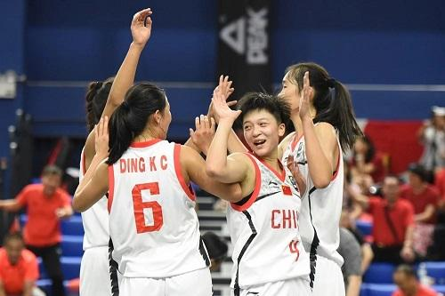
Lead in
What special thing happened in Grade 7 ?
Our team won the school basketball competition.

Slide 3
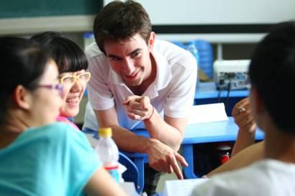
I’ve become much better at speaking English.
How have you changed since you started junior high school?

Slide 4
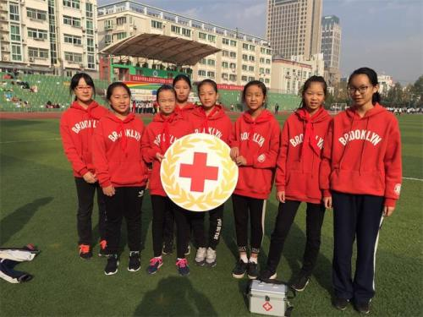
What do you remember about Grade 8?
I remember being a volunteer.

Slide 5
What did you use to do that you don’t do now?
I used to take dance lessons, but I don’t anymore.

Slide 6
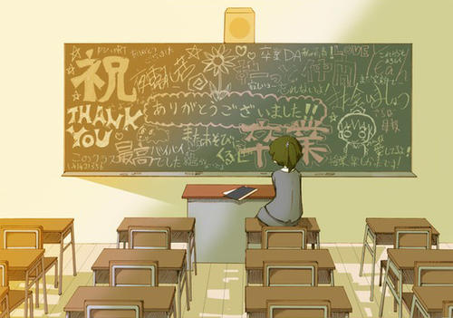
Language points
And now it’s time to graduate.

Slide 7
一、It's time for的用法
1. it’s time (for sb.) to do sth.
该是（某人）做某事的时候了。
2. it’s time for sth. 该是(做)……的时候了。
Now it’s time for graduation.

Slide 8
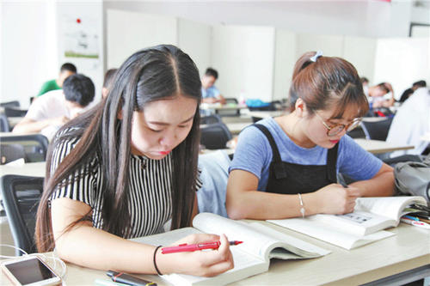
How do you think things will be different in senior high school?
I think that I’ll have to study much harder for exams.

Slide 9
二、特殊疑问句
1. 概念：由特殊疑问代词或疑问副词引导的疑问句叫特殊疑问句。
疑问代词
who, whom, whose, which, what
疑问副词
when, where, why, how

Slide 10
疑问词+一般疑问句（语序）
2. 倒装结构
Where did you go yesterday?
疑问词+谓语+其他
3. 陈述结构
Who wants to help me?

Slide 11
三、时态
1. 一般现在时
定义
构成
标志词
经常、反复发生的动作或行为及现在的某种状况。
主语+ 动词原形
always, usually, often, sometimes,
every week (day, year, month...)

Slide 12
2. 一般过去时
定义
构成
标志词
表示过去某个时间里发生的动作或存在的状态。
主语+was/ were+其他.
主语+实义动词的过去式+其他.
yesterday, last week, two months ago, the day before yesterday...

Slide 13
3. 一般将来时
定义
构成
标志词
表示将要发生的动作或存在的状态及打算、计划或准备做某事。
be(is, am, are) going to do；
will/shall do
tomorrow, next day (week, month, year), the day after tomorrow...

Slide 14
I can’t believe how fast the time went by!
感叹句
感叹句是表达喜、怒、哀、乐以及惊奇、惊讶等强烈感情的句子，感叹句通常由what或how引导。

Slide 15
四、感叹句
1. 由what引导的感叹句句式：
What + (a / an) + 形容词 + 名词(+主语+谓语)！
2. 由how引导的感叹句句式：
How + 形容词 / 副词 + 主语+谓语！

Slide 16
Let's talk
What do you remember about Grade 7?
What happened in Grade 8 that was special?
What are you looking forward to?

Slide 17
Practice
A
1. It’s time _____ say goodbye.
A. to B. for C. in D. by
2. — Jane is going to hold a concert here in July.
— Really? _____ exciting news!
A. How B. What an C. What
C

Slide 18
Summary
1. It’s time to graduate.
2. 特殊疑问句。
3. I can’t believe how fast the time went by!

Slide 19
THANKS

