Slide 1
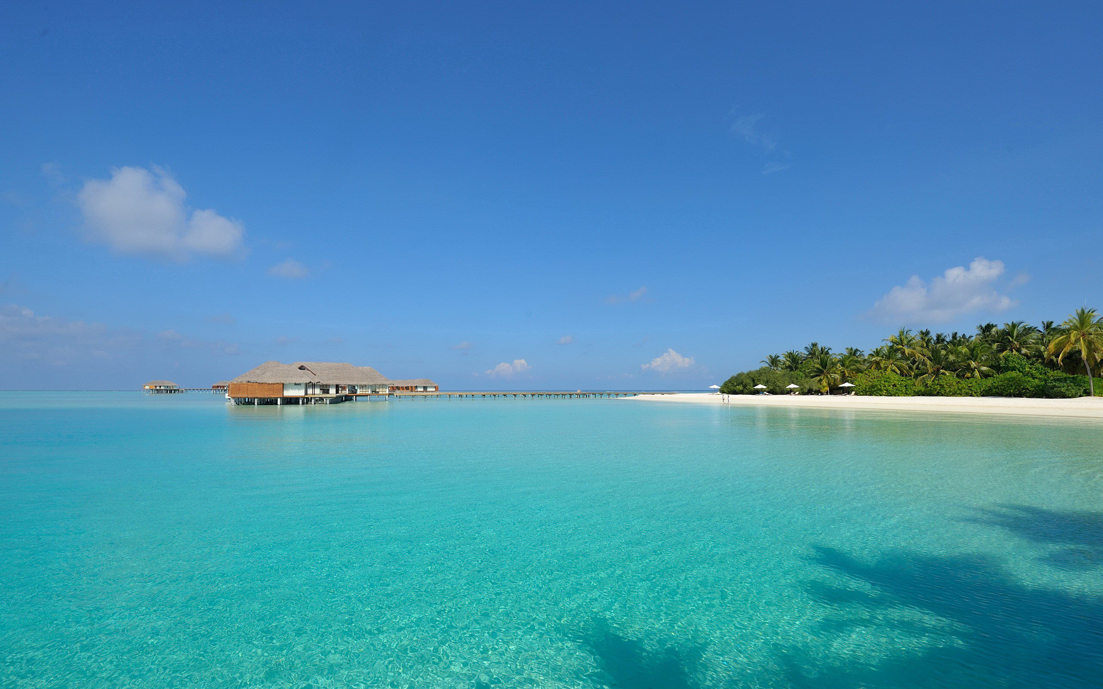
Unit 6
Space and beyond

Slide 2
内容索引
Period Five Writing—Writing a journal entry about living in space
技法点拨 文体分析 把握写作动脉
写作训练 弄清文路 写作妙笔生花

Slide 3
技 法 点 拨
文体分析 把握写作动脉
写作指导
本单元的写作目标是写一篇“太空生活日记”记录自己在太空的一天的生活场景，让大家对太空生活有一定的了解。这样的日记应该按时间顺序展开，记述这一天中发生的事情，但要注意有详有略。在具体的写作过程中要注意把太空生活与地球生活进行对比，让大家了解太空生活的奇妙之处，以引起读者的兴趣。可以通过以下三个部分来进行写作：

Slide 4
第一部分：开门见山，引入话题，即太空生活与地球生活完全不同，唤起读者兴趣。
第二部分：按时间顺序介绍自己一天的生活，注意详略得当，必要时解释一下原因。
第三部分：总结全文，发表一下自己的感受以及对太空生活的看法。

Slide 5
常用表达
1.As there is no gravity，life in space can be very different from that on the earth.
2.Some most straightforward daily tasks on the earth can be very difficult in space.
3.After getting up，I...
4.I had to...，because...
5.You can’t...，because...
6.When it is time for...，I...
7.It is so funny，isn’t it?
8.It is difficult，but I enjoyed it very much.
返 回

Slide 6
写 作 训 练
弄清文路 写作妙笔生花
假如你是李华，有幸参加了一个太空旅行项目，已经在太空生活了几天的时间。请你用英语写一篇80词左右的日记，向地球上的朋友们简单介绍一下你在太空的第一天的生活场景，要包括吃饭、锻炼以及睡觉等几个方面。

Slide 7
审题谋篇
审题
1.确定文体：这是一篇日记，记述过去的某一天所发生的事情；
2.主体时态：以一般过去时为主；
3.主体人称：以第一人称为主。

Slide 8
谋篇
第一段：应开门见山，直入主题；
第二段：按时间先后描述这一天发生的事情，注意详略得当；
第三段：发表一下自己的感受以及对太空生活的看法。

Slide 9
遣词造句
核心词汇
1.引力
2.简单的
3.拿来
4.吸管
5.锻炼
6.保持肌肉强壮
7.把……系在……上
gravity
straightforward
fetch
straw
work out
keep the muscles strong
tie...to...
_______
______________
_____
______
_________
_____________________
________

Slide 10
连词成句
1.由于没有地心引力，地球上最简单的日常工作在太空中可能会非常困难。(as 引导原因状语从句)
2.起床后，我开始吃早餐。它包括一些面包和一袋果汁。
3.工作了两个小时后，我需要锻炼一段时间来保持肌肉强壮。
As there is no gravity，the most straightforward daily tasks on the earth can be very difficult in space.
After getting up，I began to have breakfast.It consisted of some bread and a bag of fruit juice.
After I worked for two hours，I needed to work out for some time to keep my muscles strong.

Slide 11
句式升级
1.用独立主格结构改写句1。
2.用非限制性定语从句改写句2。
3.用现在分词作时间状语改写句3。
There being no gravity，the most straightforward daily tasks on the earth can be very difficult in space.
After getting up，I began to have breakfast，which consisted of some bread and a bag of fruit juice.
Having worked for two hours，I needed to work out for some time to keep my muscles strong.

Slide 12
组句成篇
用适当的过渡词语，把以上词汇和句式，再加上联想内容，组成一篇80词左右的英语短文。

Slide 13
参考范文
There being no gravity，the most straightforward daily tasks on the earth can be very difficult in space.
After getting up，I began to have breakfast，which consisted of some bread and a bag of fruit juice.I had to fetch a straw to drink the juice，otherwise it would float around in the spacecraft.Having worked for two hours，I needed to work out for some time to keep my muscles strong.I tied my feet to a special machine so that I wouldn’t float away.When it was time to go to bed，I went into a small cupboard，got into a sleeping bag and tied it to the wall.I think I must look like a big sausage.It is so funny，isn’t it?
Living in space is rather difficult but fun.I enjoy it very much.
返 回

Slide 14
本课结束

