Slide 1
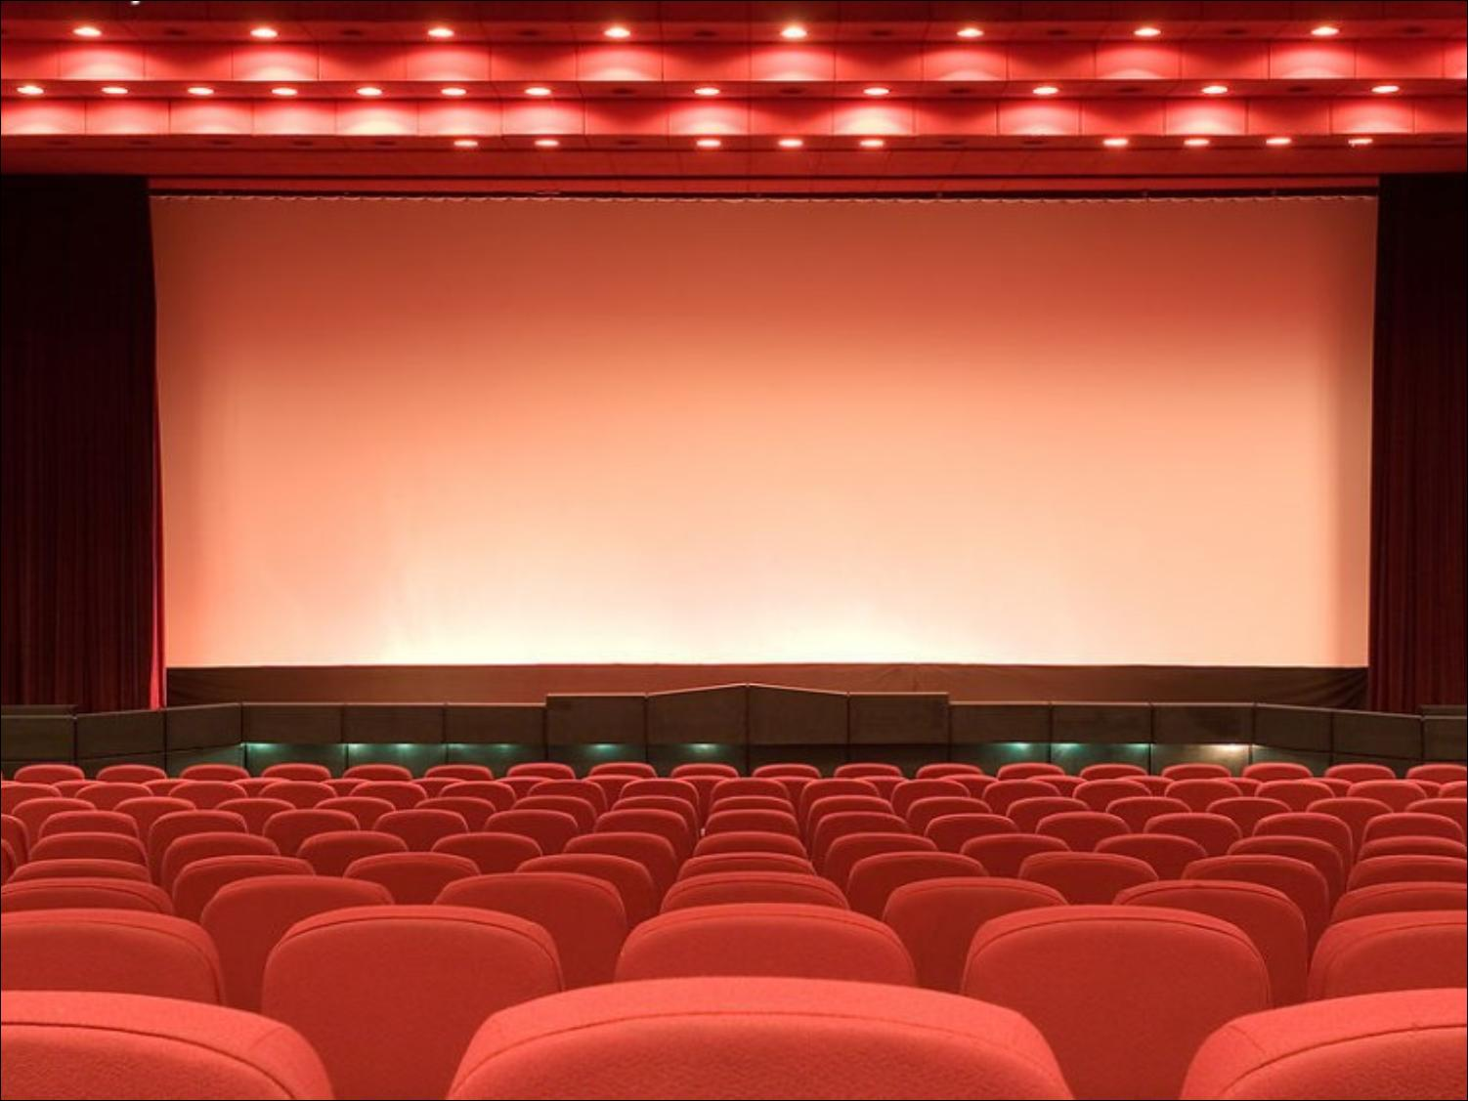
Unit 4
What’s the best movie theater?
Section B (1a-1e)

Slide 2

Warming up
Which is the closest supermarket from our school?
What is the longest wall in the world?
Which season is the hottest in Taizhou?
Which is the heaviest animal on the land?
What is the best movie theater in Taizhou?
which is the most difficult subject for you?
close-closer-closest
heavy-heavier-heaviest
long-longer-longest
good-better-best
hot- hotter- hottest
difficult -more difficult-most difficult

Slide 3

Brainstorm
…is the best/worst actor/athlete/singer/performer
…is the most boring TV show/person
…is the most delicious food
…is the quietest/loudest person
…is the funniest person
…is the most creative person
…is the serious person
…is the…
I know.

Slide 4
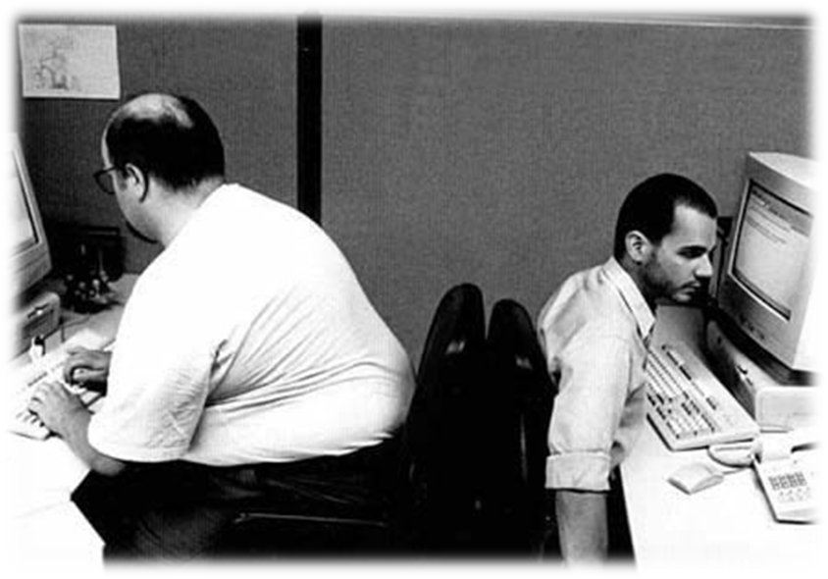
fat
→
thin
thin

Slide 5
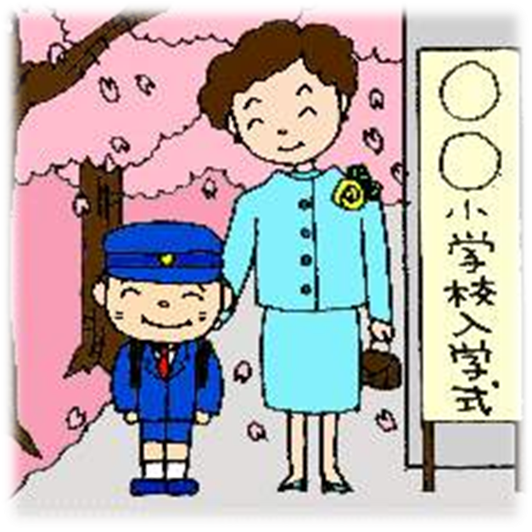
tall
short
→
tall

Slide 6
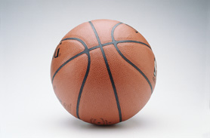
small
big
small
→

Slide 7
1a Write these words and phrases next to their opposites in the chart.
funniest most creative quietest best
 | dullest
 | loudest
 | worst
 | most boring
most creative
quietest
best
funniest

Slide 8

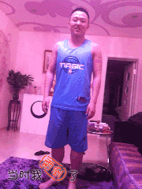

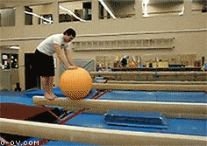
Talent show
Who do you think is the …performer?
1
2
3

Slide 9
talent
talent n. 天资；天赋
e.g. a school talent show
一场学校的才艺表演
Who is got talent? 谁有天赋
America’s Got Talent 美国达人秀
China’s Got Talent 中国达人秀

Slide 10
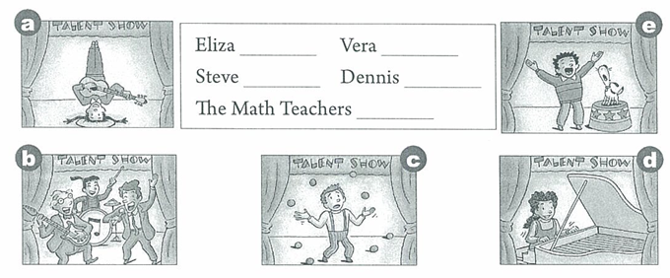
1c Listen to people talking about a school talent show. Match the
pictures with the performers .
（演员；演出者；演奏者）
d
a
e
c
b

Slide 11

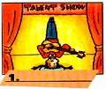




Names
Eliza Vera
Steve Dennis
The Math Teachers
Vera
5.________
1.________
Steve
The Math
Teachers
Dennis
Eliza
3.________
4.________
2.________

Slide 12

Names | What people say
Eliza | best
Steve
Vera
Dennis
The Math Teachers
the funniest
the most creative
the worst
the loudest

Slide 13
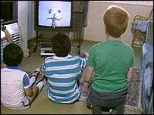
Who was the best performer?
Eliza was the best performer.

Slide 14

1e
Ask and answer quickly.
A: Who was the best performer?
B: Eliza was the best performer.
A: Who was the funniest performer?
B: Steve was the funniest performer.
A: Who was the most creative performer?
B: Vera was the most creative performer.
A: Who was the worst performer?
B: Dennis was the worst performer.
A: Who was the loudest performer?
B: The math teachers were the loudest performers.

Slide 15
Talk about the school talent show.
Who do you think was the … perform？
Talk Show
Name | What people say
Eliza
Steve
Vera
Dennis
The Math Teachers
best
excellent
great
funniest
most creative
worst
terrible
loudest
In last week’s school talent show, I think Eliza was the best
performer, she is an excellent piano payer, she is great.
Steve with the dog was the funniest. Vera was the most creative,
I don’t know many people who can play the guitar upside down.
I think Dennis was the worst performer. He was terrible. He can’t
juggle at all. And the math teachers were the loudest in the show.

Slide 16


Show yourself bravely!
I could be ordinary.
I could be the one.
我可以是平凡的。
我可以是任何人.

