Slide 1
Unit 1
Where did you go on vacation?

Slide 2
Section B
(2a-2e)

Slide 3
自主学习方案
翻译下列词组。
1.今天早上我和我的家人到达了马来西亚。
_____________________________________
2．尝试滑翔伞 ________________________
3．特殊的东西 ______________________
4.今天是多么的不同！ _____________________________________
5.等了一个多小时的火车 ________________________________
6.太多的人___________________________
7.到达山顶_____________________________________
8.因为坏天气 __________________________
9.带足够的钱 _____________________________________
10.喜欢在城镇周围散步 __________________ _

Slide 4
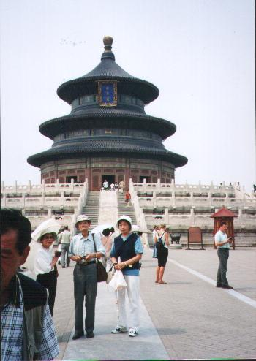
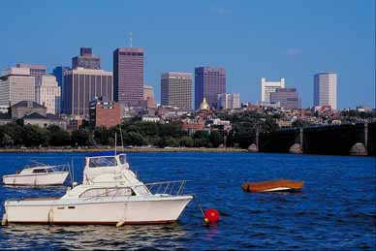
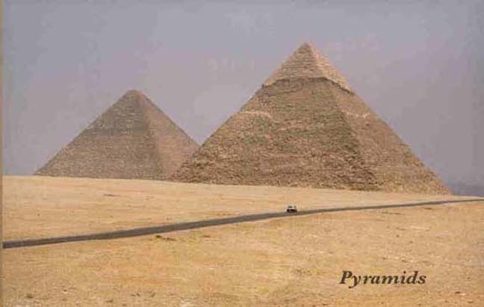
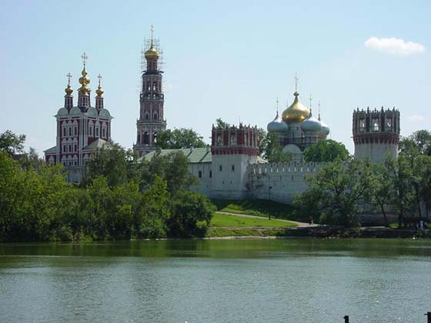
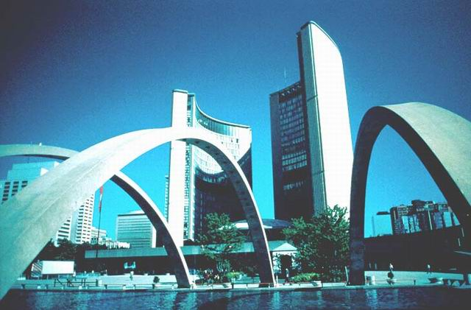
Where do you want to go? Why?

Slide 5
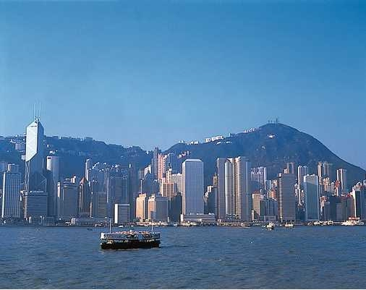
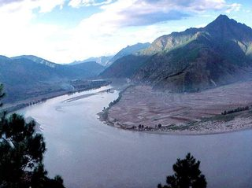
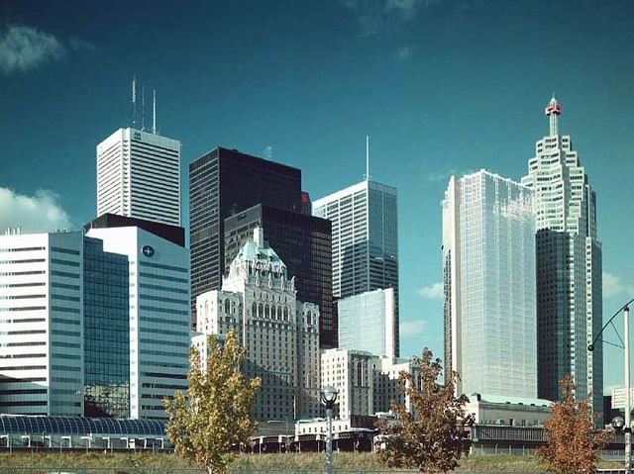
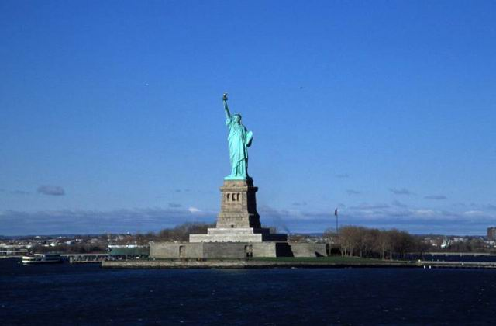
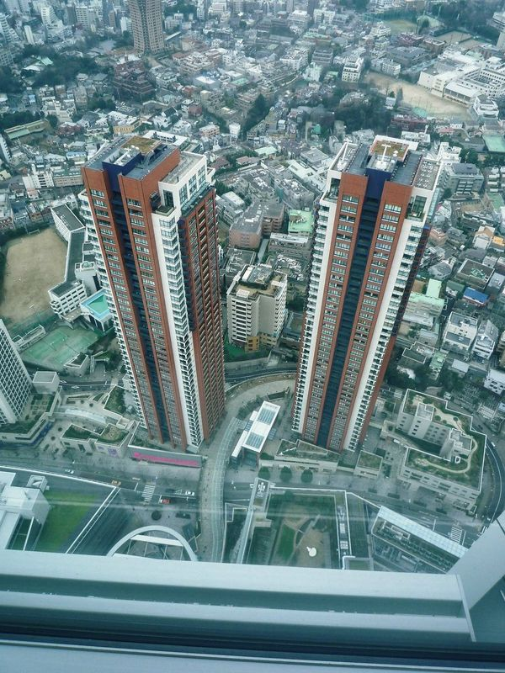

Slide 6
Discussion
Discuss the questions with your partner.
2a
What do people usually do on vacation?
They usually __________________
2. What activities do you find enjoyable?
Going fishing. ____________________

Slide 7
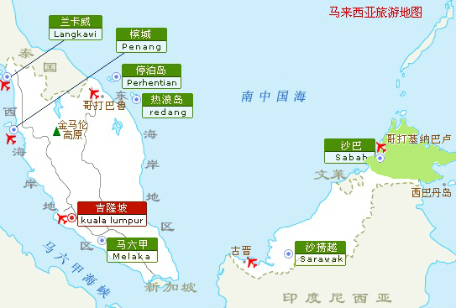
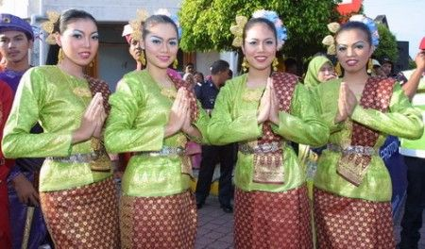
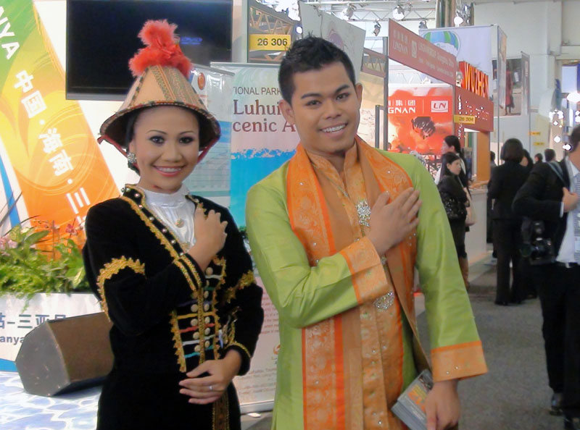
Lead in
Malaysian 马来西亚人
Malaysia 马来西亚

Slide 8
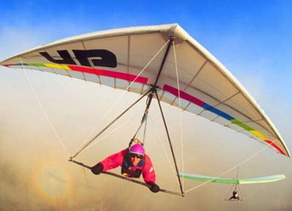
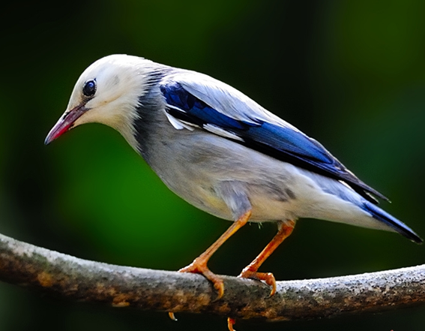
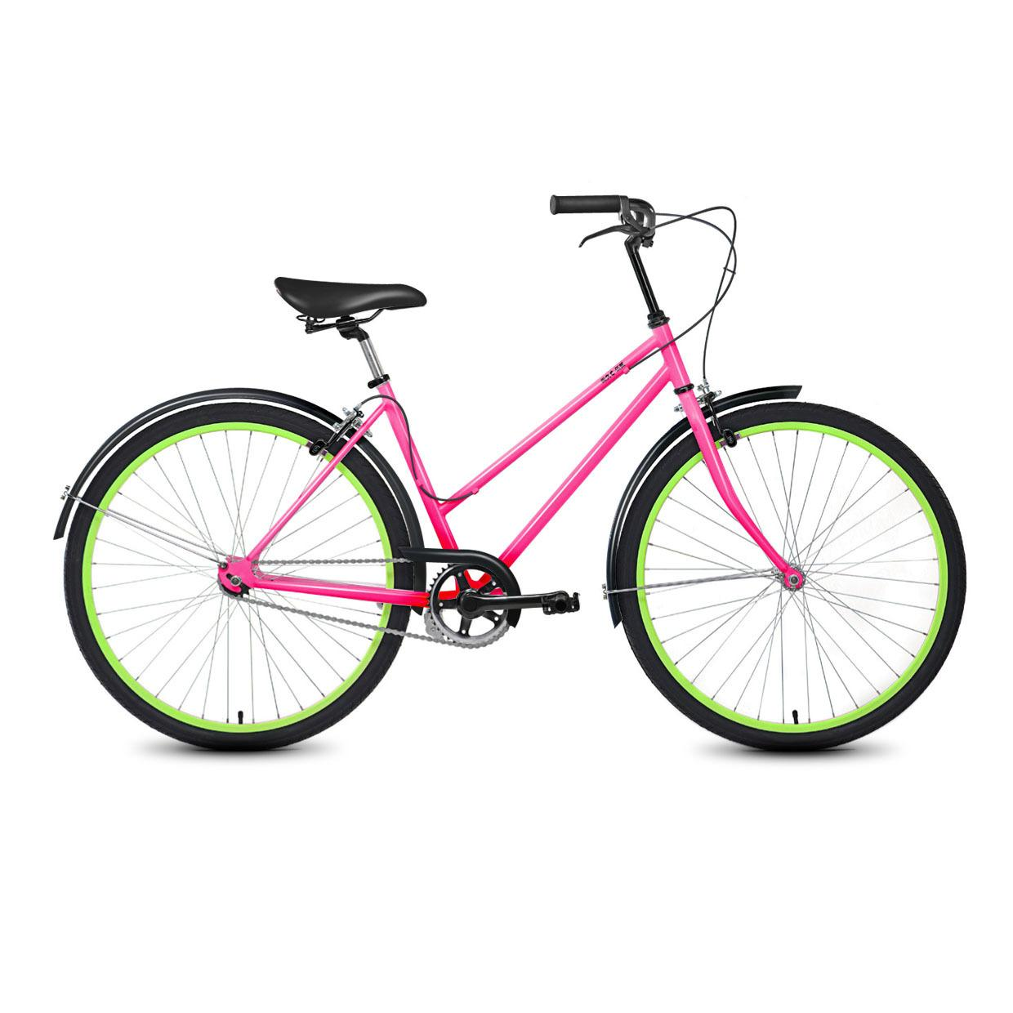
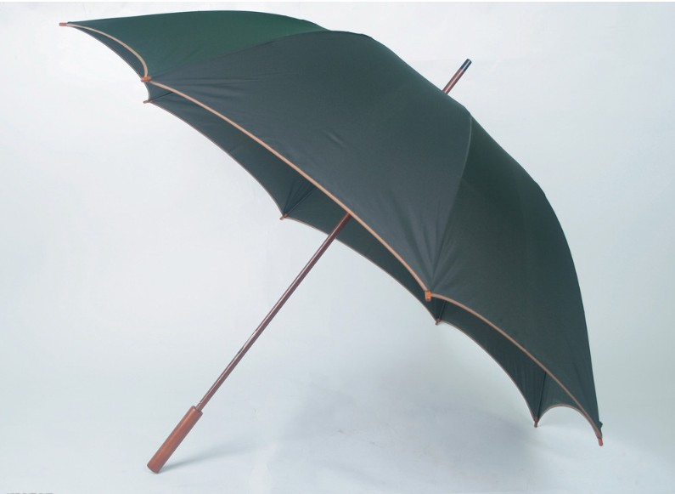
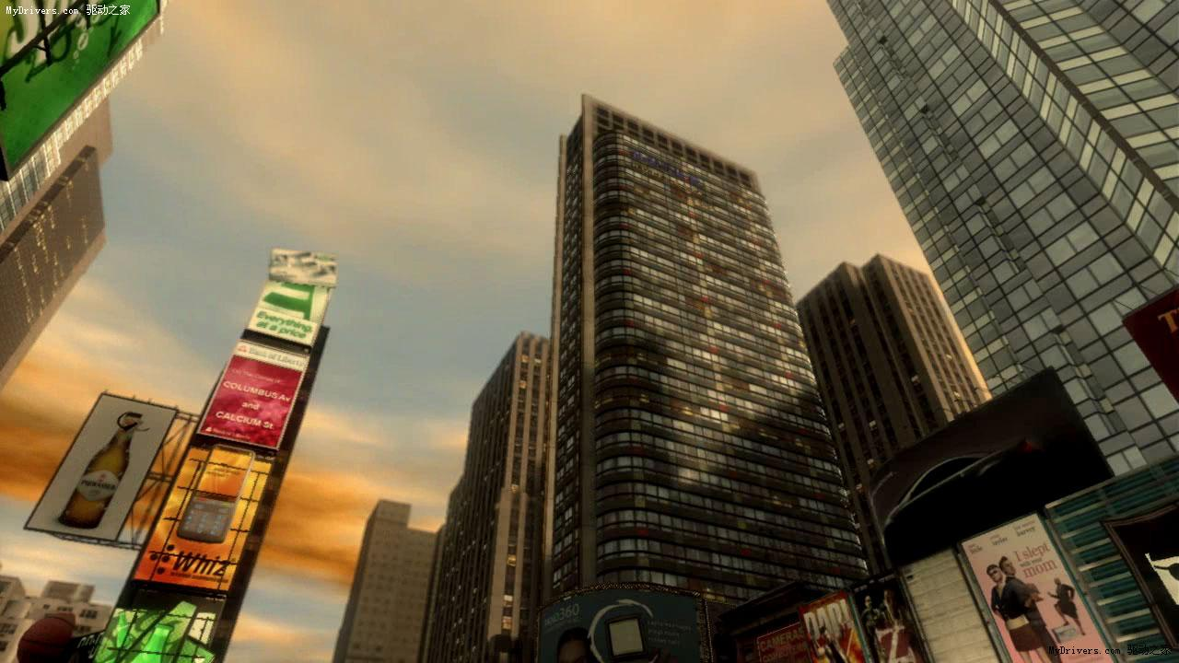
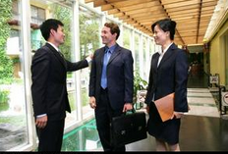
New words
paragliding n. 滑翔伞运动
bicycle n. 自行车；脚踏车
bird n. 鸟
building n. 建筑物；房子
umbrella n. 伞；雨伞
trader n. 商人

Slide 9
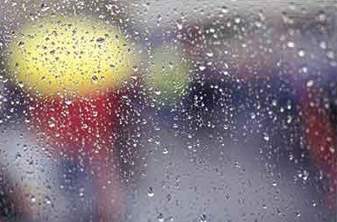
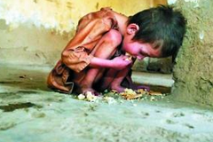
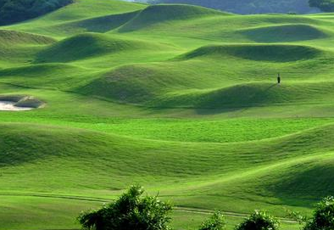
wet adj. 湿的；潮湿的；下雨的
hungry adj. 饥饿的
hill n. 小山；山丘

Slide 10
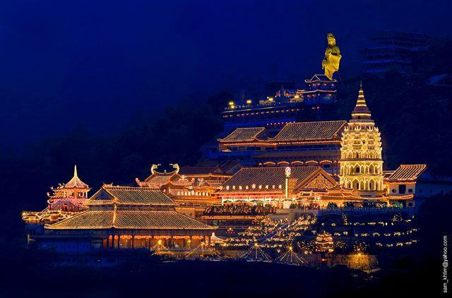
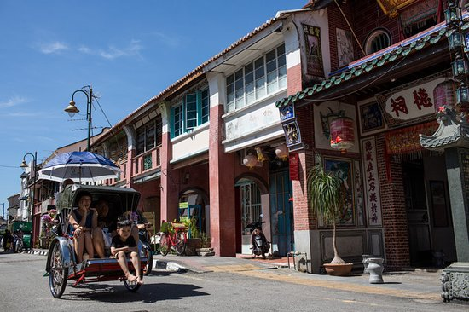
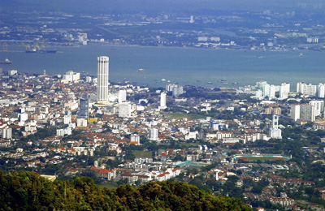
Weld Quay 海墘街
Penang Hill 槟城山
Georgetown 乔治市

Slide 11
Reading
Read Jane’s diary entries about her vacation and answer the questions.
2b
Did Jane have a good time on Monday?
________________________________
2. What about on Tuesday? __________________________________
Yes, she did.
She didn’t have a good time on Tuesday.

Slide 12
2c
Read Jane’s diary entries again. Fill in the chart.
Things Jane did or saw | Did she like it? (Yes/No) | Why or why not?
tried paragliding
 |  | They were delicious.
walked around Georgetown
Yes
It was exciting.
ate Malaysian yellow noodles
Yes
She liked the old buildings there and wondered what life was like in the past.
Yes

Slide 13
went to Penang Hill
 |  | It tasted great because she was hungry.
There were many people and they waited over an hour for the train.
It was raining and they didn’t have an umbrella.
So they got wet and cold.
They couldn’t see anything because of the bad weather.
They didn’t have enough money for food.
No
had one bowl of rice and some fish
Yes

Slide 14
Complete the conversation about Jane’s trip to Penang using the information in the diary entries.
2d
Anna: Hi, Jane. Where did you go on
vacation last week?
Jane: I ______ to Penang in _________.
Anna: Who ______ you go with?
Jane: I went with my ________.
Anna: What did you do?
went
Malaysia
did
family

Slide 15
Jane: The weather was hot and _______ on
Monday, so we went ____________ on
the beach. Then in the afternoon, we
_______ bicycles to Georgetown.
Anna: Sounds great!
Jane: Well, but the next day was not as good.
My _______ and I went to Penang
Hill, but the weather _____ really
bad and rainy. We _______ a long
time for the train and we were
sunny
paragliding
rode
father
was
waited

Slide 16
_____ and cold because we forgot to bring an _________.
Anna: Oh, no!
Jane: And that’s not all! We also didn’t bring ________ money, so we only had one bowl of rice and some fish.
wet
umbrella
enough

Slide 17
Imagine Jane went to Penang Hill again and had a great day. Fill in the blanks in her diary entry with the correct forms of the verbs in brackets.
2e

Slide 18
阅读指导：
1. 读短文可知，本文是一篇日记。记述了七月十八日简一次旅游的经过。因此，本文在时态上应用一般过去时态。
2. 应注意括号中动词过去式的形式，是规则变化的还是不规则变化的。然后做写出正确的形式。

Slide 19
Thursday, July 18th
Today ____ (be) a beautiful day. My father and I _____ (go) to Penang Hill again, but this time we _______ (walk) to the top. We _______ (start) at 9:30 a.m. and ____ (see) lots of special Malaysian flowers along the way.
was
went
walked
started
saw

Slide 20
About one hour later, we ________ (stop) and ______ (drink) some tea. Then we _______ (walk) for another two hours before we ____ (get) to the top. I ____ (be) quite tired, but the city ______(look) wonderful from the top of the hill!
stopped
drank
walked
got
was
looked

Slide 21
Language points
1. I feel like I was a bird.
feel like+从句，意为“觉得好像是……”。
e.g. I feel like I’m walking through the
history.
我感觉好像是倘佯在历史的长河中。

Slide 22
[拓展]feel like的其他用法：
① feel like + 名词或代词，意为“觉得
好像”。
e.g. It feels like rain soon.
感觉天好像很快就要下雨了。
② feel like + 动名词，意为“想做……”。
e.g. I don’t feel like walking today.
今天我不太想去散步。

Slide 23
2. And because of the bad weather, we
couldn’t see anything below.
(1)because of 意为“因为”，后跟名词。
e.g. They didn’t go fishing because of
the bad weather.
因为天气不好所以他们没有去钓
鱼。

Slide 24
[拓展] because + 句子， 意为“因为”。
e.g. 他因为生病而没有上学。
He didn’t go to school because he was ill.
=He didn’t go to school because of his illness.

Slide 25
(2) below 意为“在……下面，到……下面”。
e.g. Please do not write below this line. 请不要写到这条线下面。

Slide 26
[辨析] below与under的区别：
below指某物处于较低的地方，但不一定
是正下方; under指处于某物的正下方。
e.g. 我们在月下。
We are below the moon.
那名男孩子站在树下。
The boy stood under the tree.

Slide 27
3. My father didn’t bring enough money.
enough作形容词，意为“充足的，足
够的，充分的”。
e.g. You have enough time to get there
on time.
你有足够的时间按时到达那里。

Slide 28
[注意] 当enough作副词时，意为“足够地，充足地”。它修饰形容词时应置于该形容词后面来修饰。
e.g. The house isn’t big enough for us.
这个房子对我们来说不够大。

Slide 29
4. …so we decided to go to the beach near our hotel.
decide v. 决定；选定
e.g. He decided to get married. 他决定结婚。

Slide 30
5. My sister and I tried paragliding.
try v. & n. 尝试；设法；努力
e.g. This idea seems good but you
need to try it out. 这个想法似乎不错，但是需要试
验一下。
After a few tries they decided to
give up. 试了几次后，他们决定放弃。

Slide 31
6. I wonder what life was like here in the past.
wonder v. 想知道；琢磨
e.g. I wonder who she is.
我在想她到底是谁。
7. We waited over an hour for the train because there were too many people.
wait v. 等待；等候
e.g. She rang the bell and waited.
她按铃后就等候着。

Slide 32
针对训练
选词填空。
1. I feel like ______ (going/go) to Hong
Kong for vacation next summer vacation.
2. He’s not going to buy that car
_______ (because /because of) it’s too
expensive.
3. The train was late _________ (because/
because of) the heavy frog (雾).
going
because
because of

Slide 33
4. Her coat reaches _____ (below/ under)
her knee.
5. The boy is _________ (enough old/
old enough) to get dressed himself.
below
old enough

Slide 34
Homework
用所给动词的适当形式填空。
1. My mother ____ (buy) a new schoolbag for
me yesterday.
2. When ___ you ___ (start) to learn English?
3. My aunt ____ (take) us to dinner at a
restaurant but the food __ (is) not good at all.
4. When I _____ (am) in America, I _____
(make) a lot of new friends.
5. They ____ (have) a great sale last weekend.

