Slide 1
R·九年级全一册
Unit 3 Could you please tell me where
the restrooms are?
第三课时

Slide 2
Lead in
Do you know their antonyms?

Slide 3
clean
dirty

Slide 4
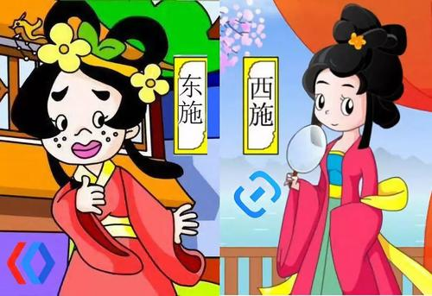
beautiful
ugly

Slide 5
quiet
noisy

Slide 6
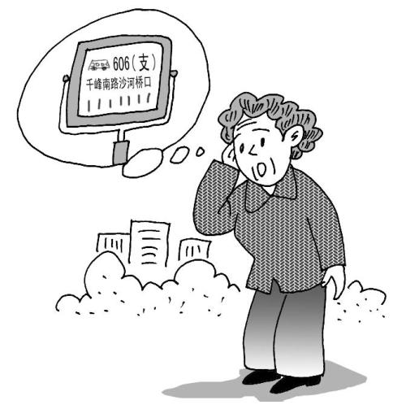
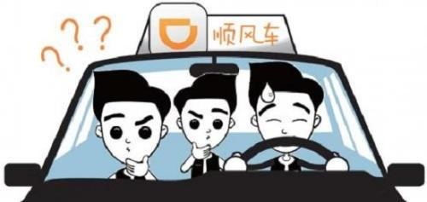
convenient
inconvenient

Slide 7
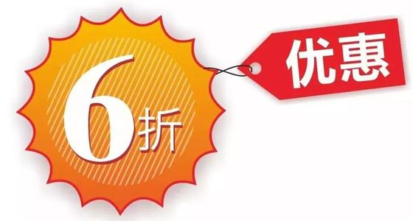
expensive
inexpensive
cheap

Slide 8
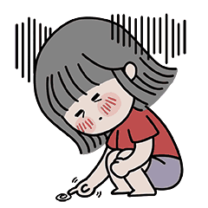
uninteresting
boring
interesting

Slide 9
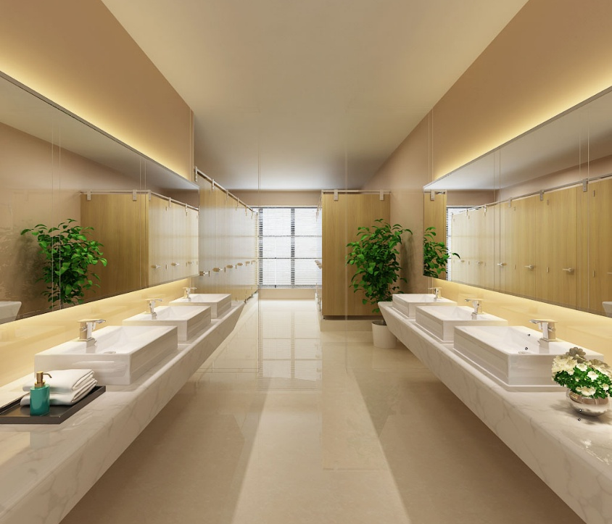
Try to describe the places.
interesting, fascinating
inexpensive, quiet
uncrowded, big
beautiful, convenient
safe, clean
clean, uncrowded, convenient
The restroom is _________________________.

Slide 10
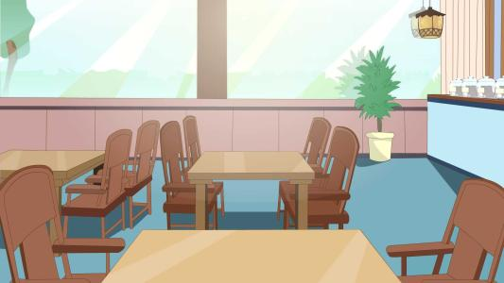
clean, inexpensive, quiet
The restaurant is _______________________.

Slide 11
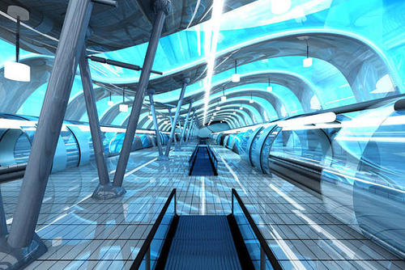
interesting, fascinating, inexpensive, quiet, big,
uncrowded, beautiful, convenient, safe, clean
convenient, safe, quiet
The subway is ___________________.

Slide 12
Free talk
_________ is __________.
places
adj.
状元成才路
restroom
museum
restaurant
park
subway
...
interesting
fascinating
inexpensive
quiet
big
…
状元成才路
状元成才路
状元成才路
状元成才路
状元成才路
状元成才路
状元成才路
状元成才路
状元成才路
状元成才路
状元成才路
状元成才路

Slide 13
Can you tell me if there are any public
restrooms around here?
Yes, there’s one at the corner of Market and Middle Streets.
状元成才路
状元成才路
状元成才路
状元成才路
状元成才路
Is it clean?
状元成才路
状元成才路
状元成才路
状元成才路
状元成才路
状元成才路
状元成才路
状元成才路
Oh, no. It is very dirty.

Slide 14
Let's write
If you have got a letter from Peking University. They invited you to have a short study vacation.
In your letter, you should:
introduce yourself
say when you are coming
politely ask for information
thank the person for helping you

Slide 15
状元成才路
状元成才路
状元成才路
状元成才路
Topic | Question
The course you will study
The time of the course
Where and what you can eat
Where you will stay
Could you please let me know what course I will study?
Can you tell me when I start the course?
Could you tell me where and what I can eat?
May I know where I will stay?

Slide 16
状元成才路
状元成才路
状元成才路
状元成才路
Topic | Question
What activities you can do
Travel to the school
Other
Could you please tell me what activities I can do during the study vacation?
状元成才路
状元成才路
状元成才路
状元成才路
状元成才路
状元成才路
状元成才路
状元成才路
状元成才路
Could you tell me how to get to the school?
状元成才路
状元成才路
状元成才路
状元成才路
Could you please tell me if there are any supermarkets around the school?

Slide 17
Practice
1. —Can you tell me ______ you bought the gift for?
—Sure. It’s for my best friend, Lucy.
A. where B. when C. how D. whom
2. It sounds more ______ to say, “Could you please tell me how to get to the station?”
A. direct B. polite C. politely D. impolite

Slide 18
Summary
1. Try to describe the places.
interesting fascinating inexpensive quiet
uncrowded big beautiful convenient
safe clean
2. How to write a more polite letter.

Slide 19
THANKS

