Slide 1
Unit 10
(3a-3c)

Slide 2
famous: people all over the world know you
rich: make a lot of money
interesting: do something you love
dangerous: get injured easily
difficult: people follow you everywhere
tired/busy: you don’t have too much time
to relax

Slide 3
3a Read the article and answer the questions.
If I become an athlete , will I be happy?
For many young people, becoming a professional athlete might seem like a dream job. If you become a professional athlete, you’ll be able to make a living doing something you love. If you become famous, people all over the world will know you . Many athletes give money to schools and charities, and do a lot of work to help people. This is a great chance that many people do not have.
However, professional athletes can also have many problems. If you are famous, people will watch you all the time and follow you every where. This can make life difficult.
If you play sports for a living, your job will sometimes be very dangerous. Many professional athletes get injured .And if you become rich, you will have a difficult time knowing who your real friends are. In fact, many famous people complain that they are not happy. They say they were happier before they became rich and famous.

Slide 4
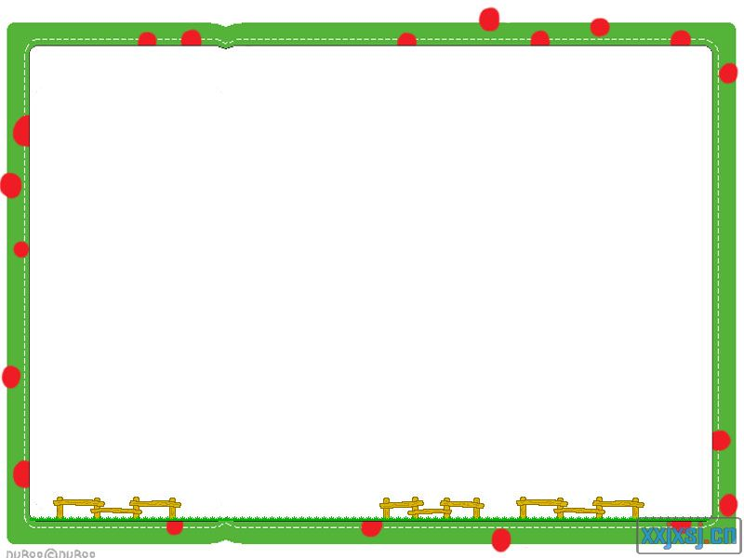
After scanning
1.What are the reasons for
becoming a professional athlete?
2.What are the reasons against
becoming a professional athlete?

Slide 5
Reasons for becoming a professional athlete.
____________________________________________________________________________________________________________________________________________________________________________________________________________________________________________________________________________________________________________
1.You can make a lot of money.
2.You can give money to schools and charities.
3.You can do something that you love.
4.You can become famous.
5.People all over the world will know you.

Slide 6
Reasons against becoming a professional athlete.
____________________________________________________________________________________________________________________________________________________________________________________________________________________________________________________________________________________________________________
1.It is very dangerous.
2.People will watch you all the time and
follow you everywhere.
3.You have a difficult time knowing who
your real friends are.

Slide 7
Intensive reading
Please find the meaning of these phrases.
Para 1
For many young people, becoming a professional athlete might seem like a dream job. If you become a professional athlete, you’ll be able to make a living doing something you love. If you become famous, people all over the world will know you . Many athletes give money to schools and charities, and do a lot of work to help people. This is a great chance that many people do not have.

Slide 8
对很多年轻人来说
一名职业运动员
以……谋生
变得闻名
全世界的人
捐钱给学校和慈善团体
for many young people
a professional athlete
make a living +doing sth.
become famous
people all over the world
give money to schools and
charities

Slide 9
Para2-3
However, professional athletes can also have many problems. If you are famous, people will watch you all the time and follow you every where. This can make life difficult.
If you play sports for a living, your job will sometimes be very dangerous. Many professional athletes get injured .And if you become rich, you will have a difficult time knowing who your real friends are. In fact, many famous people complain that they are not happy. They say they were happier before they became rich and famous.

Slide 10
变得富有
一直
到处跟随你
使生活困难
受伤
做某事困难
事实上
抱怨
become rich
all the time
follow you everywhere
make life difficult
get injured
have a difficult/ hard time+ doing sth.
in fact
complain

Slide 11
Reading strategy
While you are reading, if you just want to find out some information, scanning is a good way t make it quickly. If you want to learn about some details, intensive reading should be the right way you’ll choose.

Slide 12
If I become an athlete , will I be happy?
For many young people, becoming a professional athlete might seem like a dream job. If you become a professional athlete, you’ll be able to make a living doing something you love. If you become famous, people all over the world will know you . Many athletes give money to schools and charities, and do a lot of work to help people. This is a great chance that many people do not have.
However, professional athletes can also have many problems. If you are famous, people will watch you all the time and follow you every where. This can make life difficult.
If you play sports for a living, your job will sometimes be very dangerous. Many professional athletes get injured .And if you become rich, you will have a difficult time knowing who your real friends are. In fact, many famous people complain that they are not happy. They say they were happier before they became rich and famous.

Slide 13
Writing strategy
Everything has two sides, good or bad. If you want to show your opinions clearly, you’d better put them about one side together, and then the other side . Never mix them up. Also, suitable connectives are necessary.

Slide 14
3c
Maybe I’ll become a teacher. If I become a teacher, I will work will work with children. I love children, so I’ll be happy. I will also be able to work outside sometimes, but I won’t be famous.
Maybe I’ll become a lawyer. If I become a lawyer, I will be able to help people. But I won’t be able to work outside and I won’t be able to work with children. So I think I will be a teacher.

Slide 15
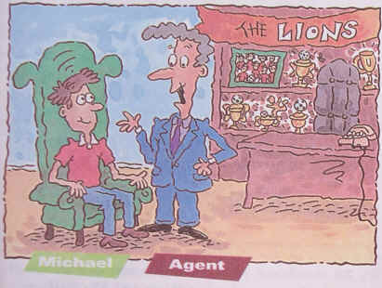
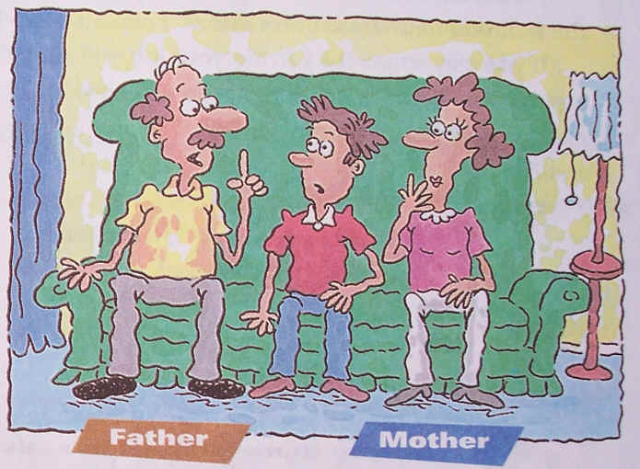
3b Do you think Michael in activity 2a decided to become a soccer player? Complete this letter from Michael to the agent Mr Brown. Decide if he joined the Lions or not
Dear Mr Brown,
I have decided that I (will/won’t)______________ join the Lions. If I join the team,________________________________________________________________________________________________________
Sincerely,
__________
be happy
be famous
go to college
travel around the world
Make a lot of money
get an education

Slide 16
Dear Mr Brown,
I have decided that I (will/won’t)________ join the Lions. If I join the team______________________
_________________________________
___________________________________________________________________________________________________
Won’t
I will travel all around the world
If I work very hard , I will be famous. And if I become famous, I will make a lot of money. But if
I join the team, I won’t go to college and won’t
get an education. So I won’t join the Lions.

