Slide 1

Unit 2

Slide 2
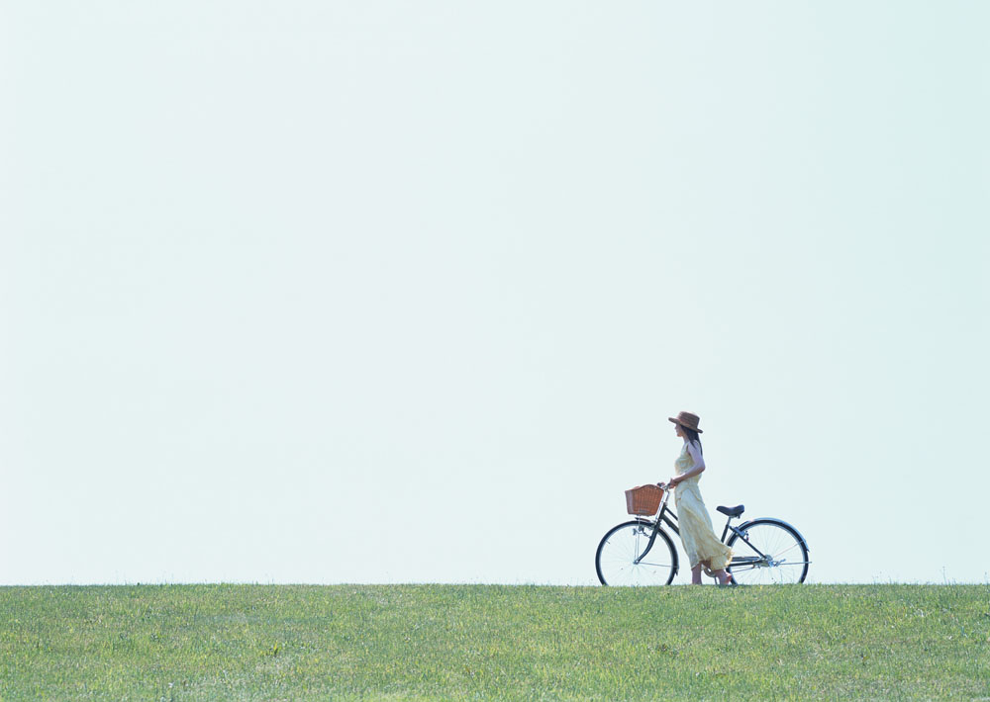

Unit 2
What time do you go to school?

Slide 3

Section A 1
1a-2d

Slide 4
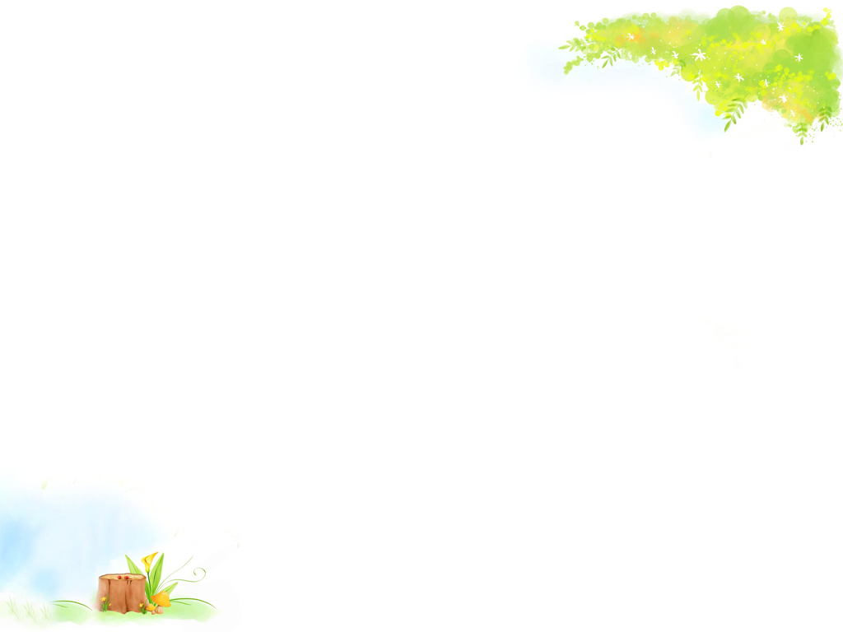
Do you know these sentences?
Time is money.
一寸光阴，一寸金。
Time is life.
时间就是生命。
Time flies.
时光如梭

Slide 5

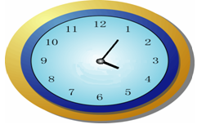
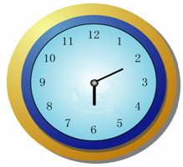
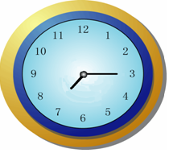
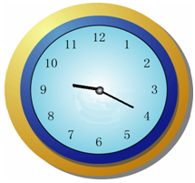
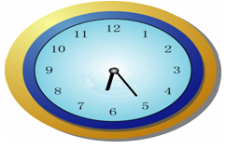
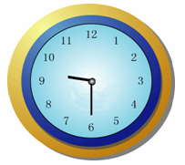
What time is it? It's...
4:05 four five
6:10 six ten
7:15 seven fifteen
9:20
nine twenty
6:25
six twenty-five
9:30
nine thirty

Slide 6
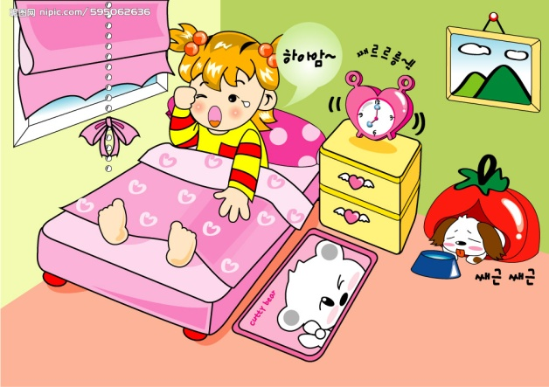
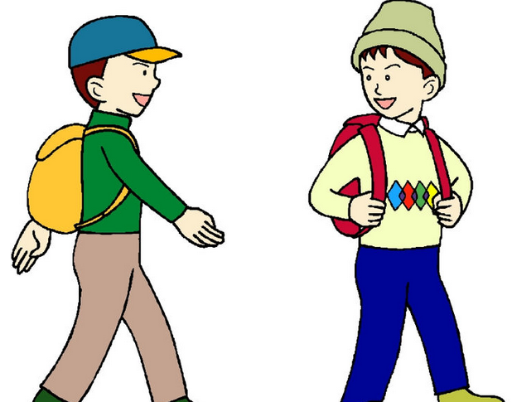
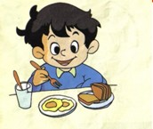
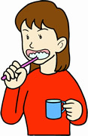
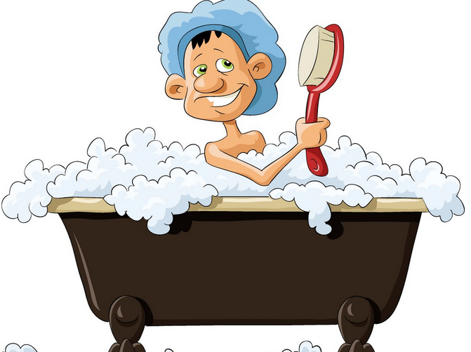
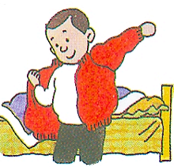
get up
get dressed
go to school
brush teeth
eat breakfast
take a shower

Slide 7

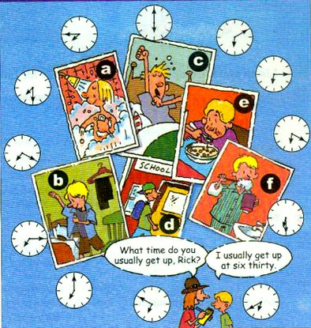
1a
Match the activities with the picture.
get up ___
go to school ___
get dressed ___
brush teeth ___
eat breakfast ___
6. take a shower ___
c
d
b
f
e
a

Slide 8

Listen and match the times with the actions.
1b

Slide 9
Speaking
1c
get up
A: What time do you usually get up?
B: I usually get up at six thirty.

Slide 10
take a shower
A: What time do you usually take a shower?
B: I usually take a shower at…

Slide 11
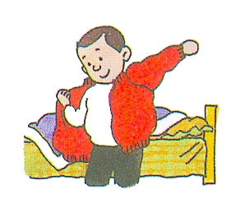
get dressed
A: What time do you usually get dressed?
B: I usually get dressed at…

Slide 12
brush teeth
A: What time do you usually brush teeth?
B: I usually brush teeth at…

Slide 13
have breakfast
A: What time do you usually have breakfast?
B: I usually have breakfast at…

Slide 14
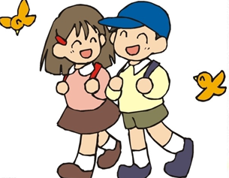
go to school
A: What time do you usually go to school?
B: I usually go to school at…

Slide 15

Listen to the conversation and complete the sentences.
Listening
2a
Jim has ____ brothers and ____ sisters.
Jim’s family has ________ shower.
two
two
only one

Slide 16
Listen again. Complete the shower schedule for Jim’s family.
2b
Name | Bob | Mary | Jack | Jim | Anna
Time | 5:30
5:50
6:15
6:30
6:45

Slide 17
Your time schedule
Activities | Time
get up
take a shower
get dressed
brush teeth
eat breakfast
go to school
6:00
6:10
6:20
6:30
6:40
7:00

Slide 18
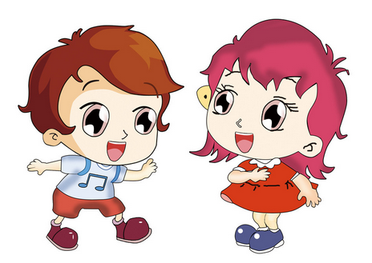
Now talk about yourself according to your time schedule.
2c
What time do you usually get up?
I usually get up at five fifty.
从未
早
Wow! I never get up so early.

Slide 19
Pay attention
1. five fif + ty = fifty 五十
four for + ty = forty 四十
想一想: 60 _______ 70 _________
80 _______ 90 _________
sixty
seventy
eighty
ninety

Slide 20
2. always 意为“总是，一直”
usually 意为“通常地，一直地”
never 意为“从未，绝不”
I _______ (通常) get dressed at six forty.
Jack is _______ (总是) late.
His grandpa _______ (从未) goes to school.
频率词
usually
always
never

Slide 21

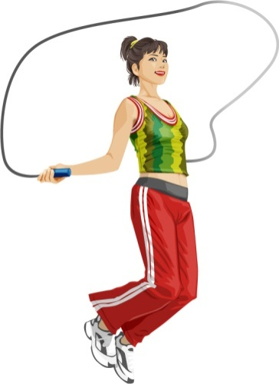
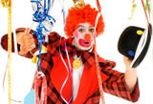
New words
funny adj.
有趣的，好笑的，滑稽的;
exercise v. & adj.
锻炼，练习

Slide 22
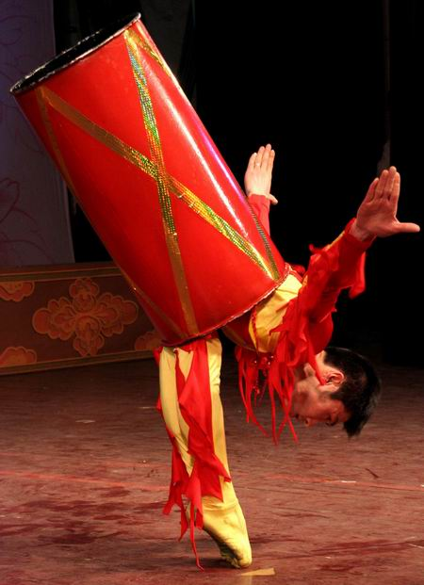
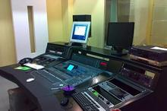
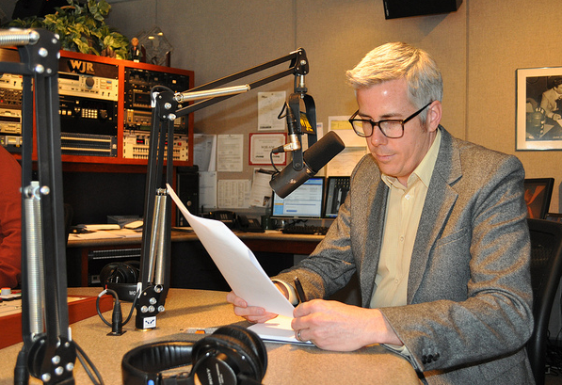
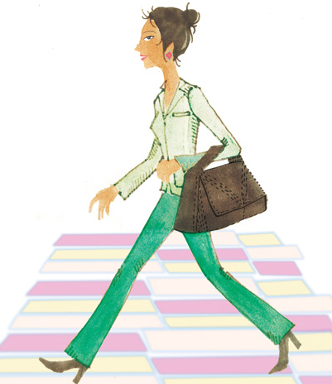
an interesting job
一个有趣的工作
radio station
电台
radio show
广播节目
go to work
去上班

Slide 23

Read the conversation in 2d. Fill in the blanks.
get up
eat breakfast
exercise
go to work
radio show
Activities
time
at eight thirty at night
at nine
at about ten twenty
at eleven
from twelve o’clock at night to six o’clock in the morning

Slide 24
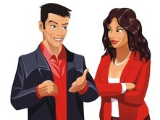
2c
Role-play the conversation.
Scott has an interesting job. He works at a radio station. Scott, what time is your radio show?
From twelve o’clock at night to six o’clock in the morning.
…
…

Slide 25

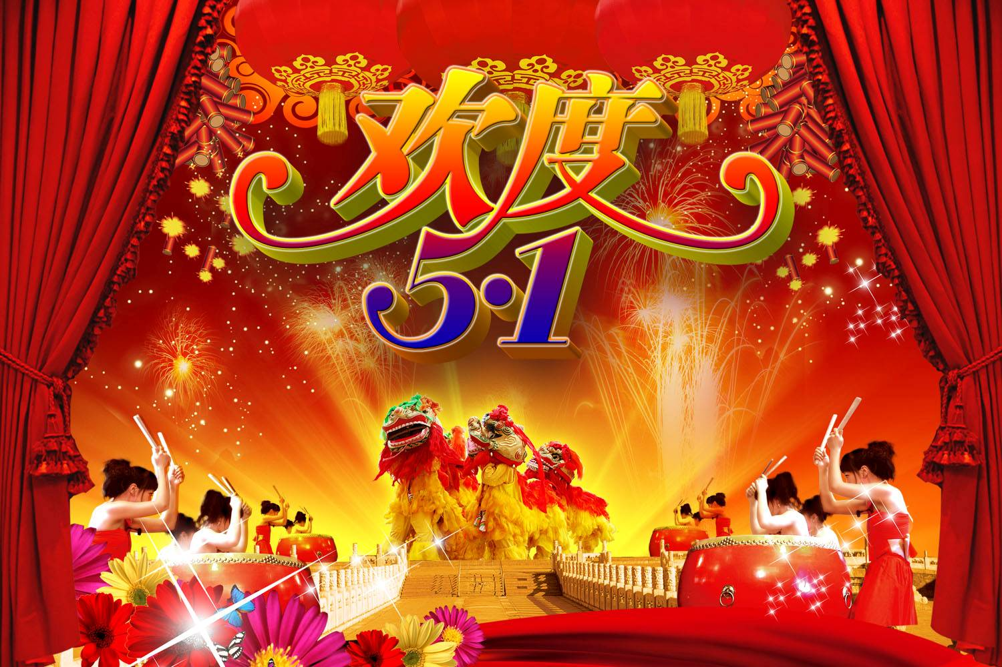
Language points
1. job与work 辨析
job是可数名词, 主要指有报酬的工作。
work是不可数名词, 主要指要付出努力
的劳动。
e.g. 鲍勃想找一份好的工作。
Bob wants to find a good ____.
job

Slide 26
今天我有很多工作要做。
I have much _____ to do today.
她每天六点钟去上班。
She goes to _____ at six o’clock.
work
work

Slide 27
2. That’s a funny time for breakfast!
time常常和介词“for”搭配，表示“做……的时间”。
e.g. We don’t have too much time for sports.
我们没有太多的时间开展体育活动。
Time for dinner, children. Go and wash
your hands, please.
孩子们，饭好了。去洗手吧。

Slide 28
3. I usually exercise at about ten twenty.
exercise 的用法小结
作动词，“锻炼”。
e.g. 他爷爷每天早晨锻炼。
His grandpa ________ in the morning.
作不可数名词，“锻炼；运动”。
e.g. 每天他都做大约十五分钟的运动。
He does about fifteen minutes’
_______ every day.
exercises
exercise

Slide 29
作可数名词，“体操；（技能）练习”。
e.g. 我们每天做早操。
We do morning ________ every day.
exercises

Slide 30
4. …so I’m never late for work.
be late for 意为“做……迟到”
e.g. 汤姆经常上学迟到。
Tom is always ____ ___ school.
late for

Slide 31

Exercises
Complete the sentences.
1. Lucy’s family has two ________ (shower).
2. An hour has ____ (six) minutes.
3. My sister always _______ (brush) teeth at 9:00 at night.
4. His aunt _____ (work) at a radio station.
showers
sixty
brushes
works

Slide 32
Fill in the blanks with the words in box.
at night, be late for, early, at six forty, funny, get up
1. Alice usually _______ at 6:30 in the morning.
2. His uncle works from 10:00 _______ to 6:00 in the morning.
3. His brother never goes to school so _____.
gets up
at night
early

Slide 33
4. The lazy boy __ always _______ school.
5. My sister always takes a shower __________.
6. Look at that boy. He’s really _____.
is late for
at six forty
funny

Slide 34

Interview your friends. Ask and answer questions about them.

