Slide 1
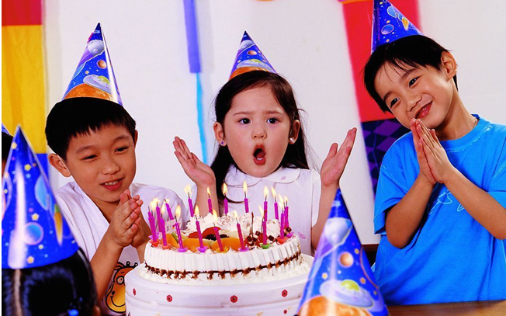
Unit 10
If you go to the party,
you’ll have a great time!

Slide 2
Section B
(3a-Self Check)

Slide 3
教学目标：
语言知识目标：
1) 复习讨论自己及伙伴们所有的问题，并
能通过讨论来找到解决问题的办法。
2) 能够综合运用所学的知识以及根据所
给的提示词来完成描述他人的问题及
解决办法 的小短文。

Slide 4
3) 能够综合运用所学的知识来描述他人的
问题及解决办法 的小短文。
4）通过完成Self Check的中练习题来全面
复习本单元的重难点知识点。

Slide 5
Revision
一、将下列词组或句子翻译成英语。
1. 有许多担忧 ________________________
2. 与某人交谈 ________________________
3. 害怕做某事 _____________________
4. 最终 ____________
5. 生气 ___________
have a lot of worries
talk to someone
be afraid to do sth.
in the end
be angry

Slide 6
6. 犯一些粗心的错误
_____________________________
7. 分享我的问题 _____________________
8. 逃避问题 __________________________
9. 将……分成两半 _______________
10. 有时候他们在学业上出现问题。
________________________________
_________________________
make some careless mistakes
share my problems
run away from the problems
cut … in half
Sometimes they have problems with their schoolwork.

Slide 7
11. 在生活中，有困难和担忧是正常的事。
___________________________________
12. 如果不和别人谈一 谈，我们肯定会觉得
更糟。
__________________________________
_______________________
罗伯特就一些寻常的问题向学生们提了
建议。_______________________________
_____________________
Problems and worries are normal in life.
Unless we talk to someone, we’ll certainly feel worse.
Robert advises students about common problems.

Slide 8
Lead-in
I don’t have many friends. What do you think I should do? Can you give me some advice?
If you join a sports team, you’ll know many new friends.

Slide 9
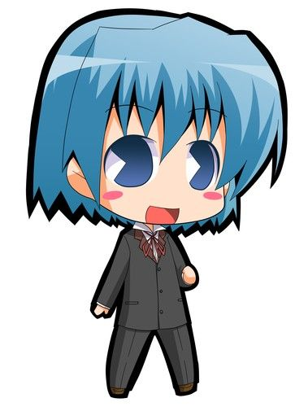
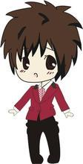
I think you should try to play games with your classmates.
I think you should join a club.

Slide 10
3a
Finding
Talk to someone you know. Find out his/her three biggest worries. Try to think of some solutions to the problems and write them down.

Slide 11
Problems Possible solutions
eat less junk food and more vegetables, do more exercise
too heavy
don’t stay up late, buy an alarm clock, ride your bike to go to school
always be late for school
take notes in class, do more exercises, ask the teacher for help
physics is difficult

Slide 12
Writing
3b
Write about your friend’s first problem and the possible solutions. Use the structures below to help you plan your writing.
My friend _______ has a problem. He/She _____________________________. I think he/she should ___________________.
If he/she _________________________,
he/she will __________________________.

Slide 13
指导
分析3b中的作文提纲，可以看出。我们需写三个方面的内容就能轻松完成一篇小作文。
首先，写清楚朋友的名字及其现在存在的问题或困难。
然后，写出自己给他的建议。并用if从句来进一步说明自己建议将会起到的作用。
最后，复读一遍作文来检查有没有错误。

Slide 14
A possible version:
My friend Jenny has a problem. She is too heavy. I think she should eat less junk food and eat more vegetables and fruit. I think she also should get more exercise. If she eats more vegetables and fruit, she will eat less junk food. If she gets more exercise, she’ll be much thinner soon.

Slide 15
Now write your advice for your friend’s second and third problem. Use the structures in 3b to help you.
3c
My friend also has two other problems. ___________________________________
___________________________________
__________________________________

Slide 16
A possible version:
…She is always late for school. I think she shouldn’t stay up later on weekdays. She should get an alarm clock. She should rides her bike to school. If she has an alarm clock, she will get up early.

Slide 17
If she rides her bike to school, it will costs her less time to get to school. She thinks physics is too difficult for her. I think she should take notes in class. She should also do more exercises. She should ask the teacher for help after class.

Slide 18
4
Your school is taking part in the project “We Can Help!” Add more items to the poster. Then talk about what you will take part in the project.
old people’s home visit
school clean-up
children’s hospital visit
_________________
____________

Slide 19
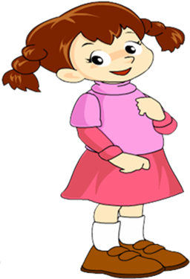
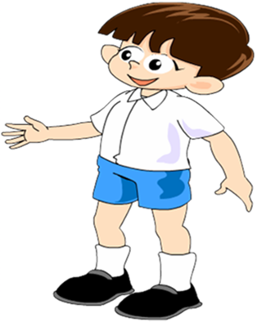
What will you do if you visit an old people’s home?
If I do that, I’ll bring the old people some flowers.

Slide 20
If I do that, I’ll sing and dance for them to make them happy.

Slide 21
Self Check
1. Fill in the blanks with the words in the box.
meeting, teenagers, video, experience
1. If my family travels to a new country
this summer, I’ll send you a letter about
my __________.
2. Will you watch the ______ with me if
you’re free this weekend?
experience
video

Slide 22
meeting, teenagers, video, experience
3. If the _________ stay out too late, their parents will worry about them.
4. I’ll go to the __________ if it ends by 5:00 p.m.
teenagers
meeting

Slide 23
2. Complete the conversation with
words in the box. Some words are
used more than once.
if, are, will, fight, want, sorry, going
A: Hi, Sally, _____ you ______ to the party tomorrow?
B: I ______ to, but I can’t.
are
going
want

Slide 24
A: Oh! But _____ you don’t go to the party, you ______ miss all the fun!
B: I know, but I got into a _____ with my parents.
if
will
fight
A: Hmm… then you should just say _____ to your parents.
B: I guess you’re right. I ______ talk to them tonight.
sorry
will

Slide 25
指导
首先，应通读对话，了解对话的大意。
其次，明确对话中A同学邀请的事由，以及B同学不能参加的原因及解决的办法。
然后，结合所给选项，逐句推敲选择。

Slide 26
1. are, going 由空格后“to the party”，可
知空格处应填go，再由时间状语tomorrow可知应用are going来表达将来时态。
2. want 由下半句“但我不能”，可推断前半句意为“我想去”，故填want一词。
3. if, will 本句为一含 if 条件状语从句的主从复合句，分析句意为“如果你不去，你将会错过所有的欢乐。”，故空格处填 if 与 will。

Slide 27
4. fight 句意“我知道，但是我与父母
亲发生了争吵”，故填fight一词。
5. sorry “say sorry to sb.”意为“向某人道
谦”，是固定搭配用法，可知空格处应
填sorry一词。
6. will 由时间状语tonight，可知本句为
一般将来时态，故在谓语动词talk前，
应用will一词来构成一般将来时态。

Slide 28
3. Use your imagination! What will
you do if…
1. it rains all weekend?
___________________________________
___________________________________
If it rains all weekend, I’ll chat with my friends online and play computer games.

Slide 29
2. there’s an English test tomorrow?
_________________________________
_________________________________
3. your cousin decides to come and visit
from another town?
_________________________________
_________________________________
_________________________________
__________
If there’s an English test tomorrow, I’ll go over my books and notes.
If my cousin decides to come and visit from another town, I’ll have a party for him. And I’ll invite a lot of good friends.

Slide 30
Homework
Write a letter to your friend. If you go to the party, what will happen? If you don’t go to the party, what will happen?

