Slide 1
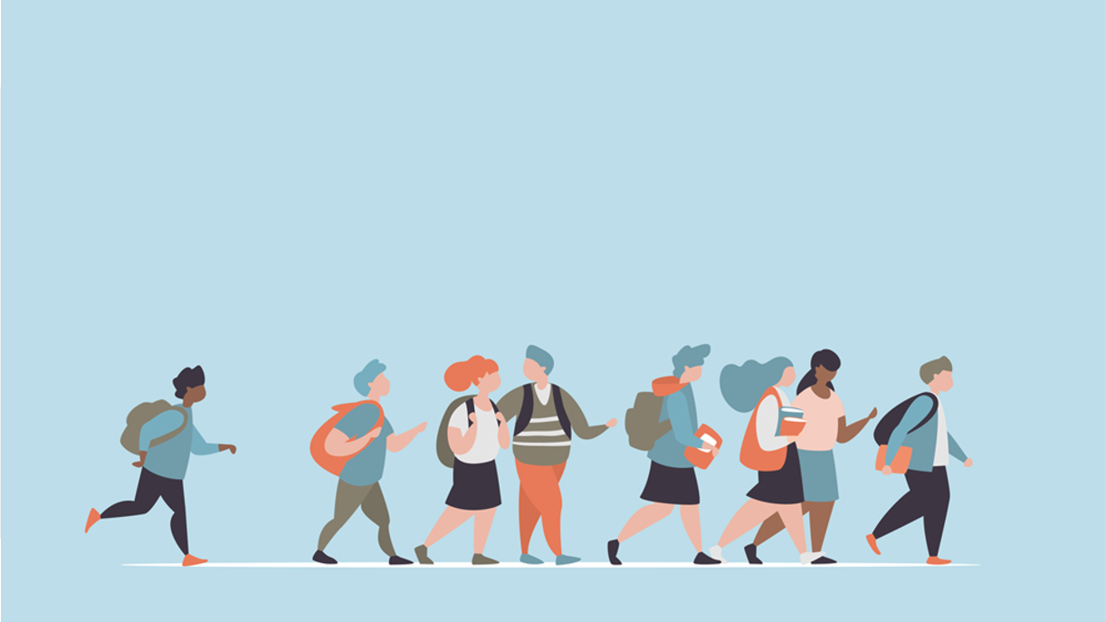
R·九年级全一册
Unit 10 You’re supposed to shake hands.
第一课时

Slide 2
Lead in
What should people do when they meet for the first time?

Slide 3
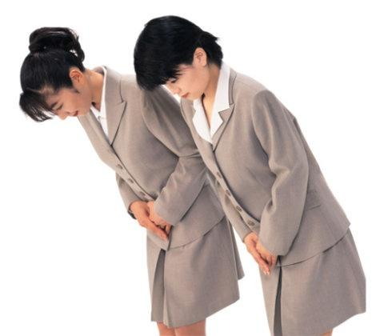
bow
They should bow.

Slide 4
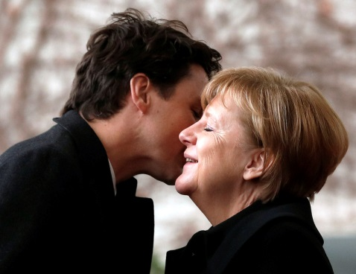
They should kiss each other.
They should hug.
kiss
hug

Slide 5
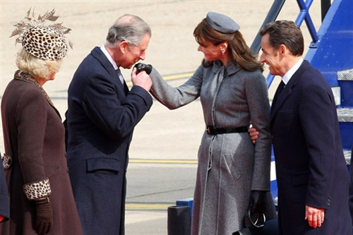
The gentleman should kiss the lady's hand.
They should shake hands.
shake hands
Hand-kissing

Slide 6
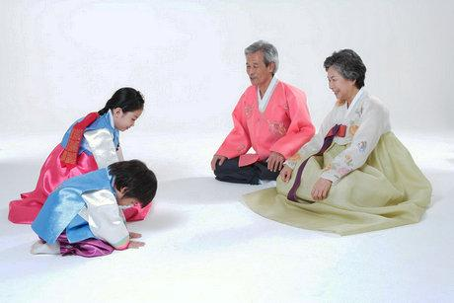
Language points
What are people in Korea supposed to do when they meet for the first time?
They’re supposed to bow.

Slide 7
How about in the United States?
In the United States, they’re expected to shake hands.

Slide 8
一、be supposed to 的用法
be supposed to do sth. 表示被要求或劝告做某事，常意为“理应/应做某事”。
be expected to 有望做……；被期待做……

Slide 9
be supposed to do sth 相当于 should do sth 或者be expected to do sth. 人称、时态和句式体现在be的变化上，to为不定式符号，后接动词原形。
状元成才路
状元成才路
状元成才路
状元成才路
状元成才路
状元成才路
状元成才路
状元成才路
状元成才路
状元成才路
状元成才路
状元成才路
状元成才路
状元成才路
状元成才路
状元成才路
状元成才路
状元成才路
状元成才路
状元成才路
状元成才路
状元成才路
状元成才路
状元成才路
状元成才路
状元成才路
状元成才路
状元成才路
状元成才路
状元成才路
状元成才路
状元成才路
状元成才路
状元成才路
状元成才路
状元成才路
状元成才路
状元成才路
状元成才路
状元成才路
状元成才路
状元成才路
状元成才路
状元成才路
状元成才路
状元成才路
状元成才路
状元成才路
状元成才路
状元成才路
状元成才路
状元成才路
状元成才路
状元成才路
状元成才路
状元成才路
状元成才路
状元成才路
状元成才路
状元成才路
状元成才路
状元成才路
状元成才路
状元成才路
状元成才路
状元成才路
状元成才路
状元成才路
状元成才路
状元成才路
状元成才路
状元成才路
状元成才路
状元成才路
状元成才路
状元成才路
状元成才路
状元成才路
状元成才路
状元成才路
状元成才路
状元成才路
状元成才路
状元成才路
状元成才路
状元成才路
状元成才路
状元成才路
状元成才路
状元成才路
状元成才路
状元成才路
状元成才路
状元成才路
状元成才路
状元成才路
状元成才路
状元成才路
状元成才路
状元成才路

Slide 10
句式：
1. 肯定句： be supposed to do sth
2. 否定句： be not supposed to do sth
相当于：shouldn’t do sth
be not allowed to do sth.
意为：不应当做某事；不被允许做某事
状元成才路
状元成才路
状元成才路
状元成才路
状元成才路
状元成才路
状元成才路
状元成才路
状元成才路
状元成才路
状元成才路
状元成才路
状元成才路
状元成才路
状元成才路
状元成才路
状元成才路
状元成才路
状元成才路
状元成才路
状元成才路
状元成才路
状元成才路
状元成才路
状元成才路
状元成才路
状元成才路
状元成才路
状元成才路
状元成才路
状元成才路
状元成才路
状元成才路
状元成才路
状元成才路
状元成才路
状元成才路
状元成才路
状元成才路
状元成才路
状元成才路
状元成才路
状元成才路
状元成才路
状元成才路
状元成才路
状元成才路
状元成才路
状元成才路
状元成才路
状元成才路
状元成才路
状元成才路
状元成才路
状元成才路
状元成才路
状元成才路
状元成才路
状元成才路
状元成才路
状元成才路
状元成才路
状元成才路
状元成才路
状元成才路
状元成才路
状元成才路
状元成才路
状元成才路
状元成才路
状元成才路
状元成才路
状元成才路
状元成才路
状元成才路
状元成才路
状元成才路
状元成才路
状元成才路
状元成才路
状元成才路
状元成才路
状元成才路
状元成才路
状元成才路
状元成才路
状元成才路
状元成才路
状元成才路
状元成才路
状元成才路
状元成才路
状元成才路
状元成才路
状元成才路
状元成才路
状元成才路
状元成才路
状元成才路
状元成才路

Slide 11
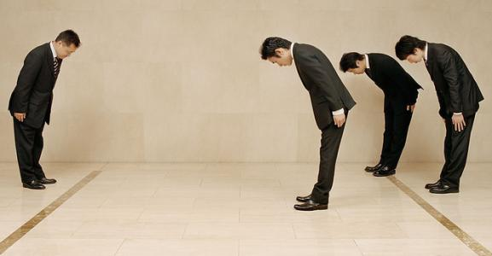
We are supposed to bow.
We are expected to bow.
We should bow.

Slide 12
We are not supposed to hug.
We are not expected to hug.
We shouldn't hug.

Slide 13
3. 疑问句：
be supposed to do sth 的疑问句是将be动词的相应形式提到主语前。

Slide 14
Am I supposed to wear jeans?
No, you’re expected to wear a suit and tie.

Slide 15
When were you supposed to arrive?
I was supposed to arrive at 7:00.

Slide 16
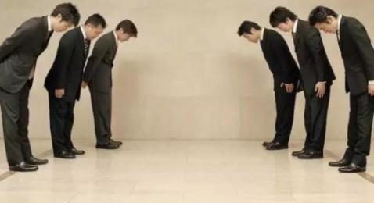
What are people in Japan not supposed to do when they meet for the first time?
They’re not supposed to hug.

Slide 17
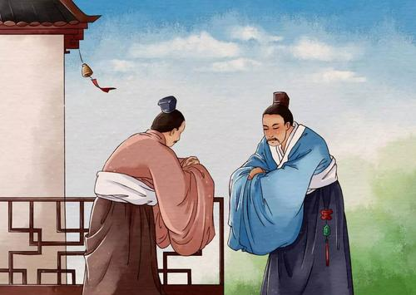
What are people in China not expected to do when they meet for the first time?
They’re not expected to kiss.

Slide 18
4. 当be supposed to 的主语是人时，意为“该……”。表示劝告、义务、责任等。
You are supposed to study hard.

Slide 19
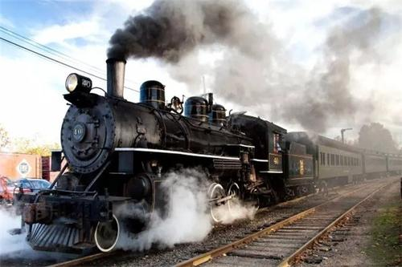
5. 当 be supposed to 的主语是物时，意为“本应；本该”。表示“某事应该发生却没有发生”。
The train was supposed to arrive half an hour ago.

Slide 20
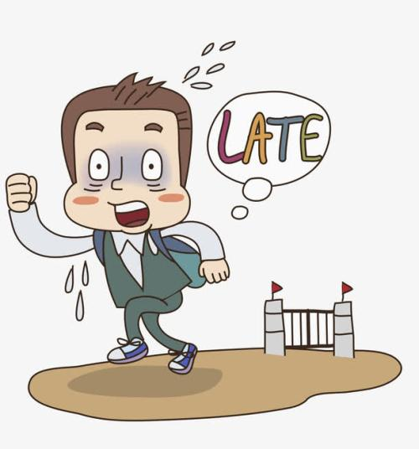
6.“be supposed to +have+及物动词过去分词”， 表示“本应该做而没做”，是虚拟语气的一种表达方式，含有责备、失望之意。
He is supposed to have arrived an hour ago.

Slide 21
Let's talk
A: In…, what are people supposed to do when they meet for the first time?
B: They’re supposed to …
Korea
the United States
Brazil
Mexico
Japan
China

Slide 22
Practice
1. He _____ stand there to wait for his teacher.
A. should to B. are supposed
C. isn’t supposed to D. doesn’t should
2. He is ______ arrive at 7:00.
A. expecting B. expected to
C. expecting to D. expected
C
B

Slide 23
Summary
What are you supposed to do when you meet someone for the first time?
1. You're supposed to shake hands.
= You're expected to ... = You should ...
2. You're not supposed to = You are not expected to = You shouldn’t = You're not allowed to do sth.

Slide 24
THANKS

