Slide 1
R·九年级全一册
Unit 14 I remember meeting all of you in Grade 7.
第三课时

Slide 2
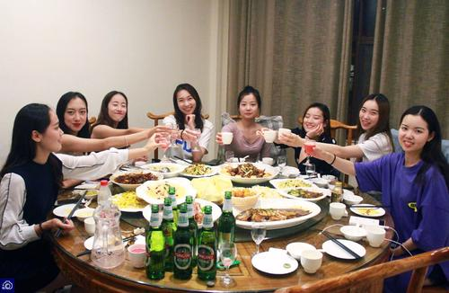
Lead in
What are you going to do?
Have a big dinner together

Slide 3
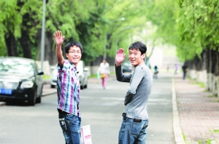
Say goodbye to teachers and classmates

Slide 4
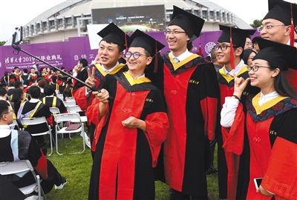
Take graduation pictures

Slide 5
What do you hope to do in the future?

Slide 6
What do you
hope to do
in the future?
I hope to get a business
degree and become a
manager.

Slide 7
Make a speech
Prepare a speech for your graduation. Use the questions to help you. Present your speech to your group.

Slide 8
How have you changed since you started junior high school?
Who has helped you most?
What advice have your parents given you?
What will you do after you graduate?
What are you looking forward to?

Slide 9
Getting started
1. Choose your topic.
2. What is your purpose?
3. Organize your thoughts and ideas.

Slide 10
The Writing Process
1. Think about your audience.
2. Grab their attention.
3. Focus on your message.

Slide 11
Giving the Speech
1. Practice reading the speech aloud.
2. Review what you’ve written and make some necessary revisions.
3. Present your speech with confidence. Speak in a loud and clear voice.

Slide 12
Let's write
Think of a person or an event from junior
high school that you will never forget. Make
some notes about how this person or event
changed your life in some way.

Slide 13
If you want to write about a person …
What you want to tell him / her
The first time you meet
Appearance & personality
Things happened to you
How he / she helped you
How you’ve been changed

Slide 14
What does he/she look like?
overweight
good-looking
slim
middle-aged
pretty
always smile

Slide 15
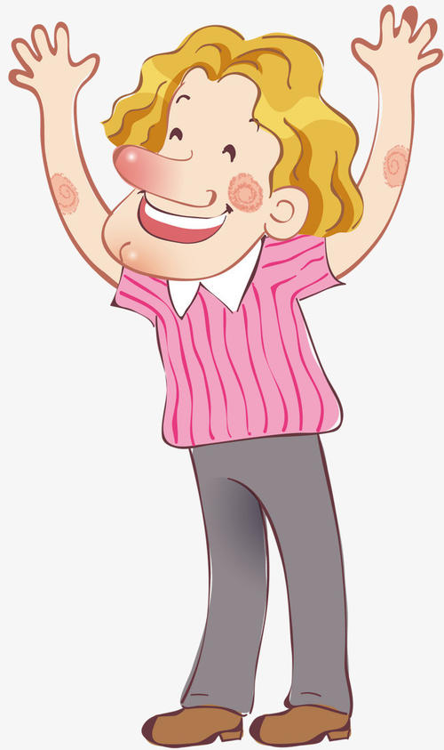
How about personality?
straightforward
hardworking
self-confident
forgetful
good-tempered
warm-hearted

Slide 16
If you want to write about an event …
When and where
What happened
Your feelings
What happened later
How you’ve been changed

Slide 17
You may begin like this：
1. I once had an experience…
2. It was the most unforgettable experience
that has ever happened in my life.
3. The most unforgettable experience in my
memory was that one day my classmates
and I went to the park.
4. I will never forget the military training.

Slide 18
Your feelings
I think this is the most unforgettable experience in my memory.
2. On that day, I began to feel that I have the duty for my life. And I must be stronger.

Slide 19
3. I felt that I was growing up, and I should be responsible for myself.
4. How exciting and unforgettable the experience was!

Slide 20
Practice
What happened in junior high school that made you have these feelings? Complete the chart.
Feelings
Memories/Experiences
excited
happy
worried
sad

Slide 21
Summary
1. Talk about future.
2. Make a speech about graduation.
3. Write a person or an event.

Slide 22
THANKS

