Slide 1
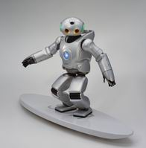
Unit 7
Will people have robots?

Slide 2
时态：一般将来时
The Simple Future Tense
练习翻译：
⑴ 明天，Jim就15岁了。
Jim will be fifteen years old tomorrow.
⑵明天我爷爷不会去钓鱼。
My grandfather won’t go fishing tomorrow.
⑶你下个月将会来合肥吗？
Will you come to Hefei next month?
⑷我们什么时候再见面？
When shall we meet again?

Slide 3
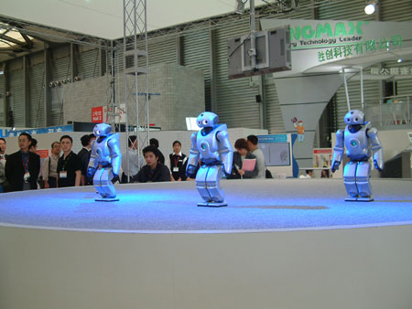

Slide 4
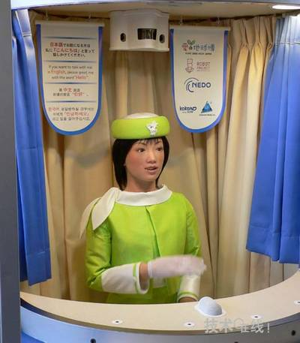

Slide 5
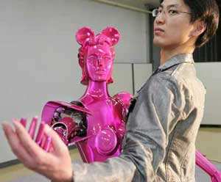
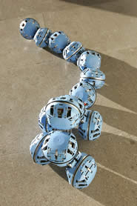
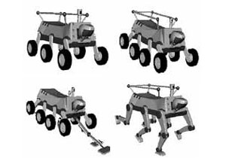
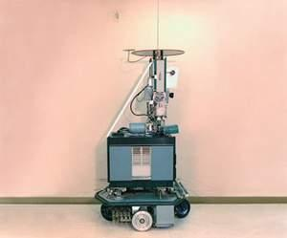

Slide 6
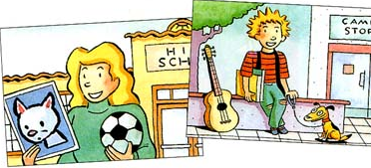
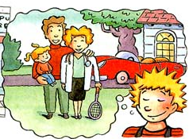

Slide 7
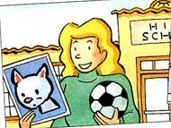
Five years ago, Sally was
She played
She had
in high school .
Soccer .
a cat .

Slide 8
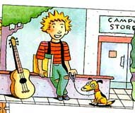
4. Today, Sally is
5. She plays
6. She has
in college.
the guitar.
a dog .

Slide 9
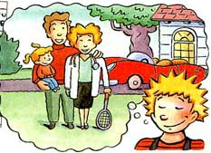
7. In five years, Sally will be
8. She will play
9. She will have
a doctor.
tennis.
a sports car/a child.

Slide 10
Five years ago:
I was a student.
I played basketball.
I had a bike.
In five years:
I will be a professor .
I will play notebook.
I will have a car.
Today:
I am a teacher.
I play computer.
I have a motorbike

Slide 11
3c Now write about yourself.
Five years ago, I was .
I played . I had .
Today, I am .
I play . I have .
In five years, I will be .
I will play . I will have .

Slide 12
Exercises I
用more, less, fewer 填空。
1. We plant trees every year, there will be _____ trees.
2. If we waste water, there will be ____ water.
3. If every family has a baby, there will be _____ people.
more
less
fewer

Slide 13
less/ more
4. I think English is _________ popular than Chinese.
5. There will be _____ robots everywhere, and humans will have ___ work to do.
6. There will be _____ free time when people retire.
more
less
more

Slide 14
Exercises II
1. I think there will be more pollution.（改为否定句）
I ______ think there ______ be more pollution.
2. He will have a good time. (先改为否定句，再改为一般疑问句)
He _____ _____ a good time.
_____ he _____ a good time?
3. Mary will get home at nine this evening. (对画线部分提问)
______ ______ Mary get home?
don’t will
won’t have
Will have
When will

Slide 15
b
1.People will have robots in their homes 100 years.
a. at b. in c. after d. with
2. Will there more cars in people’s homes?
a. have b. has c. be d. /
3. I think there will be people and pollution.
a. fewer; many b. less; fewer c, more; less d. less; fewer
4. There won’t be any in 100 years.
a. paper moneys b. papers money
c. papers moneys d. paper money
5.I think every home will a car.
a. be b. have c. has d. there be
6.There are two white on the desk. you can have one.
a. paper b. piece of paper c. papers d. pieces of paper
7 will there be more trees? Yes, .
a. they will b. there will c. there will be d. there have
c
c
d
b
d
b

Slide 16
Practice : Write a short passage about yourself
Five years ago, I was in primary school,
I played football with classmates after class,
and I had a dog. Now I’m a middle school
student, I like playing tennis . I am good at
English and I have good grades. In five years,
I will be a doctor, I will make much money,
and I will travel around the world. I will play
. I will have .
the guitar
a parrot

