Slide 1
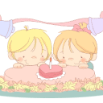
Unit 9
Can you come to my party?
Section A (2a-2c)

Slide 2
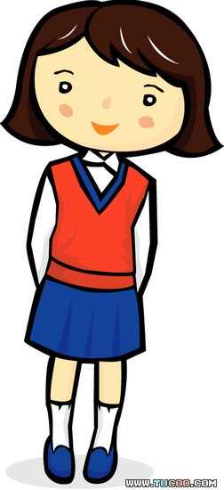
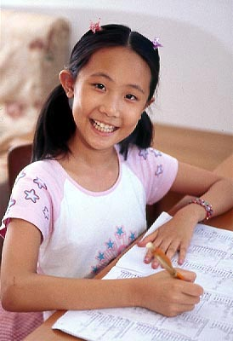
Can you come to my party?
= Would you like to come to my party?
Sure/Yes , I’d love/like to.
Sorry, I can’t . I have to study for a test
Sorry, I can’t . I am studying for a test.
Sorry, I can’t . I have too much homework.
= a lot of

Slide 3
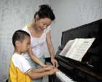
Can you come to my party tomorrow?
have a piano lesson
Sorry, I can’t. I have to ____________________. /
having a piano lesson
Sorry, I can’t. I am____________________.
Can you go shopping with me tomorrow?
go to the doctor
Sorry, I can’t. I have to ________________.
going to the doctor
Sorry, I can’t. I am____________________.

Slide 4
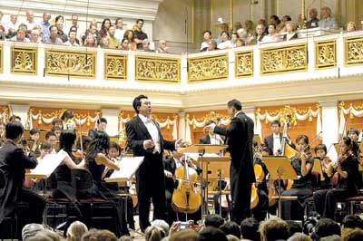
Can you come to my party the day after tomorrow?
Sorry
have to
______, I can’t. I ________ visit my aunt.
am visiting
Sorry , I can’t. I ____________ my aunt.
Can you go to a movie with me on Sunday?
I can’t
go to a concert
Sorry,________. I have to _______________.
going to a concert
Sorry, I can’t. I am __________________.

Slide 5
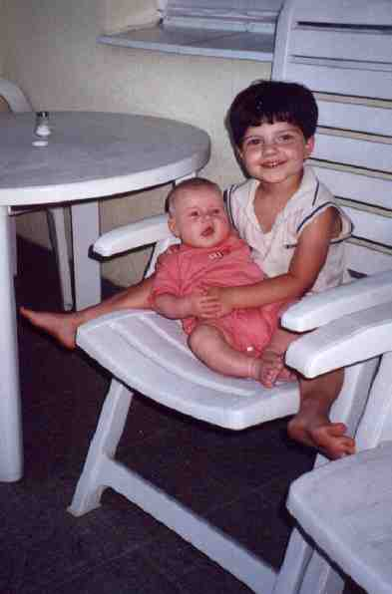
Can she go to the movies?
No, she can’t. She has to babysit her sister.
No, she can’t. She is babysitting her sister.
Can he go to the basketball game?
No, he can’t. He has to help his parents.
No, he can’t. He’s helping his parents.

Slide 6
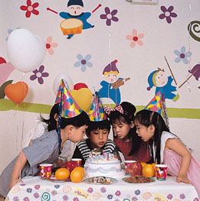
Can they go to the concert?
No, they can’t. They have to go to a party.
No, they can’t. They’re going to a party.

Slide 7
Listen.Circle “can” or “can’t”
1. Jeff can / can’t come to the party.
2. Mary can / can’t come to the party.
3. May can / can’t come to the party.
4. Claudia can / can’t come to the party.
5. Paul can / can’t come to the party.

Slide 8
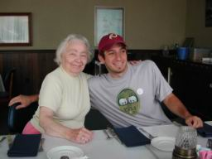
Hi, Jeff! Can you come to my party on Saturday?
I’m sorry, I can’t.
I have to __________ on Saturday.
visit my aunt

Slide 9
Hello, Mary. Can you come to my party on Saturday?
Sure, I’d love to.

Slide 10
May ! Can you come to my party tomorrow?
I’m sorry. I have to ____________.
help my mom

Slide 11
Claudia, Can you come to my party on Saturday?
I’m sorry .
I’m going _______
to the movies.

Slide 12
Paul, can you come to my party on Saturday?
I’d love to.
____________

Slide 13
A: Hey, Dave, Can you go to the movies on Saturday?
B: I’m sorry, I can’t. I have too much homework this weekend.
A: That’s too bad. Maybe another time （下次）.
B: Sure, Joe. Thanks for asking.
用下列的词组替换：
activities
go to a party
go to the concert
go to the baseball match
play soccer.
reasons
have to go to the doctor
have to study for a test
have to help my mother
have to visit my aunt
Pair work

Slide 14
Make invitations
Name | Can/Can’t | Reasons
Tom | can | /
Li Hong | can’t | study for a test
Report:
I’m having a party ___Saturday evening. I want to ____ my friends to come to my party. Tom is free. He can come to my party. Li Hong ______ come. She ________ study / is _________ for a test…. What a big/ small party!
on
ask
can’t
has to
studying

Slide 15
Read and fill in the blanks
It’s a Birthday Party!
For whom: Lisa
Time: Friday, June 30, at four-thirty
Place: Lisa’s house, 15th street
Come and have fun.
can
Lisa: Hi, Simon, _____ you come
to my _____________?
Simon: ___________ is it?
Lisa: It’s ___________ at ___________.
Simon: Great! I’d love to.
birthday party
What time
June 30
four-thirty

Slide 16
Grammar Focus
本单元谈论和学习怎样邀请别人或接受别人的邀请以及如何委婉说明不能应邀的原因。
主要句型：
Can you come to my party？
Sure, I’d love to.
Sorry, I can’t.I have to…
Sorry, I can’t. I’m visiting my aunt/…
Can he/she/they… ？
No, he/she/they can’t. He/She has /They have to…
No, he/she/they can’t. He/She is… They’re…

Slide 17
Translations:
1.你能参加我的晚会吗？
Can you come to my party?
对不起，我不能。我得帮助我妈妈。
I’m sorry, I can’t. I have to help my mom.
当然可以。我很愿意。
Sure, I’d love to.
2.她能去看电影吗？
Can she go to the movies?
不，她不能，她打算踢足球。
No, she can’t. She’s playing soccer.

Slide 18
3.他能去参加棒球比赛吗？
Can he go to the baseball game?
不,他不能。他得学习。
No, he can’t. He has to study.
4.他们能去参加音乐会吗？
Can they go to the concert?
不，他们不能。他们得去参加晚会。
No, they can’t. They have to go to a party.

Slide 19
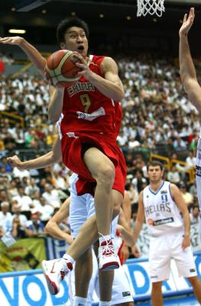
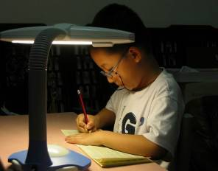
Can you watch a basketball match with me?
Sure, I’d love to.
________________
Can you come to my party tomorrow?
Sorry, I can’t. I have to _____________________.
have a piano lesson
Can you go shopping with me tomorrow?
Sorry, I can’t. I _________________________.
have to study for a test

Slide 20
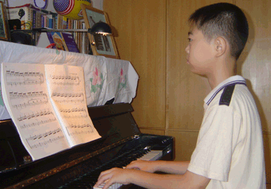
Can she go to the movies?
No, she can’t. She has to ______________.
study for a test
Can he go to the basketball game?
No, he can’t. He _________
_________________
has to
have a piano lesson.
Can they go to the concert?
No, they can’t. They _____________________
have to go to a party.

Slide 21
Can you come to my party the day after tomorrow?
Sorry
______, I can’t. I’m not feeling well. I am _________________________.
going to see the doctor
Can you go to a movie with me on Sunday?
I can’t
going to a concert
Sorry,________. I am __________________.
Can you go fishing with me the day after tomorrow?
Sorry, I can’t
_____________. I ___________________________.
am babysitting my sister

Slide 22
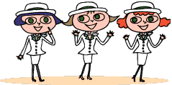
It’s a
For whom:
Time:
Place:
Come and join us!
school music concert!
Greenwood Boy
Saturday June 26, 2005,
at seven-thirty
school dinning hall

