Slide 1
R·九年级全一册
Unit 12 Life is full of the unexpected.
第一课时

Slide 2
Lead in
Have you ever been late for school? What happened to you?

Slide 3
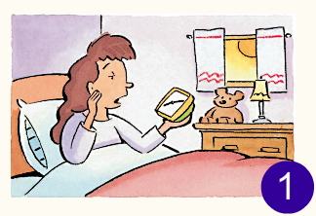
Mary's morning ...
wake up late
take a shower

Slide 4
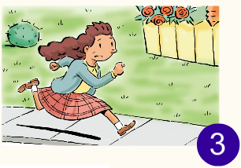
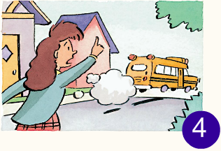
run to catch the bus
bus have just left

Slide 5
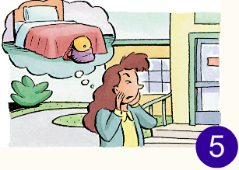
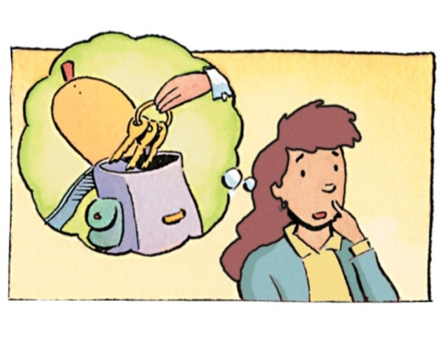
6
leave bag at home
leave keys in the bag

Slide 6
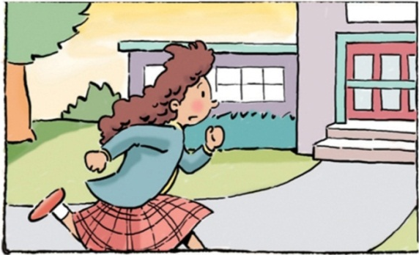
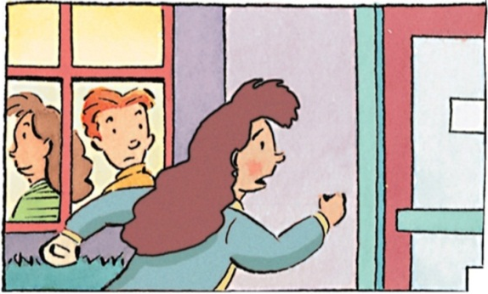
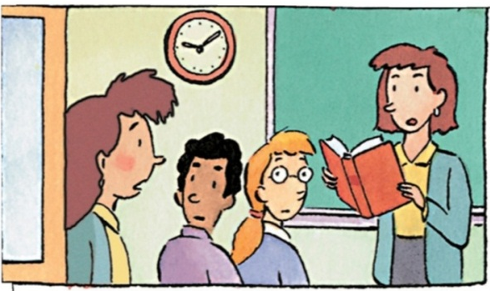
7
8
9
run back to school
class have started
teacher asks for her homework

Slide 7
What happened to you, Mary?
I woke up late. By the time I got up, my brother had already gotten in the shower.

Slide 8
Language points
一、by the time引导时间状语从句
by the time引导的时间状语从句的复合句。by the time意为“到……时，在……以前”，引导时间状语从句，主句常用过去完成时。

Slide 9
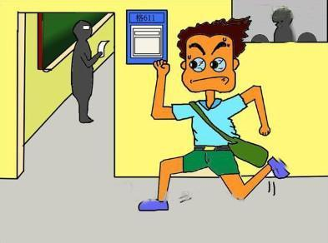
By the time you got to school, you were only five minutes late for class.

Slide 10
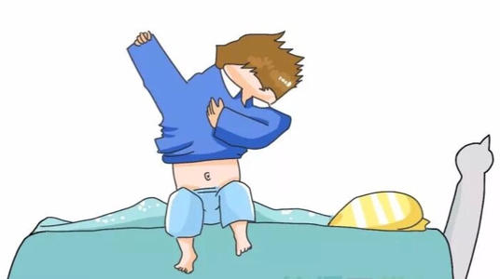
So I just quickly put on some clothes and rushed out of the door.

Slide 11
二、“穿”的表达
put on
wear
dress
强调穿的动作，宾语是物，反义词组为take off。
强调穿的状态，以物为宾语，可用于进行时。
既可表动作也可表状态，既可作及物动词也可作不及物动词，但多接人作宾语。

Slide 12
get dressed 为动词短语
“穿上衣服，打扮起来”
=be dressed或dress up。
如果后面有表示“衣服/颜色”的名词做宾语时，需用介词in，即“get/be dressed in+衣服/颜色”。

Slide 13
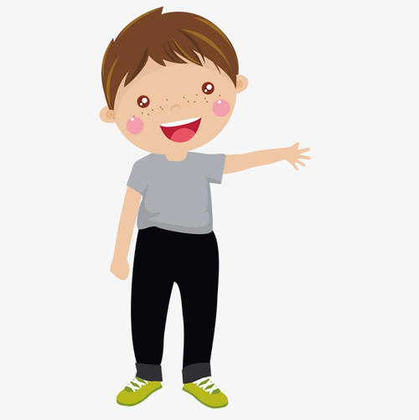
He’s getting dressed.
He’s dressed in grey.

Slide 14
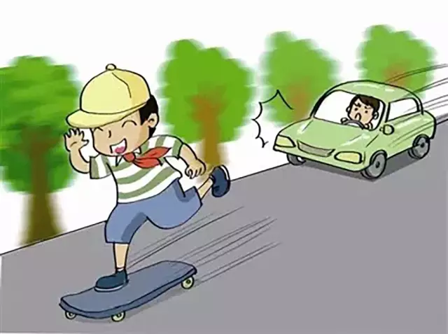
Life is Full of the Unexpected.

Slide 15
三、be full of 与be filled with
be full of | be filled with
“充满；装满”，属主系表结构，侧重于状态。
“充满；装满”，是fill…with的被动语态。
The room is full of people.
The bottle is filled with sand.

Slide 16
By the time you got to the airport, your plane to New Zealand had already taken off. What happened to you?
I was about to go up when I decided to get a coffee first.

Slide 17
be about to do sth.意为“即将 / 马上做某事”，表示按计划、安排即将发生某事或打算做某事。
例：飞机就要起飞了。
The plane is about to take off.

Slide 18
Practice
1. 当我到车站时，火车已经开走了。
____ ____ ____ I got to the station, the
train ____ ________ left.
2. 长大后，他会离开这儿。
He _____ _____ here by the time he ______ up.
By the time
had already
will leave
grows

Slide 19
Summary
1. By the time I got up, my brother had already
gotten in the shower.
2. So I just quickly put on some clothes and
rushed out of the door.
3. Life is Full of the Unexpected.
4. I was about to go up when I decided to get a
coffee first.

Slide 20
THANKS

