Slide 1
R·九年级全一册
Unit 1 How can we become good learners?
第二课时

Slide 2
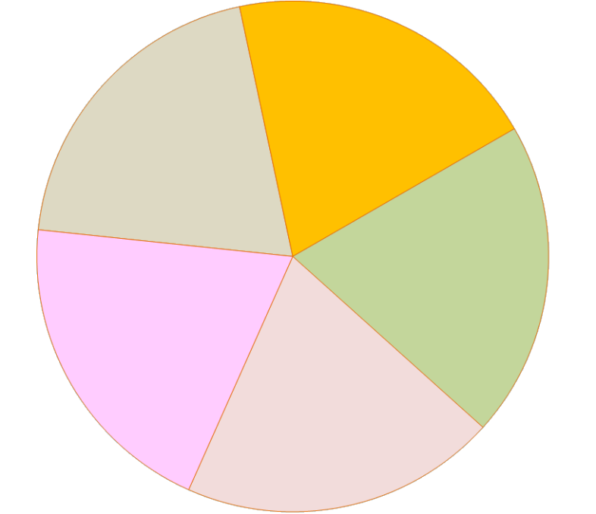
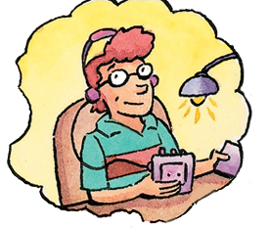
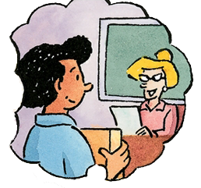
Let's play
A: How do you study for a test?
B: I study by ....

Slide 3
grammar
learning new words
listening
Do you have any difficulties in learning English?
speaking
writing
pronunciation

Slide 4
Language points
What difficulties do you have in learning English?
I was afraid to ask questions because of my poor pronunciation.

Slide 5
一、害怕的表达
1. be afraid to do sth.
害怕做某事或不敢做某事
2. be afraid of doing sth.
①担心会发生某事或某情况
②害怕做某事或不敢做某事

Slide 6
What difficulties did you have in learning English?
The teacher spoke so quickly that I did not understand her most of the time.

Slide 7
I want to learn new words and more grammar so that I can have a better understanding of English movies.
What difficulties do you have in learning English?

Slide 8
watching an English movie can
improve one’s pronunciation
learn useful sentences

Slide 9
watching their body language
and the expressions on their faces
get the
meaning by
listening for the key words
looking up new words
in a dictionary

Slide 10
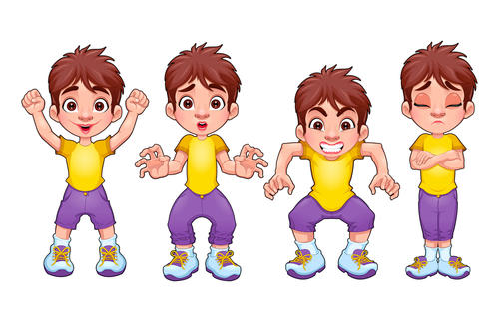
I discovered watching their body language and the expressions on their faces is the secret to get the meaning.

Slide 11
I discovered listening for the key words is the secret to get the meaning.

Slide 12
I discovered watching an English movie can improve one’s pronunciation and learn useful sentences.

Slide 13
二、discover和invent
I discovered that listening to something interesting is the secret to language learning.

Slide 14
discover
invent
指发现，某种本来存在而以前未被发现的事物或未为人所知的东西。
invent指发明，即原来没有而后来发明创造的东西。

Slide 15
三、提建议的表达
How to give some advice：
Why don’t you …?
Why not …?
Maybe you should …
You can/could …
What about/How about …?

Slide 16
I can’t always understand spoken English.
Why not …?
How about …?
I can’t spell some English words.
Maybe you should …
I can’t …

Slide 17
Practice
1. — 你是怎样准备考试的？
— 哦，我和同学们一起学习。
— How do you study for tests?
— Well, I study by working with my classmates.

Slide 18
Summary
1. Do you have any difficulties in learning English?
2. I was afraid to ask questions because of my poor pronunciation.
3. The teacher spoke so quickly that I did not understand her most of the time.
4. I discovered that listening to something interesting is the secret to language learning.

Slide 19
THANKS

