Slide 1
Unit 5

Slide 2
Unit 5
Why do you like pandas?

Slide 3
Section A 2
Grammar focus-3c

Slide 4
Grammar focus
阅读Grammar focus部分, 完成下列句子。
1. 你为什么喜欢熊猫？ _____________________
2. 因为它们是有趣的。
________________________________
约翰为什么喜欢考拉？ ________________________
Why do you like pandas?
Because they’re kind of interesting.
Why does John like koalas?

Slide 5
4. 因为它们很可爱。 _________________________
5. 为什么你不喜欢老虎？
_________________________
6. 因为它们真得很吓人。 __________________________
Because they’re very cute.
Why don’t you like tigers?
Because they’re really scary.

Slide 6
狮子来自哪里？
_________________________
8. 他们来自南非。
_________________________
9. 熊猫来自哪里？
_________________________
10. 他们来自中国。
_________________________
Where are lions from?
They’re from South Africa.
Where does pandas from?
They’re from China.

Slide 7
探究乐园
一、why 引导的特殊疑问句。
用法：why 是对原因进行提问的疑问 句，其答语多用 because 来引导。
句子结构
Why do you + _________ + 其他
动词原形

Slide 8
例如：你为什么喜欢大象？
____________________________
因为它们聪明。
____________________________
Why do you like elephants?
Because they’re kind of clever.
二、where 引导的特殊疑问句询问来 自 哪里。
句子结构
Where + ___ + 名词 + _____?
are from

Slide 9
答语：They are + from …
考拉来自哪里？___________________________
他们来自澳大利亚。___________________________
长颈鹿来自哪里？ ___________________________
它们来自非洲。 ___________________________
Where are koalas from?
They are from Australia.
Where are giraffes from?
They are from Africa.

Slide 10
三、形容词在句子中的用法。
1. 形容词在句子中作表语。置于 _______ 之后。
如: 大象很聪明。_________________________
狮子真得有点吓人。______________________
系动词
Elephants are kind of smart.
Lions are really scary.

Slide 11
2. 形容词在句子中作定语。 形容词 + ______
杰克是个聪明的孩子。 ____________________________
这是一本有趣的故事书。
____________________________
名词
Jack is a clever boy.
This is an interesting story book.

Slide 12
Pairwork
Fill in the blanks with the words from the box. Then practice the conversation.
3a
because they’re do don’t cool like why where

Slide 13
先通读对话一遍，了解对话的大体意思。可知本对话是两人在谈论所喜欢及不喜欢的动物和原因；以及此动物来自哪里。
2. 根据答语确定问句中的词语；或根据问句确定答语中的词语。第一、二句由答语“from South Africa” 可知上一句是询问动物来自哪里。
3. 认真读句子，根据句子的主语的数来确定谓语动词的数或用何助动词（do， does）。
4. 最后，再通读一遍短文看一下语句通顺与否。

Slide 14
Check the answers:
Where
A: _______ are lions from?
B: ________ from South Africa. Do you _____ lions?
A: No, I don’t.
B: Why ______ you like lions?
A: Because they’re really scary. But I like giraffes.
B: Really? _____ do you like giraffes?
They’re
like
don’t
Why

Slide 15
A: Well, _________ they’re kind of interesting. Do you like pandas?
B: Yes, I do. But I like tigers a lot.
A: Tigers? Why ___ you like tigers?
B: They’re really _____.
because
do
cool

Slide 16
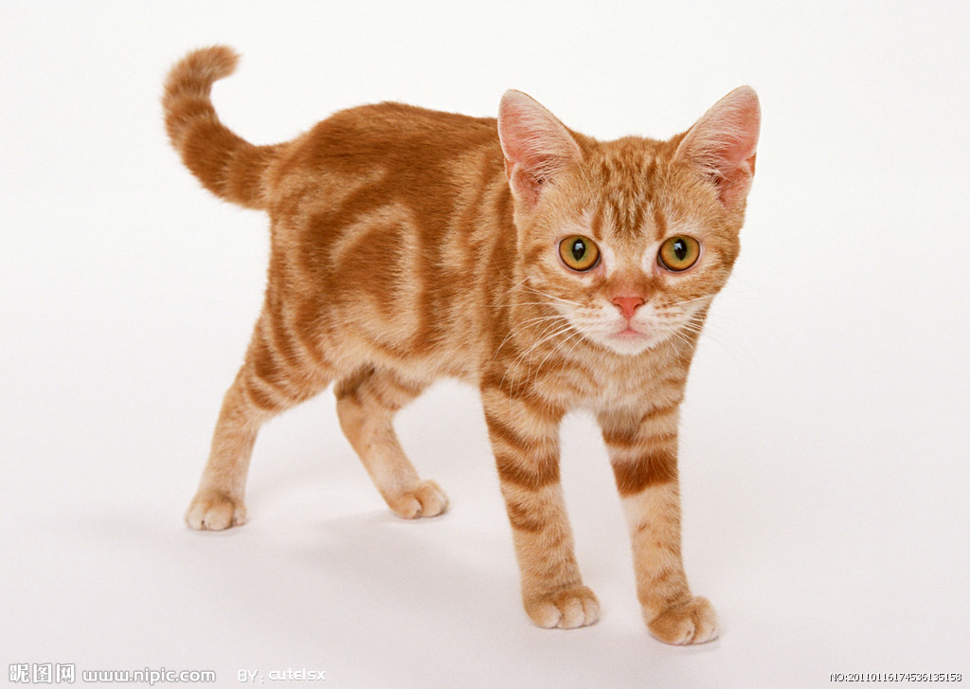
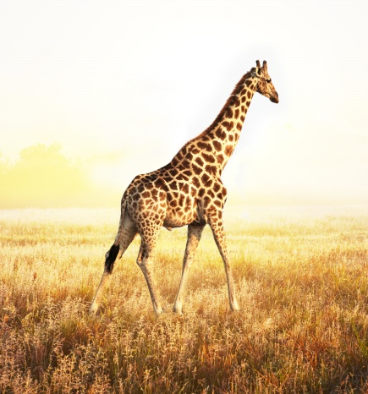
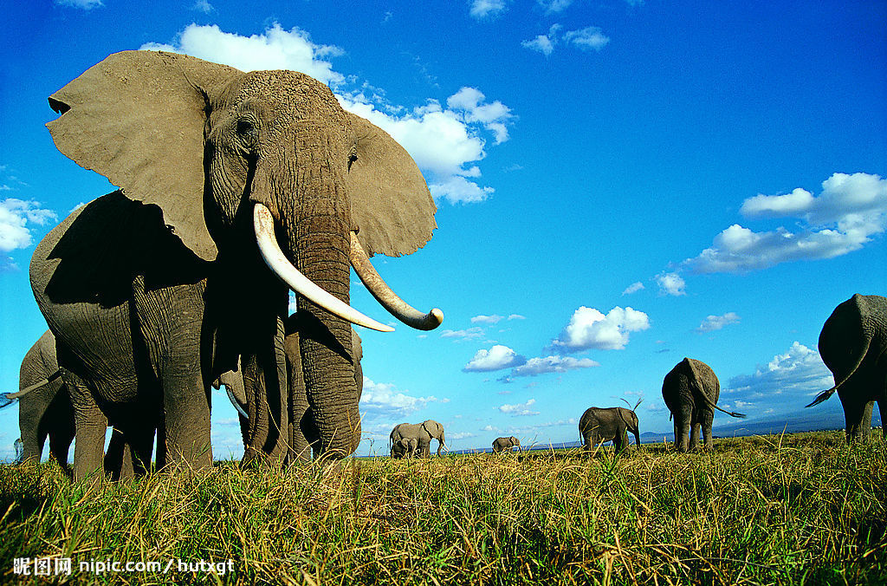
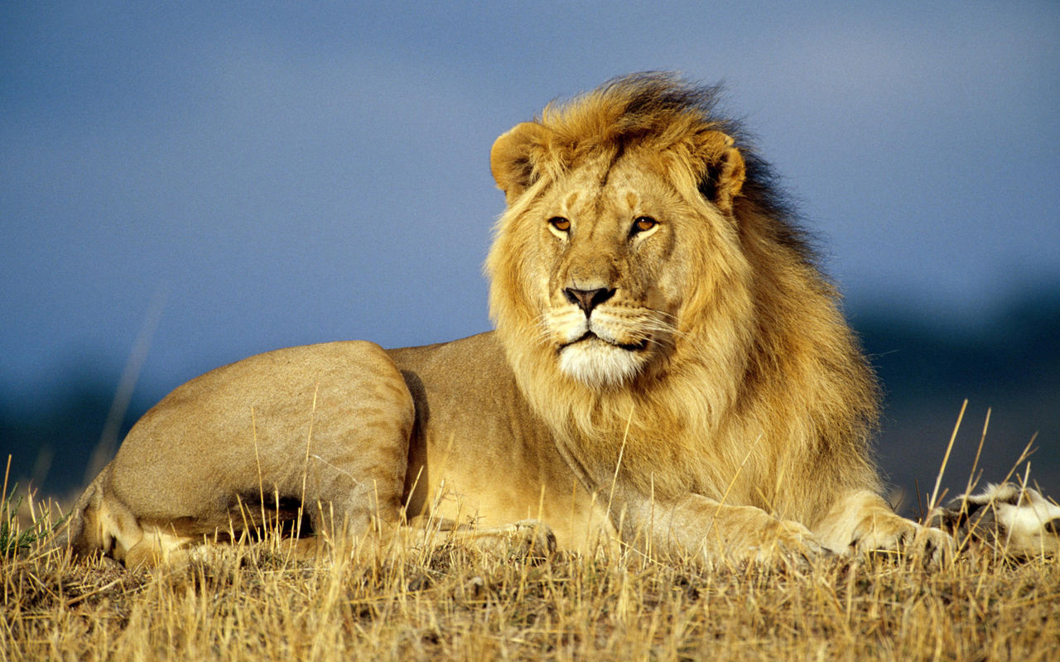
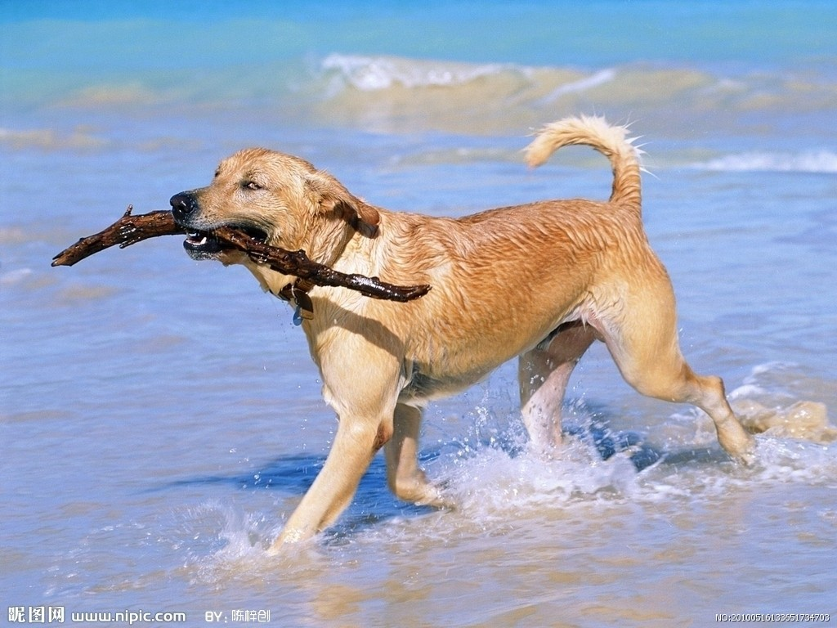
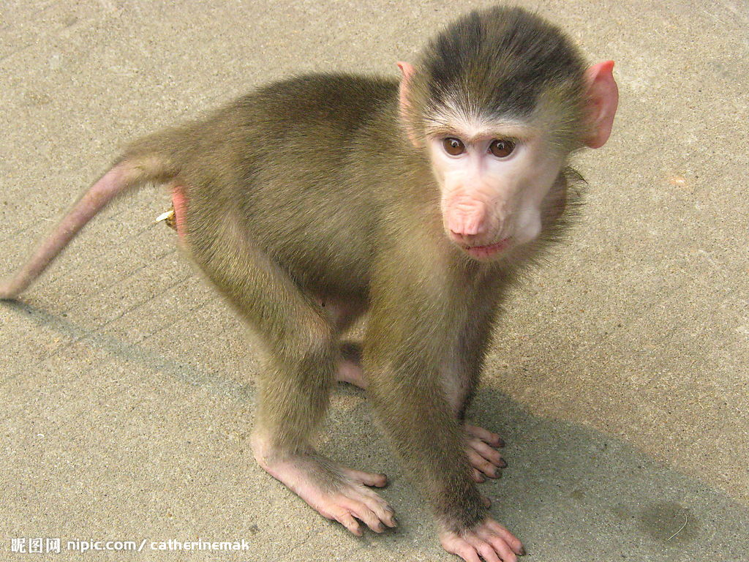
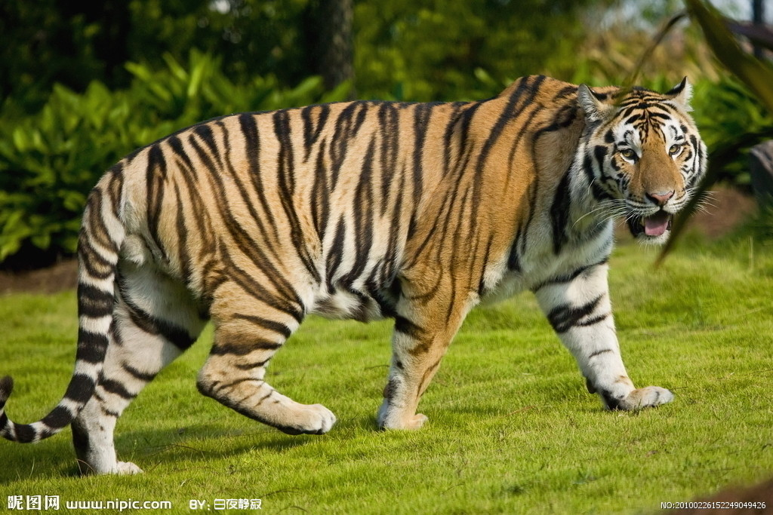
Write names of animals in the blanks to make sentences that are true for you.
3b
I like _____ because they’re cute.
I like _____ because they’re smart.
3. I like _____ because they’re interesting.
4. I don’t like _____ because they’re lazy.

Slide 17
方法指导
回顾一下已经学过的一些动物的英语名称。
dog, cat, tiger, lion, elephant, koala, giraffe ……
2. 看清句中对动物描述的形容词，根据自己的实际想法确定一个动物进行回答。
3. 确认是用名词的复数形式填写。（因为在这里是用名词复数形式来表达这一类动物。）

Slide 18
Check the answers:
1. I like _______ because they’re cute.
2. I like ________ because they’re smart.
3. I like ________ because they’re interesting.
4. I don’t like ____ because they’re lazy.
pandas
elephants
giraffes
cats

Slide 19
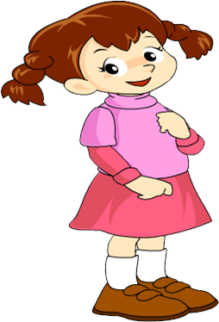
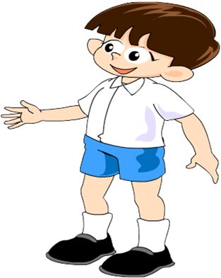
Game
Think of an animal. Ask and answer questions with your partner to guess each other’s animal.
3c
What’s your favorite animal, Tom?
Guess!

Slide 20
Is the animal big?
Yes, it is.
Where is the animal from?
It’s from China.
Is it black and white?
Yes, it is.
Yes, you’re right!
It’s a panda.

Slide 21
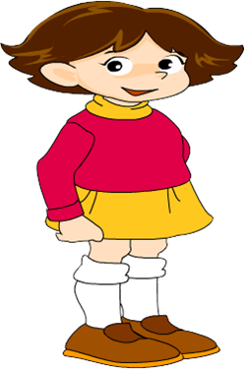
Is the animal smart?
Yes, it is.
It’s from India.
Where is the animal from?
Is it big and fat?
Yes, it is.
Yes, you’re right.
It’s an elephant.

Slide 22
Make a survey about your partners’ favorite animal. Then report it to your group.
Survey
 | Favorite animal | Why | From where | Color
A
B

Slide 23
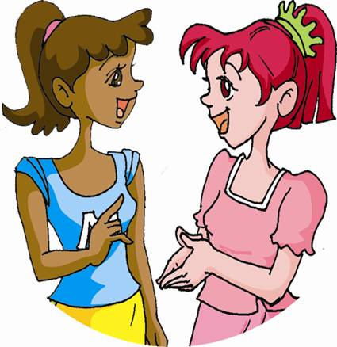
What’s your favorite animal?
My favorite animal is ______.
Why do you like them?
Because they’re ______.
Where are they from?
They’re from _______.
What color are they?
They’re ______.

Slide 24
 | Favorite animal | Why | From where | Color
A
B
elephants
cute
Africa
grey
white and black
pandas
interesting
China

Slide 25
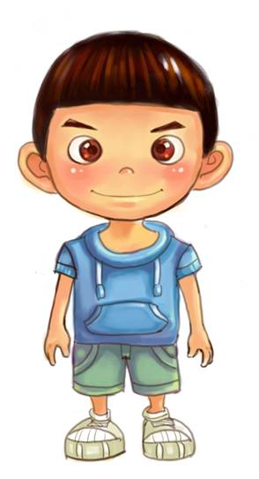
Report
My partner, A’s favorite animal is elephants. He thinks they’re cute. They’re from Africa. They’re grey.
B’s favorite animal is pandas. He thinks they’re interesting. They’re from China. They’re white and black.

Slide 26
Exercise
句型转换。
1. The cats are from Australia. (对划线部分提问)
__________________________________
2. I like pandas because they’re cute. (对划线部分提问) __________________________________
3. My dog can walk on two legs. (对划线部分提问)
__________________________________
Where are the cats from?
Why do you like pandas?
What can your dog do?

Slide 27
4. Linda likes giraffes because they’re fun. (对划线部分提问) ___________________________
5. Eric doesn’t like cats because they’re lazy. (对划线部分提问) ___________________________
Why does Linda like giraffes?
Why doesn’t Eric like cats?

Slide 28
Homework
Remember the sentences in the
Grammar Focus.
2. Write five sentences about your
favorite animals.

