Slide 1
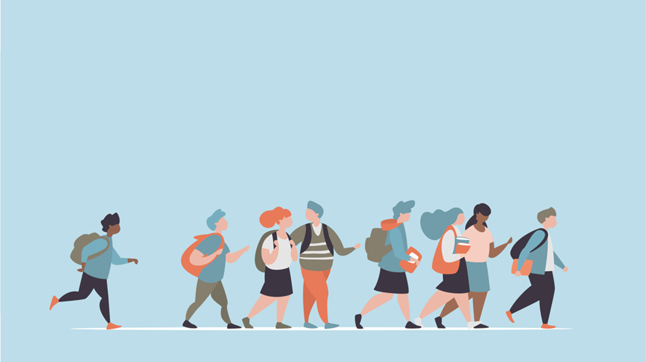
R·九年级全一册
Unit 11 Sad movies make me cry.
第一课时

Slide 2
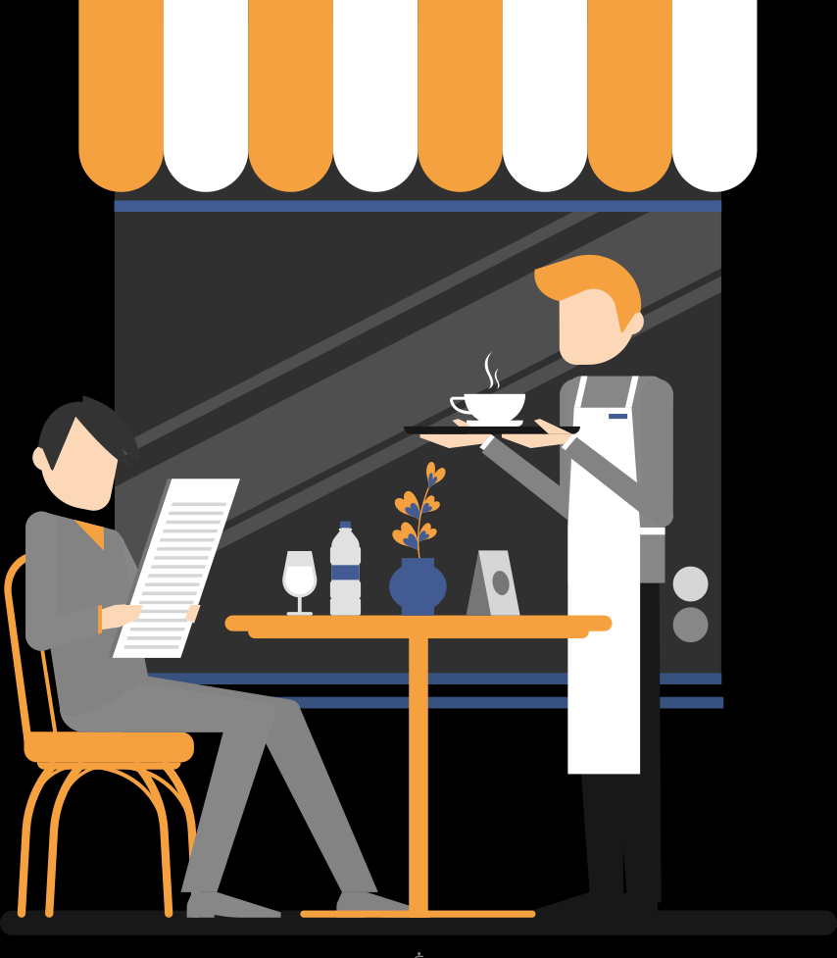
Lead in
How do you choose restaurants?
What do you consider most important when you judge a restaurant?

Slide 3
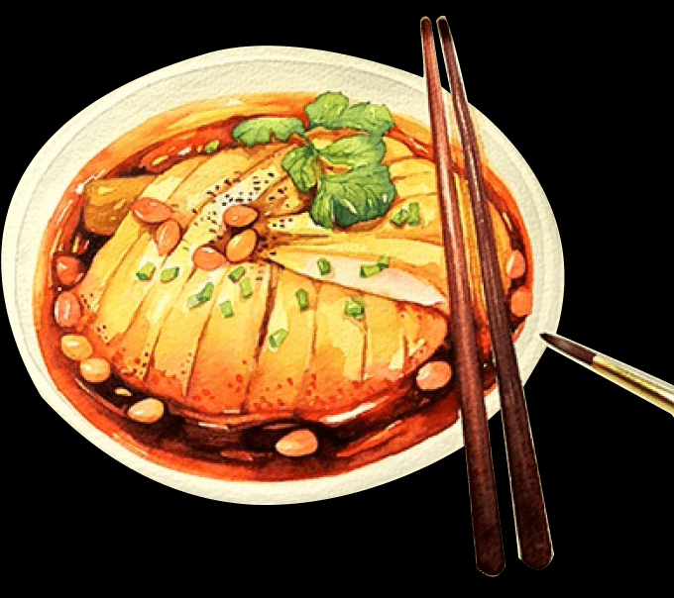
delicious food
great music

Slide 4
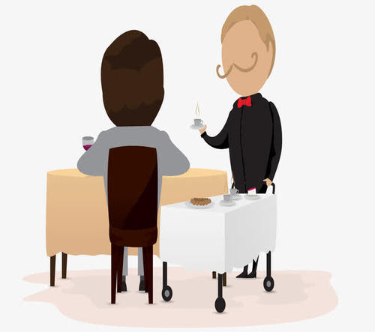
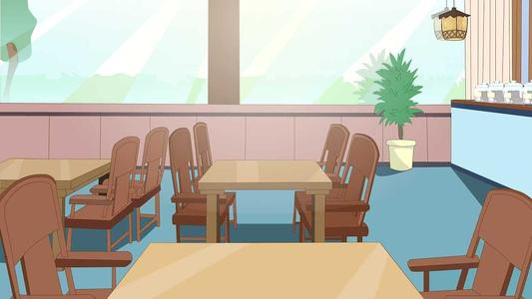
comfortable environment
nice service

Slide 5
Language points
loud music
awful pictures

Slide 6
some plants
comfortable music
relaxed

Slide 7
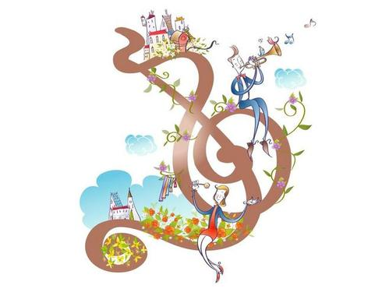
I’d rather go to Blue Ocean
because I like to listen to quiet music while I’m eating.

Slide 8
一、would rather 的用法
1. would rather do sth. 宁愿做某事。
其否定形式为 would rather not do sth.
I’d rather not go to Blue Ocean.

Slide 9
would rather do sth. than do sth.
宁愿做某事而不愿做某事；
would do sth. rather than do sth.
与其做某事不如做某事。

Slide 10
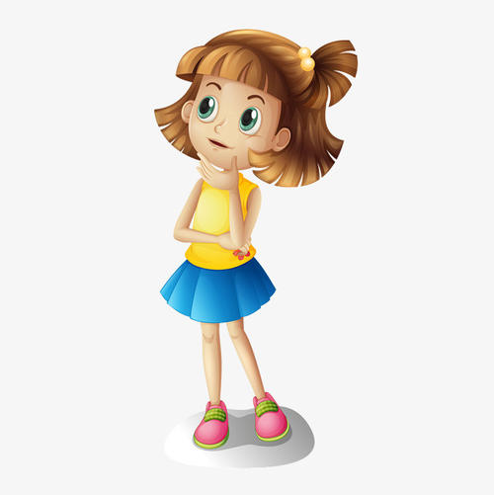
I would rather go home than go to the party.
I would go home rather than go to the party.

Slide 11
2. rather than 与instead of意思相近，但是instead of 后跟名词、代词或v-ing形式，不能跟动词原形。
3. prefer to do... rather than do... “宁愿......而不......”

Slide 12
I would rather do homework than do housework.
I do homework instead of doing housework.
I prefer to do homework rather than do housework.

Slide 13
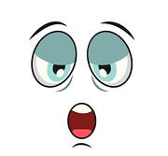
But that music makes me sleepy. I want to have the hamburgers at Rockin’ Restaurant.
makes me sleepy

Slide 14
二、make的用法
当make的意思是“使; 使得”时
make + sb. + adj.
“使某人或某物处于某种状态”

Slide 15
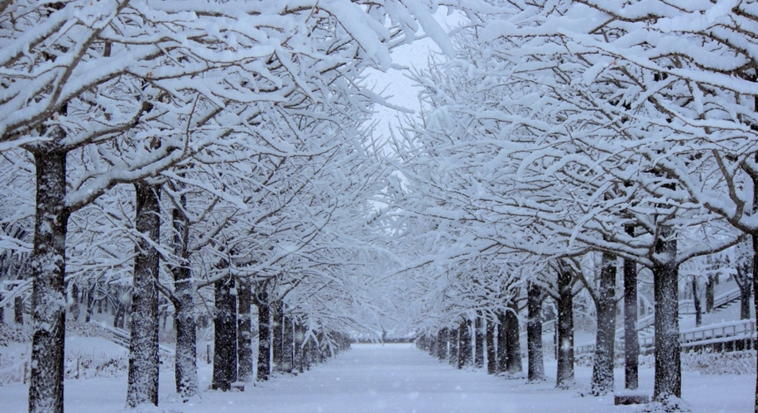
The snow makes the trees white.

Slide 16
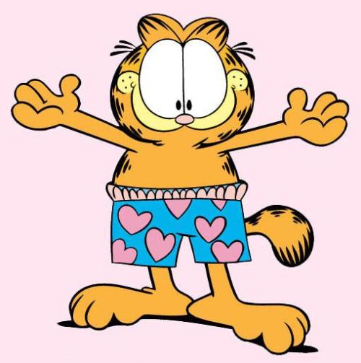
make + sb. do sth.
“使某人做某事”
The cat makes us feel funny.

Slide 17
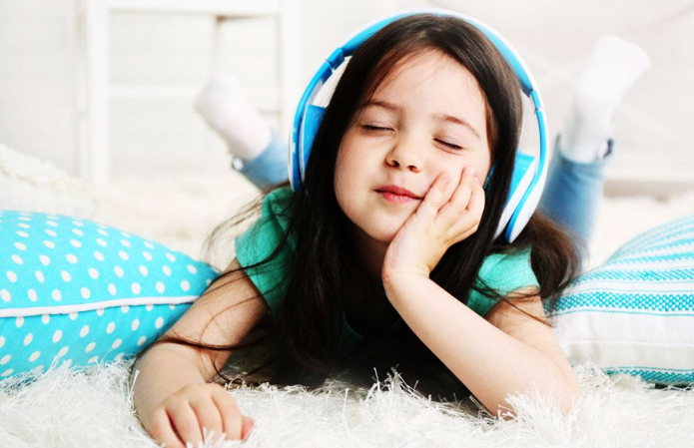
The music makes the girl smile.

Slide 18
Practice
1. 一直等她让我很生气。
Waiting for her drives me angry.
状元成才路
2. 我宁愿待在家里也不愿去购物。
I’d rather stay at home than go shopping.
状元成才路

Slide 19
Summary
1.would rather do sth. 宁愿做某事。
The loud music makes me nervous.
2. Soft and quiet music makes me relax.
3. Money and fame don't always make
people happy.

Slide 20
THANKS

