Slide 1
R·九年级全一册
Unit 2 I think that mooncakes are delicious!
第二课时

Slide 2
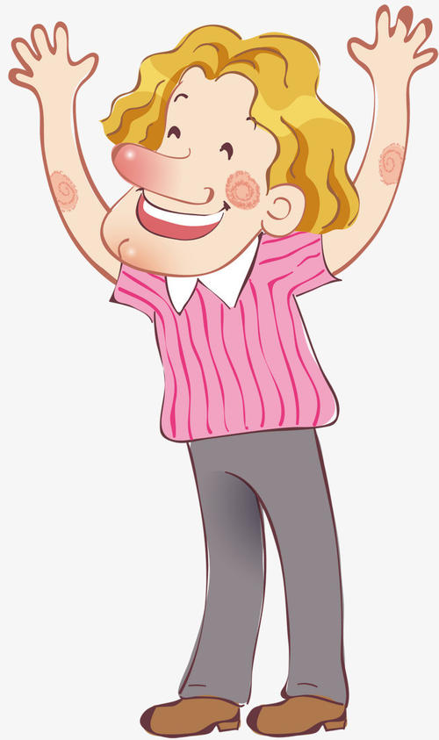
Lead in
I love the races.
I think that they’re
fun to watch.
What a great day! What do you like best?

Slide 3
I love the ice cream mooncakes. I think that they’re special.
How delicious these mooncakes are! What do you like best?

Slide 4
Language points
一、宾语从句的概念
在复合句中，由一个句子充当宾语，这个句子叫做宾语从句。

Slide 5
引导词（连接词）
语 序
时 态
二、宾语从句三要素

Slide 6
由that引导的宾语从句
that在非正式文体中可以省略
宾语从句结构I:
主语+谓语动词+that+宾从(肯定句、否定句)

Slide 7
主语
谓语
宾语从句(否定句)
Bill thinks that the races were not that interesting to watch.

Slide 8
主语
谓语
宾语从句(肯定句)
I know that the Water Festival is really fun.

Slide 9
三、宾语从句的时态
主句使用现在时，从句可使用任何时态；
I think that you are right.
I think that he was wrong.
I think that they have been to Singapore.

Slide 10
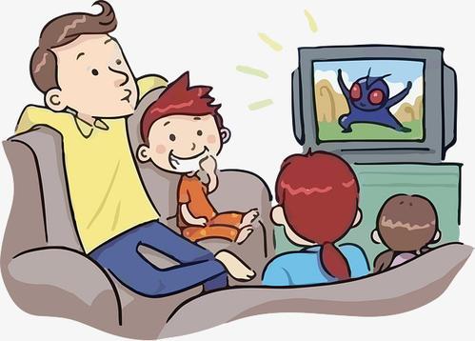
2. 主句使用过去时态，从句一律使用过去时态；
Lin Tao thought the TV play was very interesting.

Slide 11
3. 当宾语从句是客观真理或不可改变的自然现象时，宾语从句须用一般现在时，不受主句时态的限制。
Our teacher told us that light travels faster than sound.

Slide 12
四、由if / whether引导的宾语从句
whether/if不可省略
宾语从句结构 II:
主语+谓语动词+whether/if+宾从(一般疑问句，陈述语序)
由于if和whether连接的是一般疑问句，因此要注意把从句语序改为陈述句语序。

Slide 13
主语
谓语
宾语从句(一般疑问句，陈述语序)
I wonder whether June is a good time to visit Hong Kong.

Slide 14
主语
谓语
宾语从句(一般疑问句，陈述语序)
I wonder if they’ll have the races again next year.

Slide 15
1. 在动词不定式之前只能用whether:
I can’t decide whether to stay.

Slide 16
2. 在 whether … or not 的固定搭配中:
I want to know whether it’s good news or not.

Slide 17
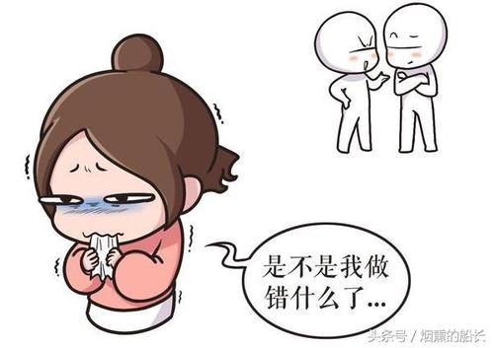
3. 在介词后，只能用whether:
I worry about whether I did something wrong.

Slide 18
4. 宾语从句放在句首表示强调时:
Whether it is true or not, I can’t tell.

Slide 19
Practice
D
1. I don’t know ____ or not he should enter the race.
A. if B. that
C. what D. whether
2. —Let’s go to the community if it ____ tomorrow.
—But nobody knows if it ____ tomorrow.
A. won’t rain; rains B. doesn’t rain; rains
C. doesn’t rain; will rain D. won’t rain; will rain
C

Slide 20
Summary
1. I think that they’ re fun to watch.
2. 宾语从句结构I:
主语+谓语动词+that+宾从(肯定句、否定句)
宾语从句的时态取决于主句的时态。

Slide 21
THANKS

