Slide 1
Unit 10

Slide 2
Unit 10
I'd like some noodles.

Slide 3
Section A 1
1a-2d

Slide 4
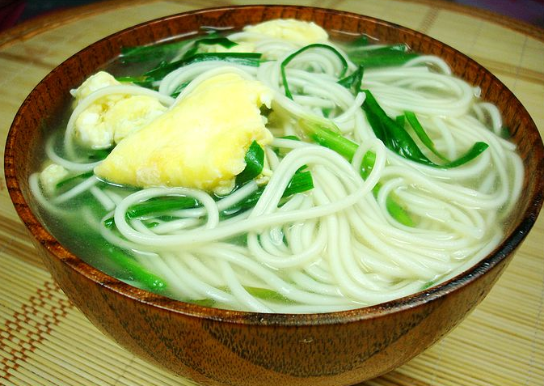
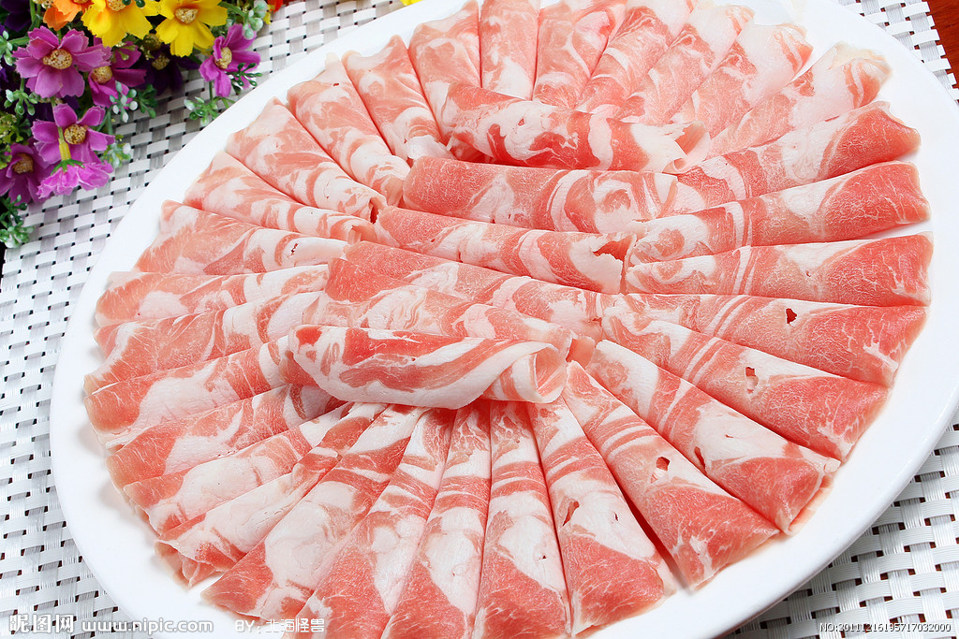
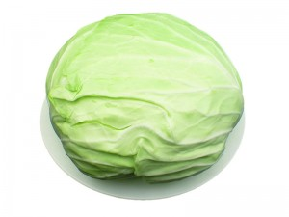
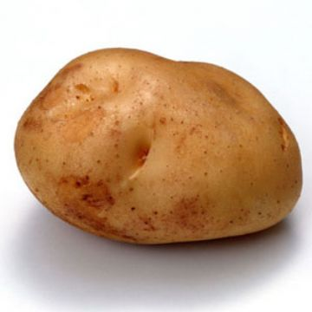
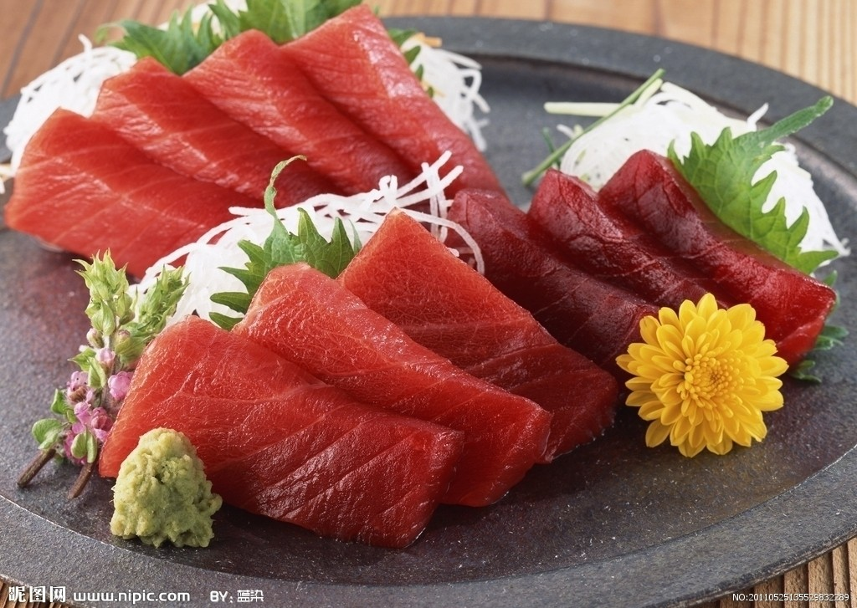
New words
noodle n. 面条
mutton n. 羊肉
cabbage n.
卷心菜; 洋白菜
potato n. 土豆
beef n. 牛肉

Slide 5
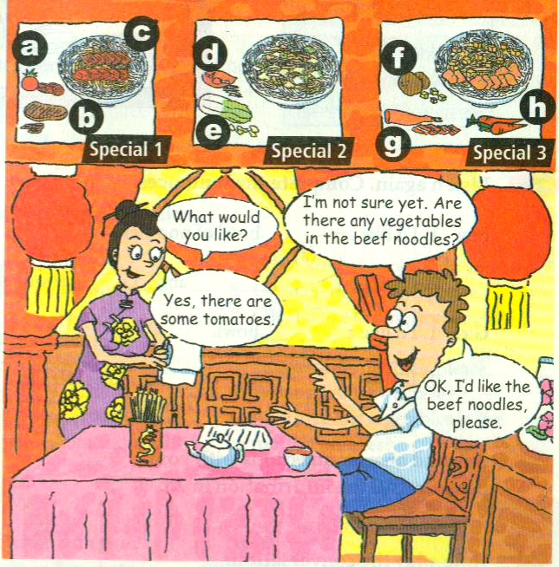
Match the words with the foods.
1a
mutton __
beef __
noodles __
chicken __
cabbage __
potatoes __
tomatoes __
carrots __
g
b
c
d
e
f
a
h

Slide 6
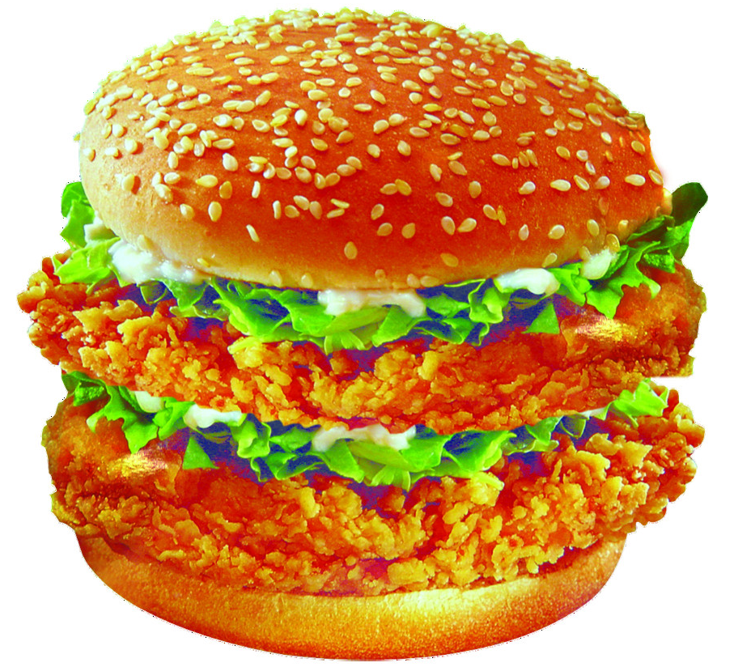
比眼力
What food is it?
It’s a hamburger.

Slide 7
What food is it?
It’s a bowl of egg noodles.

Slide 8
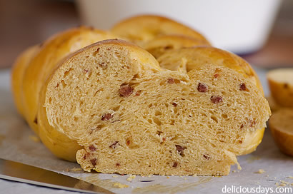
What food is it?
It’s bread.

Slide 9
What food is it?
It’s mutton.

Slide 10
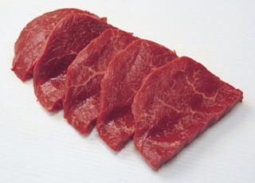
What food is it?
It’s beef.

Slide 11
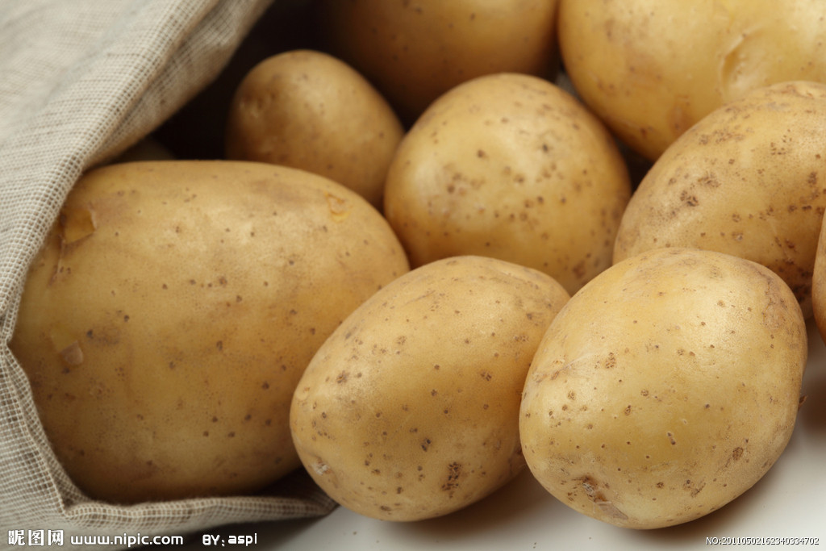
What vegetables are they?
They’re potatoes.

Slide 12
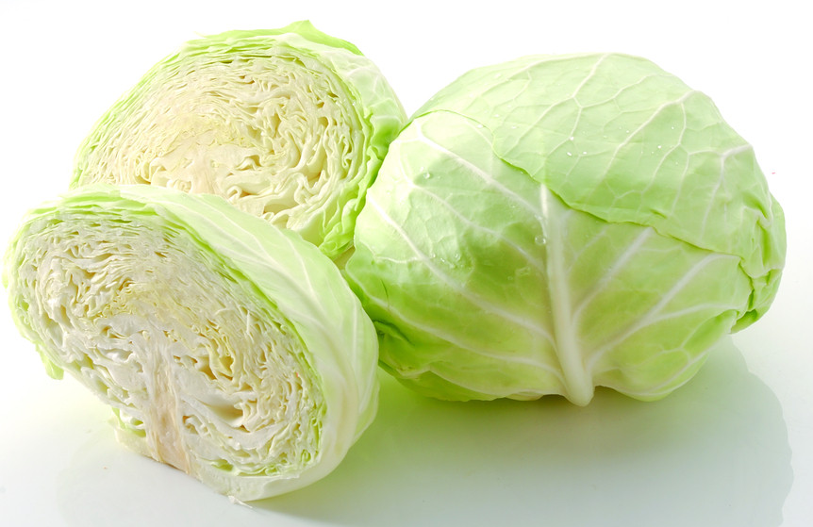
What vegetables are they?
They’re cabbages.

Slide 13
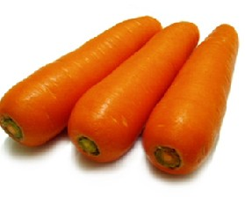
What vegetables are they?
They’re carrots.

Slide 14
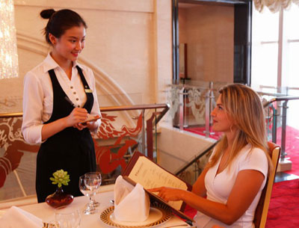
Presentation
What would you like?
I’d like some egg noodles?

Slide 15
Listen and check (√) the noodles that the person orders.
Listening
1b
√
____ Special 1
____ Special 2
____ Special 3

Slide 16
Pairwork
1c
Practice the conversation in 1a with your partner. Then make your own conversations.

Slide 17
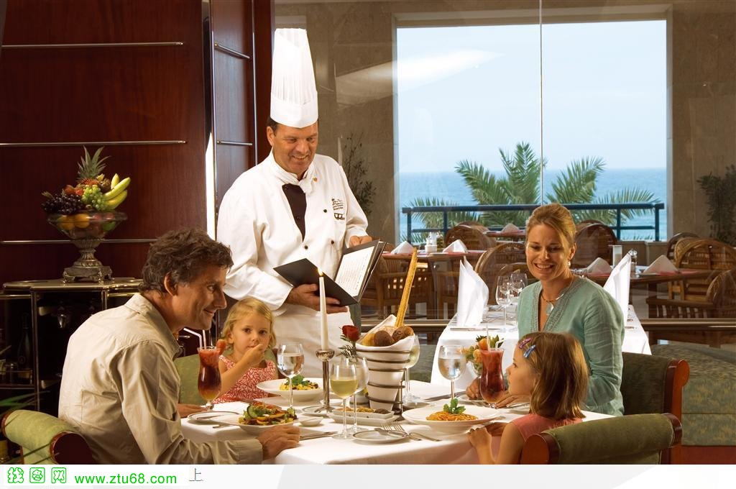
What would you like?
I’m not sure yet. Are there any vegetables in the beef noodles?
Yes, there are some tomatoes.
OK. I’d like the beef noodles.

Slide 18
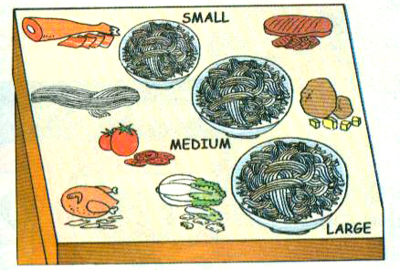
2a
Listening
1. __ noodles
2. __ beef
3. __ mutton
4. __ chicken
5. __ tomatoes
6. __ cabbage
7. __ potatoes
8. __ vegetables
Listen and check (√) the names of the foods in the box.
√
√
√
√
√
√

Slide 19
Listen again. Complete the sentences.
2b
Boy: 1. I’d like a ______ bowl of noodles.
2. I’d like _______, ______ and
________ noodles.
large
chicken potato
cabbage
Girls: 1. I’d like a _________ bowl.
2. I’d like _____ and ________ noodles, please.
medium
beef tomato

Slide 20
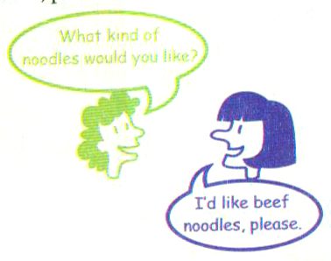
Pairwork
Ask and answer questions with your partner. Use the information in 2a.
2c

Slide 21
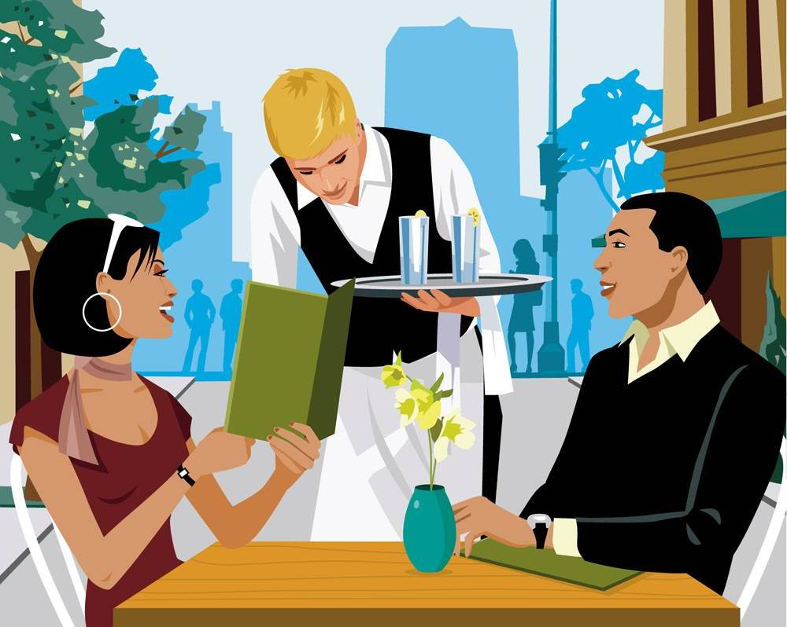
What size would you like?
I’d like a large bowl of noodles.
And what kind of noodles would you like?
I’d like chicken, potato and cabbage noodles.

Slide 22
What size would you like?
I’d like a medium bowl.
What kind of noodles would you like?
I’d like beef and potato noodles.

Slide 23
What size would you like?
I’d like a small bowl.
I’d like mutton and cabbage noodles.
What kind of noodles would you like?

Slide 24
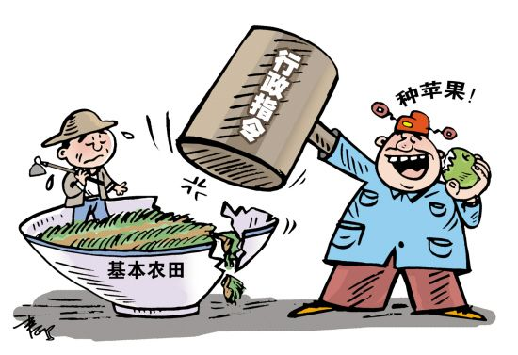
New words
order n. & v. 点菜；命令
take one’s order 点菜

Slide 25
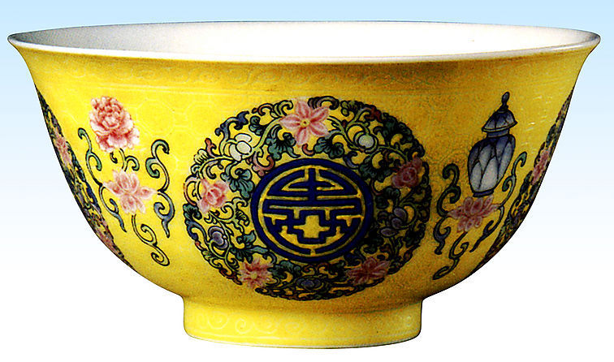
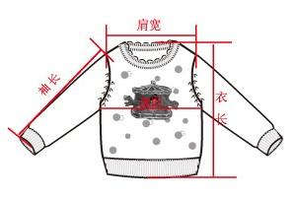
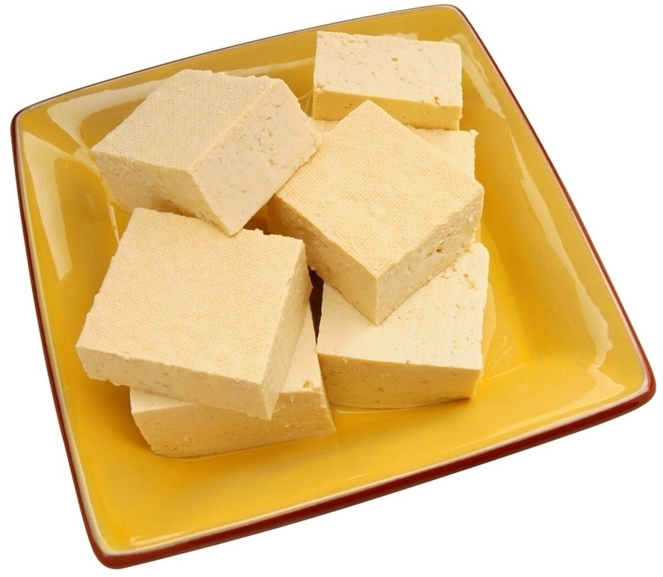
bowl n. 碗
one (large) bowl of ... 一(大)碗 ......
size n. 大小；尺码
tofu n. 豆腐

Slide 26
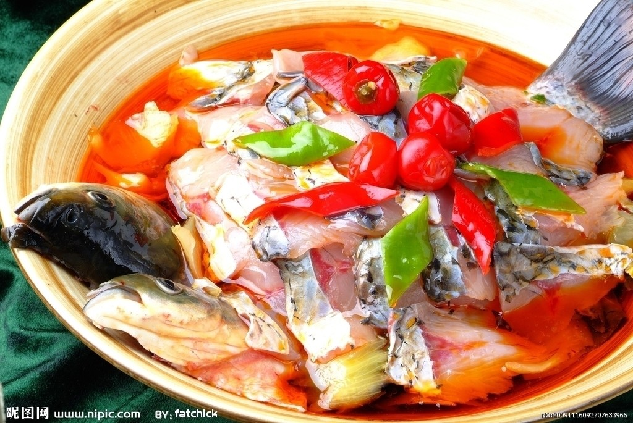
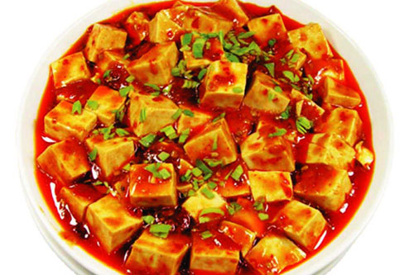
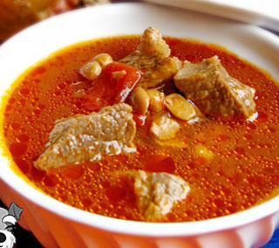
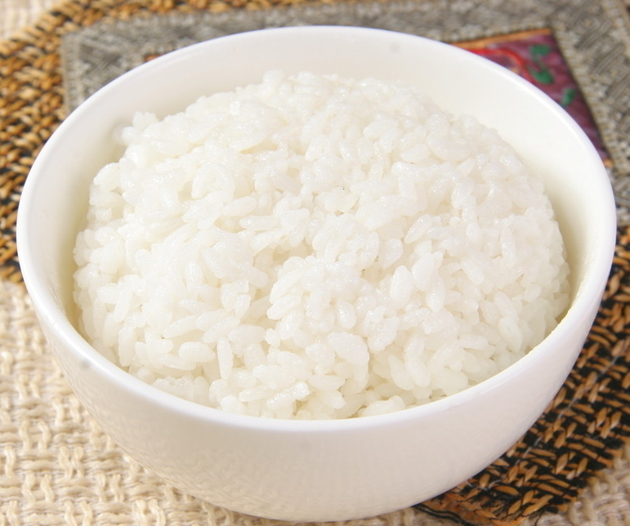
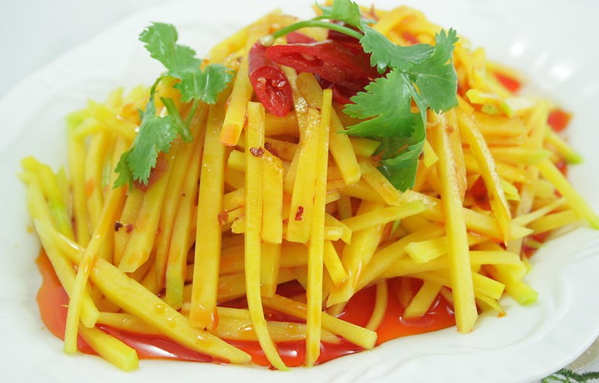
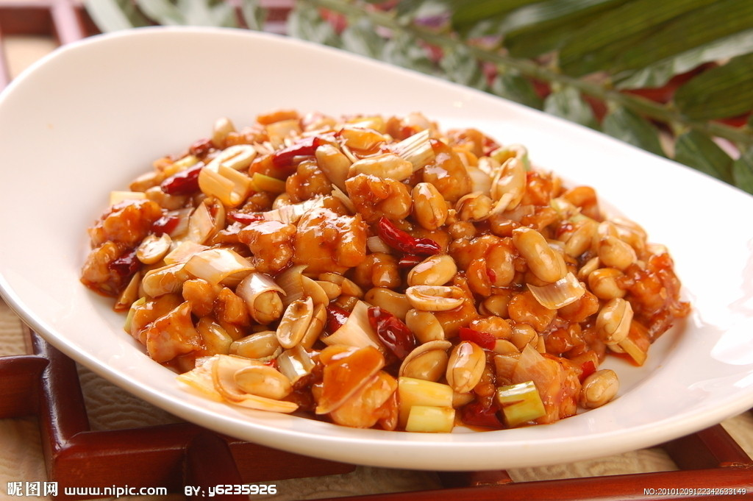
Reading
2d
Read the conversation in 2d and check their food.
√
√
√
√

Slide 27
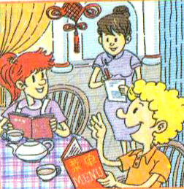
Role-play
2d
Role-play the conversation.
Waiter: Good afternoon. May I
take your order?
Sally: Yes. Are there any vegetables in the beef soup?
Waiter: Yes. There are some tomatoes.
Sally: OK. We’d like one bowl of beef soup.
Waiter: Sure. What size would you like?

Slide 28
Sally: Large, please.
Tom: We’d also like gongbao chicken and some mapo tofu with rice.
Waiter: OK. One large bowl of beef soup, one gongbao chicken, and one mapo tofu with rice.
Tom: Yes, that’s right.

Slide 29
Language points
What kind of noodles would you like?
would like表示“想要”，与want同义，但比want更委婉。would like中的would可缩写为’d。would like没有人称和数的变化，后面可接名词，可用于would like to do sth.结构中，表示“愿意做某事”，还可用于would like sb. to do sth.，表示“想让某人做某事”。如：

Slide 30
I would / I’d like a small bowl of soup.
我想要一小碗汤。
She would / She’d like to play tennis.
她想打网球。
My father would like me to go home early.
我爸爸想让我早点回家。

Slide 31
Would you like sth.?(你想要……吗？)常用来委婉地提供帮助。其肯定回答常用Yes, please等；其否定回答常用No, thanks等。如：
— Would you like mutton noodles?
你想要羊肉面吗？
— Yes, please. / No, thanks.
是的。/ 不，谢谢。

Slide 32
【运用】
根据各题后括号内的要求完成下列各题。
(1) The girl wants some orange juice. (改为同义句)
__________________________________
(2) Would you like some dumplings? (作肯定及否定回答)
__________________________________
The girl would like some orange juice.
Yes, please./ No, thanks.

Slide 33
(3) 她愿意在数学方面帮助我。(翻译成英语)
__________________________________(4) 我想让我朋友和我打篮球。(翻译成英语)
__________________________________
__________________________________
She would like to help me with my math.
I want / would like my friend to play basketball with me.

Slide 34
2. May I take your order?
你可以点菜了吗？
也可以说“Can I take (have) your order?”, “Are you ready to order?”这些都是服务 员请客人点菜的礼貌用语。如：
— May I take your order?
— Yes. I’d like some mapo tofu with rice.

Slide 35
3. a bowl of 一碗……
two bowls of 两碗……
e.g. I’d like a bowl of beef cabbage noodles.
我想要一碗牛肉洋白菜面。
We’d like two bowls of mutton carrots soup.
我们想要两碗羊肉胡萝卜汤。

Slide 36
Exercise
补全下列对话。
Waiter: May I take your ______?
Jack: Yes. Are there any _________ in the mutton soup?
Waiter: Yes. There ____ some carrots.
Jack: OK. Can I have one ______ ____ mutton soup, please.
order
vegetables
are
bowl
of

Slide 37
Waiter: Sure. What ______ _______ your like?
Jack: Large, please. I’d also like some gongbao chicken _______ rice.
Waiter: OK. One bowl of mutton soup and some gongbao chicken
with rice.
size
would
with

Slide 38
Homework
记忆本节课所学的表示食物的词汇。
与伙伴表演2d中的对话，并模仿这个对话表演一个在饭店点菜的场景。

Slide 39
Thank you!

