Slide 1
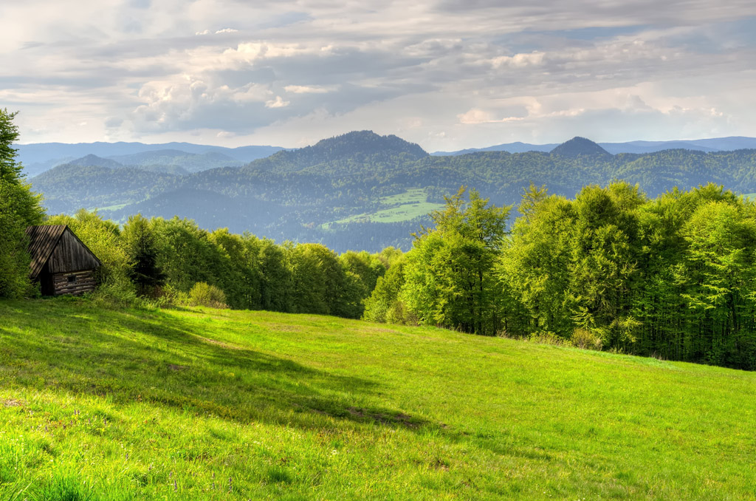
Unit 5
Into the unknown

Slide 2
内容索引
Period Three Using language & Developing ideas
语篇理解 精读演练 萃取文本精华
基础自测 自主学习 落实基础知识
互动探究 探究重点 互动撞击思维
达标检测 当堂检测 基础达标演练

Slide 3
语 篇 理 解
精读演练 萃取文本精华
Ⅰ.Read the passage quickly and get the general idea of the passage.
1.What’s the main idea of the passage?
A.There are millions of shipwrecks lying under waters.
B.Human’s exploration deep into the sea.
C.The tough environment of the sea bed.
D.Some new discoveries made by the scientists in the deep sea.
√

Slide 4
2.Read the passage and match the main idea of each paragraph.
Para.1 A.We are entering a new age of oceanic discovery.
Para.2 B.We have little knowledge of Earth’s sea bed.
Para.3 C.Many archaeological finds are made in shallow waters.
Para.4 D.There are extraordinary creatures in the deep sea.
Para.5 E.The oceans are a valuable source of natral resources.

Slide 5
Ⅱ.Read the passage carefully and choose the best answer.
1.What challenges must scientists overcome if they dive deep into the sea?
A.The high pressure of the water.
B.The darkness under the water.
C.The extreme cold under the sea.
D.All the above.
√

Slide 6
2.What possibly caused the city of Neápolis to be buried underwater?
A.A tsunami. B.An earthquake.
C.A serious flood. D.A volcano eruption.
√

Slide 7
3.What can’t we see in the waters more than 200 metres deep?
A.Strange creatures. B.Corals.
C.Light. D.The barreleyes.
√

Slide 8
4.Which of the following is TRUE according to the passage?
A.We have known more about the earth than the moon.
B.Even a whole city may be buried under the waters.
C.Most of the fishes live in shallow waters.
D.Humans have reached the deepest area of the ocean in a submarine(潜艇).
√
返 回

Slide 9
基 础 自 测
自主学习 落实基础知识
重点单词
1. n.逃跑，逃走
2. v.后退；离开；退避
3. v.克制，抑制(情绪)
4. adj.地图上没有标明的
5. v.探索，探究
6. v.退缩，畏缩
7. adj.考古学的；考古的
8. n.珊瑚
9. n.毫米
getaway
retreat
subdue
uncharted
delve
shrink
archaeological
coral
millimetre

Slide 10
10. adv.向上，朝上
11. n.海沟
12. adj.等同的；等值的；相当的
13. v.(使)整齐地堆起；摞起
14. adv.此外；而且；不仅如此
15. adj.显要的；显著的；值得注意的
16. n.物质
17. n.船；舰
upwards
trench
equivalent
stack
furthermore
notable
substance
vessel

Slide 11
18. n.调查
→ v.调查；研究；审查^{①}
19. n.钻探；勘探
→ v.钻孔；打眼；操练^{②}
investigation
investigate
drilling
drill

Slide 12
掌握规律 巧记单词
①investigate v.调查；研究；审查＋tion→investigation n.调查
例如：prediction n.预言；预测 correction n.更正 devotion n.奉献 operation n.操作；手术
②drill v.钻孔；打眼；操练＋ing→drilling n.钻探；勘探
例如：shopping n.购物 engineering n.工程学
ending n.结局 beginning n.开端；开始

Slide 13
核心短语
1. 逃跑，逃走
2. 逃命
3. 调查，检查
4. 试水，试探
5. 避开……；从……处脱身
6. 动身踏上(漫长的)旅途
7. 积极投入到……中去
8. 再三考虑，慎重考虑
9. 避免做，不愿做
10. 调查(问题)
make a getaway
run for one’s life
check out
test the waters
steer clear of
set out
throw oneself into
think twice
shrink from
look into

Slide 14
经典句式
1.分词位于句首的完全倒装句
an estimated three million shipwrecks.
据估计，全世界的海底有300万艘沉船。
2.if省略结构
Today，some 500 years after the Esmeralda set sail，there is little— —land on our planet left unexplored.
今天，在“埃斯梅拉达”号起航约500年后，我们的星球上几乎没有未被探索过的陆地。
Lying under waters across the globe are
if any

Slide 15
3.过去分词短语作定语；现在分词短语作结果状语
The research is giving scientists a greater understanding of how the sea bed was formed，as well as helping identify areas for deep-sea drilling， .
这些船只进行的研究使科学家们对海床的形成有了更深入的了解，并帮助确定了深海钻探的区域，使深海勘探进入了一个全新的时代。
4.as...as...和……一样……
...and the world beneath the waves may one day be almost _________________
the land we walk upon today.……
也许有一天，我们对海底世界会像对今天所走的陆地一样熟悉。
conducted by these vessels
taking deep-sea exploration into a whole new era
as familiar to us as
返 回

Slide 16
互 动 探 究
探究重点 互动撞击思维
重点词汇
So while you may be tempted to check out a strange object or to test the waters of a new situation，it can be safer to steer clear of the unfamiliar.所以，虽然你可能会被一个陌生的物体所诱惑，或者尝试一个新环境的水域，但避开不熟悉的东西会更安全。
1
check out调查；检查；结账离开；(把钱等)取出

Slide 17
[写出下列句子中check out的汉语意思]
(1)She checked out 3,000 yuan from the bank yesterday to buy a TV set.
____________
(2)The accountant checked out the bills and found them OK. ___________
(3)We loaded the car while Dad checked out at the desk. _____
(把钱等)取出
检查，核对
结账

Slide 18
※check in(在旅馆、机场等)登记，报到
check up核对；检验
※pay by check用支票付款
make/have a check (of)核对
(4)Brain needed to meet a friend named Tony before he for his flight.
布莱恩在办理登机手续前需要见一个叫托尼的朋友。
(5)I will just to see if the letter has arrived yet.
我要快速地查一下，看看那封信是否已经到了。
(6)I haven’t any cash on me；can I pay ?
我身上没带现金，可以用支票付款吗？
checked in
make/have a quick check
by check

Slide 19
In more recent times，Norwegian explorer，Roald Amundsen endured one of the most hostile environments on Earth when he set out into uncharted territory to reach the South Pole.在近代，挪威探险家罗尔德·阿蒙森为了到达南极，进入了一片未知的领域，忍受了地球上最恶劣的环境之一。
2
set out出发(for)；着手(to do)；安排
set about (doing sth. )开始；着手(做某事)
set aside将……放在一边；省出或留出(钱或时间)
set up创建；建立；开办
set down写下，记下
set off点燃；使……爆炸；出发，动身；引起

Slide 20
(1)Success is the result of devoting your time and energy to what you’ve set out to do.
成功是把你的时间和精力投入到你已经开始做的事情上的结果。
(2)After the earthquake，people set about (rebuild) their homes.
地震过后，人们开始重建家园。
(3)She her work and began to read the new novel.
她把工作放在一边，开始看这本新小说。
(4)The young man distinguished himself by his own company.
这个年轻人通过创建自己的公司而出名。
(5)A letter from his hometown his homesickness the other day.
不久前的一天，来自家乡的一封信引发了他的乡愁。
rebuilding
set aside
setting up
set off

Slide 21
Of course，exploration doesn’t have to mean blindly throwing ourselves into the unknown，and it’s never wrong to think twice before taking action.当然，探索并不意味着盲目地投入到未知的世界，在采取行动之前三思是没有错的。
3
throw oneself into积极投入到……中去
throw away抛弃；扔掉
throw off脱去
throw up举起；呕吐
throw out抛出；扔出去
throw oneself on扑倒在……上；完全依赖

Slide 22
(1)So，a lot of young people throw themselves into the voluntary work in hospitals actively.
因此，很多年轻人积极投身于医院的志愿工作。
(2)People are recycling many things which they would have in the past.
人们正在回收利用许多他们在过去会扔掉的东西。
(3)Protect the water environment consciously；and don’t peels，paper scraps，etc.
自觉保护水环境；不要乱扔果皮、纸屑等。
(4)So many times I’ve had to run off to the bathroom and .
很多次我不得不跑到厕所去呕吐。
thrown away
throw out
throw up

Slide 23
While there is no need for us to shrink from new situations，we should always look into things first and consider our options.虽然我们没有必要在新情况下退缩，但我们应该总是先把事情调查清楚，然后再考虑我们的选择。
4
shrink v.退缩，畏缩 (shrank/shrunk；shrunk/shrunken)
n.收缩，皱缩，缩水，萎缩
shrink from因害怕而避开
shrink with因……收缩

Slide 24
(1)Can you tell me whether this woolen sweater will shrink when washed?
你能告诉我这件羊毛衫洗后会缩水吗？
(2)In a sense the Internet the world where we are living.
从某种意义上说，互联网已经缩小了我们生活的世界。
(3)A brave fighter never danger in doing a difficult task.
一个英勇的战士在执行困难任务时决不害怕危险。
(4)The girl selling matches in the street .
街上太冷了，卖火柴的女孩把身子蜷缩起来。
has shrunk
shrinks from
shrank with cold

Slide 25
look into调查；审查；研究
look ahead (to sth. ) 向前看(某物)；为将来打算
look down upon/on看不起，轻视
look forward to盼望；期望
look out (for)当心，注意，提防
look through快速查看；浏览
look up往上看；查阅
look up to尊敬，敬仰

Slide 26
(5)The police have received the complaint，and now they are looking into it.
警察已接到了举报，现在正在调查这件事。
(6)I’m looking forward to (hear) the good news.
我盼望着听到好消息。
(7)The time has come when we should the future.
我们是时候来设想一下未来了。
(8)Her mother tells her not to the poor.
她妈妈告诉她不要看不起穷人。
(9)That we each should the old is our Chinese traditional virtue.
我们每个人都要尊重老人，这是中国的传统美德。
hearing
look ahead to
look down upon/on
look up to

Slide 27
经典句式
Lying under waters across the globe are an estimated three million shipwrecks.据估计，全世界的海底有300万艘沉船。
1
本句是一个完全倒装句，正常语序应该是An estimated three million shipwrecks are lying under waters across the globe.构成进行时态的现在分词、作表语的过去分词、形容词或副词，有时可以移到句首，对动作或状态加以强调。

Slide 28
(1)Lying on the floor was a wounded peasant boy.
躺在地板上的是一个受伤的农家男孩。
(2) was a famous scientist from Australia.
站在报告厅前面的是一位来自澳大利亚的著名科学家。
(3) was a king who died more than 2,000 years ago.
埋葬在这座坟墓里的是一位2 000多年前死去的一个国王。
Standing in the front of the lecture hall
Buried in the tomb

Slide 29
Today，some 500 years after the Esmeralda set sail，there is little—if any—land on our planet left unexplored.今天，在“埃斯梅拉达”号起航约500年后，我们的星球上几乎没有未被探索过的陆地。
2
本句中 if any 为一种省略形式，补充完整是 if there is any表示“如果有的话”。常见的if条件状语从句的省略结构有：
if so如果是这样的话
if not如果没有
if ever如果有过/发生过的话
if possible如果可能的话
if necessary如果有必要的话

Slide 30
(1)Please help me to correct the spelling mistakes，if any(if there are any), in my composition.
请帮我改正我作文中的拼写错误，如果有的话。
(2) ，you must go back and get it.
如果是这样的话，你必须回去把它取来。
(3)Find a neighbor or someone else to help， .
如果可能的话，找个邻居或者其他人帮助。
If so
if possible
返 回

Slide 31
达 标 检 测
当堂检测 基础达标演练
Ⅰ.单句语法填空
1.Women have grown tired of being looked down by employers.
2.Set some time each day to write something，even if it is only five minutes.
3.I threw myself heartily my work for the rest of the school year.There is little time left.
4. (seat) at the back of the classroom are some teachers from Hongxing Middle School.
on/upon
aside
into
Seated

Slide 32
5.How many delegates(代表团) have checked for the conference so far? I want the exact number.
6.To the disappointment of the people of the nation，the economy is _________
(shrink) instead of growing.
in
shrinking

Slide 33
Ⅱ.完成句子
7.Brian rarely, ，goes to bed before 11∶00 p.m.
布莱恩很少在晚上11点之前睡觉。
8.The early morning mist had cleared .
在我们动身前，清晨的薄雾就消散了。
9.This is a great place for camping but you have to snakes.
这是个野营的好地方，但你必须当心蛇。
10. are some exchange students from England.
站在我们前面的是一些来自英国的交换生。
if ever
before we set out
look out for
Standing in front of us

Slide 34
11.When you’ve finished with your breakfast banana，don’t the peel.
当你吃完早餐的香蕉时，不要扔掉香蕉皮。
throw away

Slide 35
Ⅲ.选词填空
下面的短文是P56－57的课文改写，请从下表中选择合适的词汇并用其适当的形式完成此文。
resource；detail；vast；take；furthermore；despite；exist；cooperation
Although we have had more 12. maps of the universe，we still have limited knowledge of the sea bed under the 13. waters of the oceans.In reality，there 14. life in the dark zones of the oceans,15. the high pressure，darkness，and extreme cold.16. ，the oceans are a valuable source of natural 17. .With international 18. ，humans are diving deeper and deeper into the oceans with the help of modern vessels,19. deep-sea exploration into a whole new era.
detailed
vast
exists
despite
Furthermore
resources
cooperation
taking
返 回

Slide 36
本课结束

