Slide 1
Unit 12

Slide 2
Unit 12
What did you do
last weekend?

Slide 3
Section A 2
Grammar focus - 3c

Slide 4
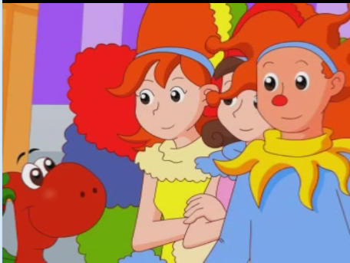
Let's watch and learn!

Slide 5
Grammar focus
阅读Grammar Focus部分，完成下列句子。
上个周末你做什么了？
___________________________
2. 我做了我的家庭作业。 __________________
What did you do last weekend?
I did my homework.

Slide 6
我们去划船了。_______________
谁去探望了她的奶奶？
_______________________
5. 是蓓基？_________
上个周末她去了哪里？ ___________________________
We went boating.
Who visited her grandma?
Becky did.
Where did she go last weekend?

Slide 7
7. 她去了农场。
____________________________
8. 她和谁一起去的？
____________________________
9. 她和她的同学们一起去的。
____________________________
She went to the farm.
Who did she go with?
She went with her classmates.

Slide 8
探究乐园
一、一般过去时态的特殊疑问句。
1. 特殊疑问词 + was/were + 主语 + 其他？
上个周末你过得怎么样？
_____ ____ your last weekend?
How was

Slide 9
昨天下午他们在哪里？
_______ _____ they yesterday afternoon?
昨天晚上谁在教室里？
____ ____ in the classroom last night?
昨天你为什么迟到了?
_____ _____ you late yesterday?
Where were
Who was
Why were

Slide 10
2. 特殊疑问词 + did + 动词原形 + 主语 +其他？
昨天他做了什么事情？
_____ ____ he do yesterday?
上个周末她参观了什么地方？
______ ____ she _____ last weekend?
你和谁一起去的动物园？
____ ____ you go to the zoo _____?
他们什么时候到达北京的？
_____ ____ they arrive in Beijing?
What did
Where did visit
Who did with
When did

Slide 11
练一练
对下列句子中的划线部分提问。
1. I got up at nine yesterday morning.
______ ____ you get up yesterday morning?
2. We did our homework last night.
_____ ____ you ___ last night?
When did
What did do

Slide 12
3. They were in the supermarket last Sunday.
_______ _____ they last Sunday?
4. My last weekend was kind of boring.
_____ _____ your last weekend?
Linda took a walk with her parents after dinner.
_____ ____ Linda take a walk with after dinner?
Where were
How was
Who did

Slide 13
Writing
Fill in the blanks with who, what, where or how.
3a
A: ______ did you do last weekend?
B: I played badminton on Saturday.
A: Sounds fun! _____ did you play with?
B: I played with my father. He’s really good!
What
Who

Slide 14
指导
此类填空题，应主要根据答语的意思来确定问句中所缺的特殊疑问词是什么。第一句的答语是一活动，故第一空格处应填what；第二句答语强调了人物，故问句中的特殊词为who。

Slide 15
2. A: _____ was your weekend?
B: It was great! I had so much fun!
A: _______ did you go?
B: The weather was beautiful, so I
went to the beach with my
parents.
How
Where

Slide 16
指导
第一句的答语意为“很棒”，故问句应是询问周末过得怎么样。因此应填How；
第二句答语回答了与父母亲去了海滩一事，故问句中应是询问地点，且问句中没有介词with (与……一起)，因此应填where。

Slide 17
3. A: ______ did Jim lose?
B: He lost his keys. He often loses things.
A: That’s too bad. ______ did he lose them?
B: I heard it was yesterday.
What
When

Slide 18
指导
第一句的答语意为“他丢了他的钥匙”，再由问句中有lose一词，可知问句应是询问丢了什么，因此应填What；
第二句答语回答听说是昨天，故问句中应是询问何时丢钥匙的，因此应填when。

Slide 19
Reading
Complete the passage with the correct forms of the words in the box.
3b
say be climb see run away
A family of mice were in the kitchen on Saturday morning when they _____ a big cat. Baby Mouse _______ afraid and ______ onto his father’s back.

Slide 20
Father Mouse shouted at the cat, “Woof, woof!” The cat quickly _______. “Wow, Dad, you’re good!” ______ Baby Mouse. “Well, son, that’s why it’s important to learn a second language,” answered Father Mouse.

Slide 21
方法指导
这是一个短文填空题，用所给动词的正确时态将短文内容补充完整。
2. 先应通读一遍短文来掌握文章的大意，然后通过文中的一些重点句子的时态来确定整个故事发生的时间。

Slide 22
由第一句中的“were”及时间状语“on Saturday morning”，可以确定本文的故事发生在过去，故除了一些直接引语句子外，应用一般过去时态。
3. 细读每一句话，根据上下文意来推敲空格处的意思，确定用哪一个词汇，写出其正确的形式。

Slide 23
Check the answers.
A family of mice were in the kitchen on Saturday morning when they ____ a big cat. Baby Mouse _____ afraid and _______ onto his father’s back.
saw
were
climbed

Slide 24
Father Mouse shouted at the cat, “Woof, woof!” The cat quickly _________. “Wow, Dad, you’re good!” ____ Baby Mouse. “Well, son, that’s why it’s important to learn a second language,” answered Father Mouse.
ran away
said

Slide 25
Language Points
1. mouse 意为“老鼠”，复数形式为“mice”。 如：
他们看到了两只老鼠。
They saw two mice.

Slide 26
2. language 意为“语言”，是可数名词。如：
英语、汉语、法语是三种不同的语言。
English, Chinese and French are three different languages.
3. shout at “冲......大声叫嚷”，后面要跟人或事物。如：
不要朝孩子们大声喊叫。
Don’t shout at the children.

Slide 27
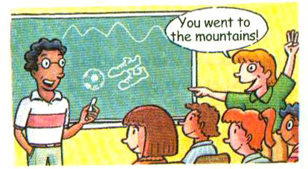
Guessing
Think of two things you did last weekend. Draw pictures of them. Your classmates guess what you did.
3c

Slide 28
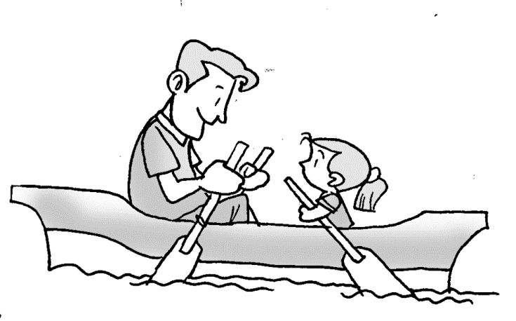
What did I do?
You went boating.
You went with your daughter?

Slide 29
Talking
Take some photos of your vacations to school. Ask and answer about your vacations.

Slide 30
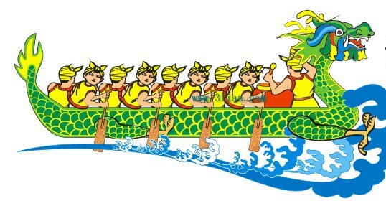
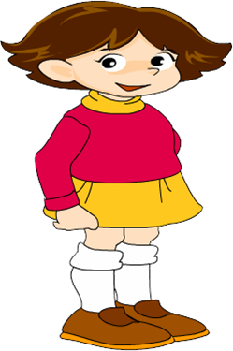
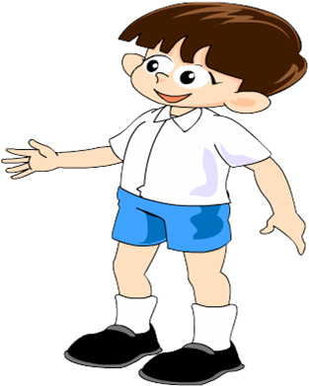
Where did you go on Dragon Boat Day?
I went to the countryside.
What did you do there?
I watched the boat race.

Slide 31
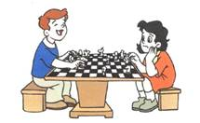
What did you do last weekend?
I played chess.
Who did you play with?
With my mother.

Slide 32
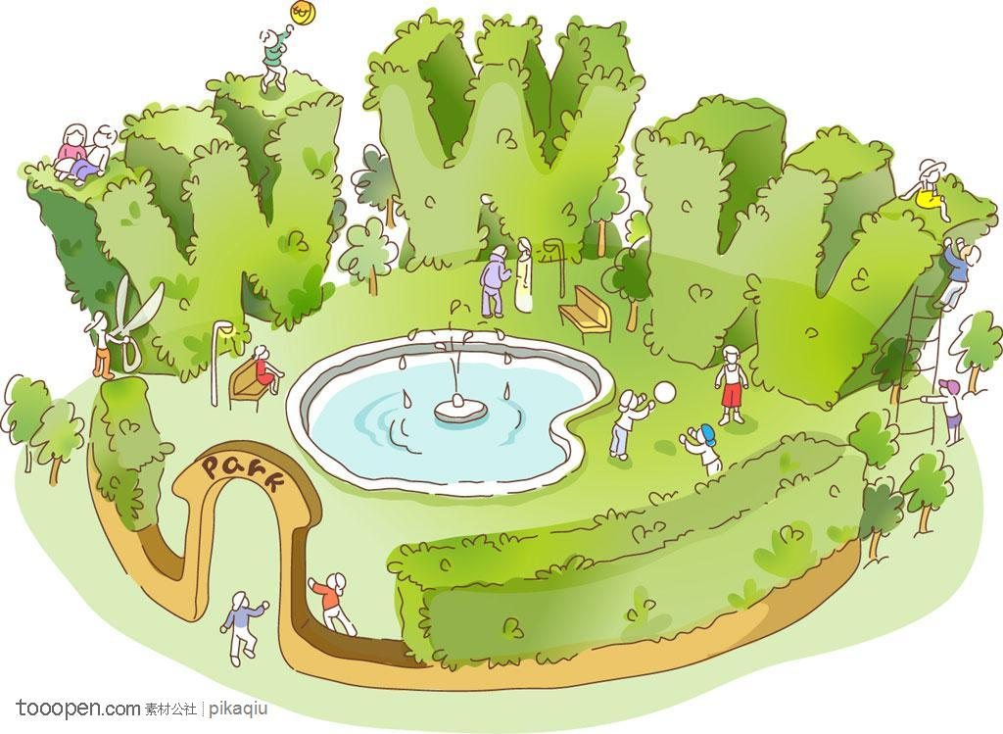
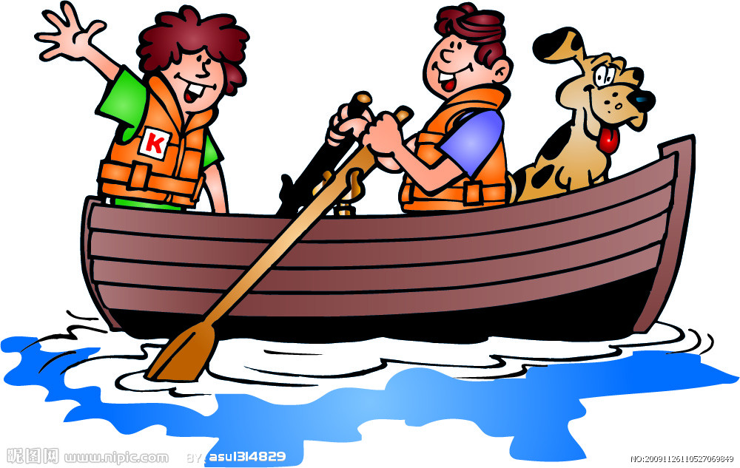
Practice
1. Look at the pictures, and read the
conversation then fill in the blanks.
A: How ____ your last weekend?
B: It was great.
was

Slide 33
A: _______ did you go?
B: I went to the _____.
A: _____ did you go _____?
B: I went with my classmate.
A: ______ did you do there?
B: We _____ ________ and _____ some photos.
Where
park
Who with
What
went boating took

Slide 34
2. 从方框中选择恰当的单词，并用其正确形式填空。
say look get walk ask have
Mr. Jones went to the mountains for a holiday. He ________ to the train station and ____ on the train on Sunday morning.
walked
got

Slide 35
He ____ a new hat. He often put his head out of the window to _____ at the mountains. But the wind pulled his hat off. He quickly threw his old bag out of the window. Some people ______ “Why?”. He ____, “There’s no name and address on my hat, but there’s my name and address on my bag.”
had
look
asked
said

Slide 36
Homework
1. Remember the sentences in the
Grammar Focus.
2. Think of six interesting things you did in the last month. Then write them down in English.

