Slide 1
Unit 7

Slide 2
Unit 7
It's raining!

Slide 3
Section A 1
1a-2d

Slide 4
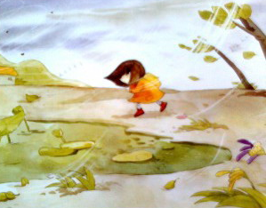
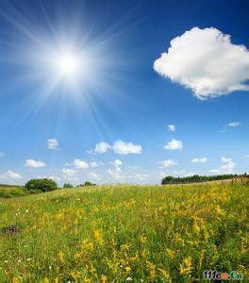
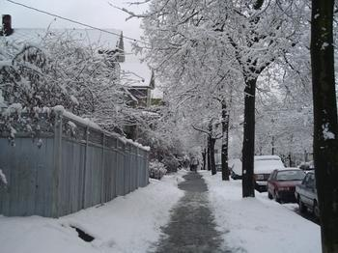
New words
windy adj. 多风的
cloudy adj. 多云的
sunny adj. 晴朗的
snow v. 下雪 n. 雪

Slide 5
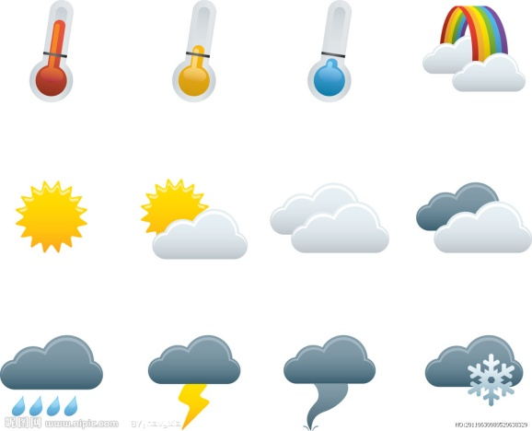
weather n. 天气
cook v. 做饭

Slide 6
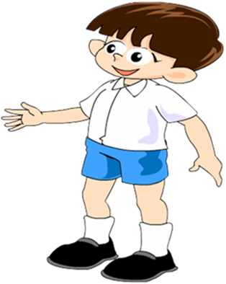
Warming up
Talk about the weather.
What’s the date today?
The weather is good today.
Yes, it’s sunny/cloudy/windy….
It’s …

Slide 7
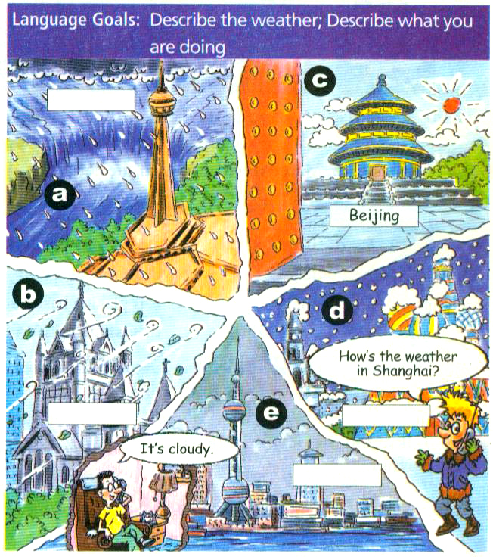
1a
Match the words with the pictures [a-e].
raining ___
windy __
cloudy __
sunny __
snowing __
a
b
e
c
d

Slide 8
Listening
1b
Listen and write these city names in the boxes above.
Beijing Moscow Toronto Boston Shanghai

Slide 9
Toronto
Beijing
Boston
Moscow
Shanghai

Slide 10
Pairwork
Imagine you are in one of the places in 1a. Talk about the weather with your friend on the phone.
1c
— How’s the weather in Beijing?
— It’s sunny.

Slide 11
— How’s the weather in Shanghai?
— It’s cloudy.
— How’s the weather in Moscow?
— It’s snowy.

Slide 12
— How’s the weather in Toronto?
— It’s raining.
— How’s the weather in Boston?
— It’s windy.

Slide 13
Listen and number the pictures [1-4].
Listening
2a
4
2
3

Slide 14
Listen again. Match the names with the activities.
2b
c Uncle Joe
___ Jeff
___ Mary
___ Aunt Sally
a. is playing computer games.
b. is cooking.
c. is playing basketball.
d. is watching TV.
a
d
b

Slide 15
Pairwork
2c
Talk about the people with a partner.
— What’s Uncle Joe doing?
— He’s playing basketball.

Slide 16
— What’s Aunt Sally doing?
— She’s cooking in the kitchen.

Slide 17
— What’s Mary doing?
— She’s watching TV.

Slide 18
— What’s Jeff doing?
— He’s playing computer games.

Slide 19
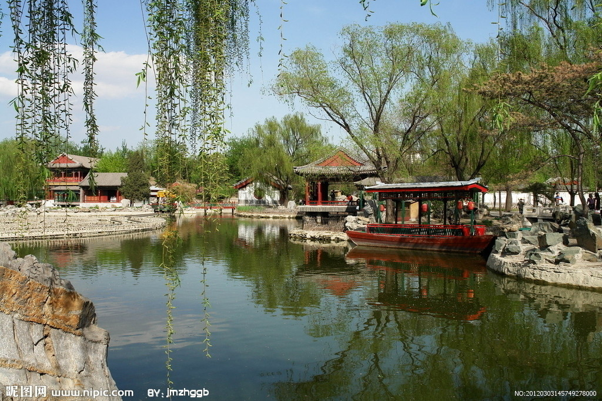
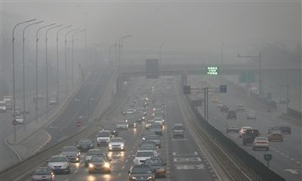
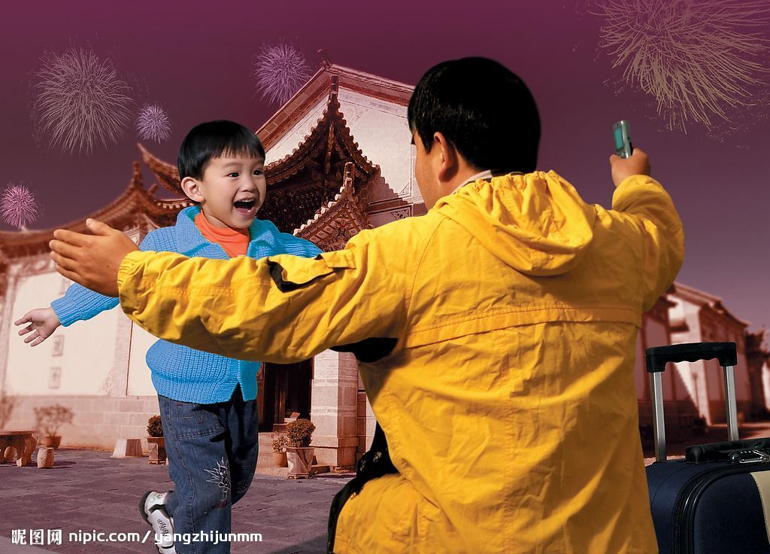
New words
park n. 公园
bad adj. 坏的 bad weather
back adv. 回来
come back
message n. 信息

Slide 20
Reading
Read the conversation in 2d and answer the questions.
2d
1. What’s Steve doing?
_______________________________ _______________________________
2. What’s Rick’s brother doing?
_______________________________
3. What does Steve want Rick’s brother to do? _________________________________
He’s playing basketball with some friends at the park.
He’s studying at his friend’s home.
He wants Rick’s brother to call back.

Slide 21
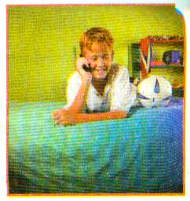
Role-play the conversation.
Rick: Hello, Rick speaking.
Steve: Hi, Rick. It’s Steve. How’s it going?
Rick: Not bad, thanks. The weather’s great.
What are you doing?
Steve: I’m playing basketball with some
friends at the park.
Rick: Sounds like you’re having a good time.

Slide 22
Steve: Yeah. Is your brother at home?
Rick: Oh, he’s not here. He’s studying
at his friend’s home.
Steve: Can I take a message for him?
Rick: Yes. Could you just tell him to
call me back?
Steve: Sure. No problem.

Slide 23
Language points
1. It’s raining.
rain 做动词，意为“下雨”。
e.g. 现在天津在下雨。 _________________________
【拓展】rain 做名词，意为“雨水”。
e.g. There is a lot of rain in summer in our city. 我们这里夏天雨量很大。
It’s raining in Tianjin now.

Slide 24
2. It’s windy.
windy 多风的； cloudy 多云的； sunny 晴朗的
构词法：名词 + y → 形容词
e.g. 今天宁夏风很大。
It’s ______ in Ningxia today.
windy

Slide 25
3. How’s the weather in Beijing?
weather 是不可数名词，意为“天气；气候”。
其前面不能用不定冠词 a 修饰，但可以用定冠词 the 或 bad/fine 等修饰；通常可以用 it 来指代。
e.g. 春天在中国北部是多风的。
___________ is windy in spring in the north of China.
The weather

Slide 26
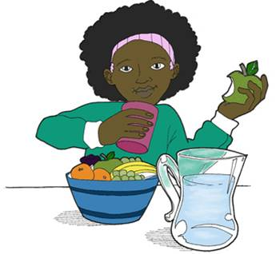
— 今天天气如何？
— 今天下雨。
— How’s the ________ today?
— ____ raining.
weather
It’s
4. She’s cooking.
cook 作动词，意为“烹调；煮”
e.g. 通常妈妈给我们做晚饭。
My mother usually cooks for us.
【拓展】作名词，意为“厨师”。

Slide 27
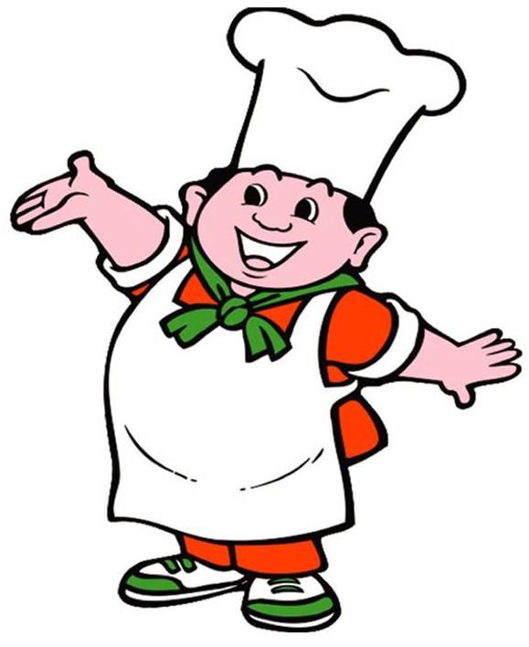
e.g. 我叔叔是一位很棒的厨师。
My uncle is a great cook.
5. How’s it going? 情况怎么样？
How’s …? 句型在问候语中用来询问对 方的情况。

Slide 28
答语常为：Great. / Pretty good. /Not bad.等。
e.g. 你的学习情况如何？
How’s it going with your study?
【拓展】 表达问候还可以用 How are you? 进行询问，答语常为“Fine, thank you.”。
这两句话的重点不在于询问，而在于问
候或打招呼。

Slide 29
6. No problem. 没有问题。
e.g. — 你会做风筝吗？ — 没问题。
— Can you make a kite?
— No problem.

Slide 30
7. Sounds like you’re having a good time.
这是一个省略句，相当于 It sounds like you’re …。英语It sounds like …与It sounds …句型近似，都表示“听起 来……；听上去……”。这种省略的用 法十分口语化，在日常英语会话中经 常听到。例如：

Slide 31
(It) Sounds like he’s all right now.
听上去他现在病已经好了。
(It) Sounds like you had a good time on your trip.
听起来你旅行玩得很开心。

Slide 32
练一练
一、用所给单词的适当形式填空。
1. It’s a ______ day today (sun).
2. The weather is bad now. It’s _______ (wind).
3. Sounds like you __________ (have) a good time now.
sunny
windy
are having

Slide 33
cloudy
4. It’s ______ (cloud) now. Is it going to rain?
5. — How’s the weather now?
— It _________ (rain) now.
6. It’s ______ (snow) in winter in Harbin now.
is raining
snowy

Slide 34
二、根据汉语提示完成句子。
1. 多伦多的天气如何？
_____________________________
— 你那里情况怎么样？
— 不错。
_____________________________
_____________________________
How’s the weather in Toronto?
— How’s it going?
— Not bad.

Slide 35
3. 我奶奶正在给我们做饭。
_____________________________.
4. 你能给杰克捎个信吗？ _____________________________?
5. — 你能告诉她给我回个电话吗？
— 没问题。
______________________________?
______________________________
My grandma is cooking for us
Can you take a message for Jack
— Can you tell her to call me back
— No problem.

Slide 36
Homework
一、总结有关天气的词汇。
二、编写三个有关天气问答的对话。
1. windy
2. raining
3. snowy

