Slide 1
人教版必修第二册
Period 1 Listening &Speaking &Talking
Unit 2 Wildlife Protection

Slide 2
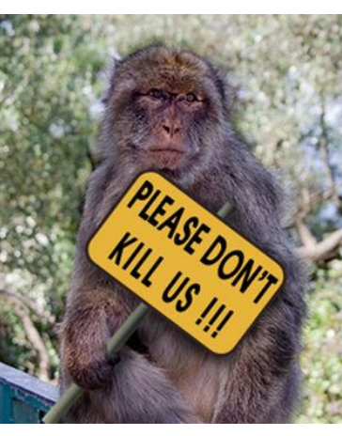
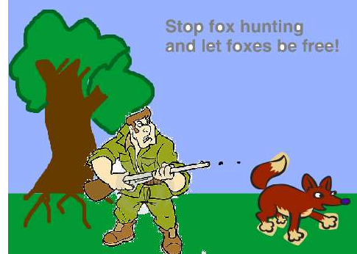
Part 1: Listening and Speaking Leading-in
They tell us wildlife is being hunted and under threat.
What messages do these posters share?

Slide 3
Before listening:
Listening tip
Before Listening，we can use visuals to predict content and look at the pictures, videos, charts and other visuals to help us predict.
Prediction
Predict what the listening text is about by looking at the pictures.
The listening text is probably about some animals that are endangered and why and how we can protect them from being extinct.

Slide 4
While listening: Listening to the first part of the tape, the students need to solve the following tasks. .
wildlife
Our planet‘s ____________is dying out at an alarming rate. Between 150 and 200 species are becoming ___________ every day. This mass extinction is caused by hunting, habitat _________and pollution. We must make people aware of the problem and help_______ the endangered wildlife before it’s too late!
extinct
loss
protect

Slide 5
While listening:
Play the second part of the tape answer the following questions.
1.How many elephants are killed on average every day?
2.What did Prince William say about China?
3. What does “change begins with you” mean?

Slide 6
While listening:
1.How many elephants are killed on average every day?
54
2.What did Prince William say about China?
China can become a _________________in wildlife protection.
global leader

Slide 7
While listening:
3. What does “change begins with you” mean?
If you want things to change, you must change yourself first and not wait for others to be the first one to do sth, you must be the number one to start to do the first action. In this way, we can change the world for the better.

Slide 8
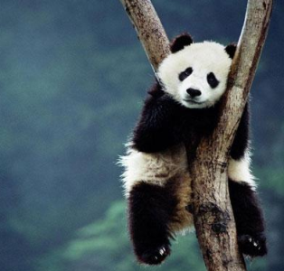
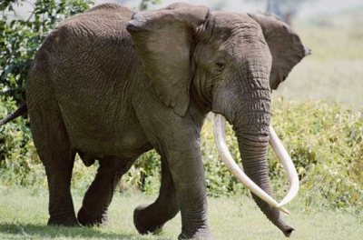
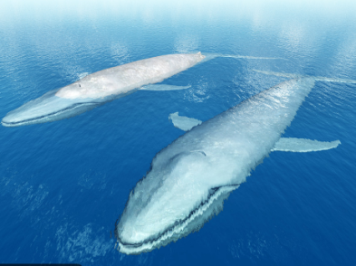
Talking Project
In pairs, discuss the questions, role-play the example, and then talk about one of the animals in the photos below.
1. What do you know about the animals in the photos?
2. What is being done to help them?

Slide 9
A: I'm concerned about the blue whales. What do you know about them?
B: Well, I know that they're being hunted and their number is getting dramatically smaller, so they're in danger of extinction. Blue whales need large and clear water habitats, so it's difficult for them to adapt to the changes.
A: That's terrible. What measures are being taken to help them?
B: The authorities are under pressure to make laws to ban illegal hunting whales and tell people not to buy whales products.

Slide 10
Part 2: Listening and Talking
Listen to the tape, for the first time, and then ask the students to solve the following tasks.
Choose the right ending for each sentence.
1.Binoculars
2. Build bird feeders
3. Use a bird field guide
4. Put paper cut-outs on windows
A:in order to identify birds
B. so that birds do not crash into them in order that .. .
C. to make sure that birds have enough food
D. are used for watching birds from far away
D
C
A
B

Slide 11
Part 2: Listening and Talking
Listen and answer the questions.
1. Who are the teenagers?
2. Where are they?
3 What are they doing?
3. Why are they doing it?

Slide 12
Part 2: Listening and Talking
Listen and answer the questions.
1. Who are the teenagers?
They are from a bird watching club.
2. Where are they?
In the Qinling Mountains.

Slide 13
Part 2: Listening and Talking
Listen and answer the questions.
3 What are they doing?
They are searching for new wild birds and looking them up in their field guide.
3. Why are they doing it?
It is interesting and you can practice it anywhere.

Slide 14
Part 2: Listening and Talking
Listen again and use the phrases you hear to fill in the blanks.
Expressing purposes
This is used for.../so as to…/in order to/ He has done it so that… /in order that…
1. They got up early _____________search for wild birds.
2. I've brought a field guide ___________we can look up the birds we see.
3. My dad gave me the binoculars ______________we can see the birds better.
4. Bird watching clubs clean up habitats build bird feeders, and put paper cut-outs on windows ________________protect birds.
so as to
so that
in order that
in order to

Slide 15
Talking Project
Work in groups. Think of the wildlife in your neighborhood and their needs.
What can you do to care for them?
Find out the solutions.
Role play a dialogue with your peers.

Slide 16
Version :
A: I often see wild cats and dogs in our neighborhood. Maybe we should do something to care for them.
B: Should we put out bowls of food for them?
C: Sure, and I think we could also put out boxes or other things for them, so that they can find shelter when it's cold or wet outside.
D: What else can we do for them?
A: Why not raise money and form a pet’s homeless shelter where homeless pets can find a home and may be adopted by others.
C: Sound great. Let’s make a plan and try it

Slide 17
Homework
Finish the exercise that is given today.

Slide 18
人教版必修第二册

