Slide 1
人教版必修第二册
Unit 2 Wildlife Protection
Period 2 Reading and Thinking:
A Day in the Clouds

Slide 2
Let’s look at some animals, and discuss what they have in common?

Slide 3
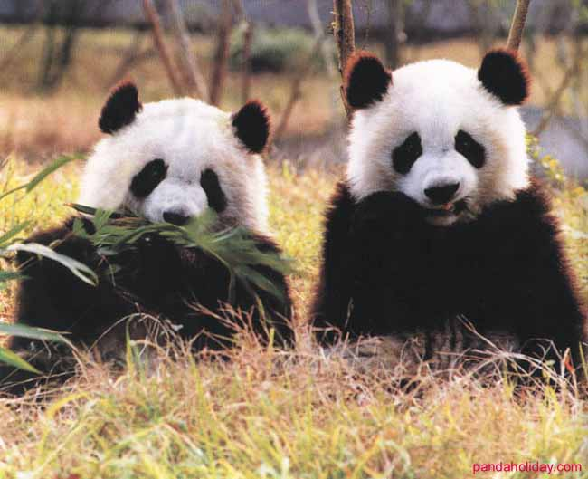
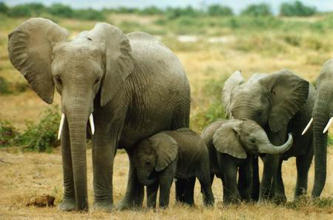

Slide 4
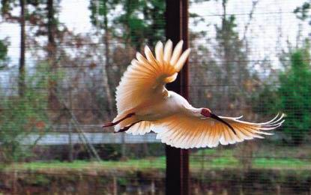
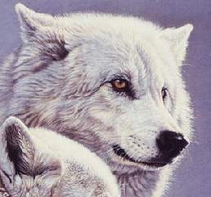
朱鹮
北极狼

Slide 5
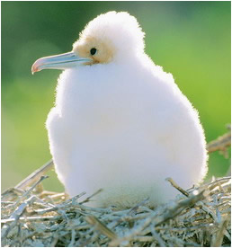
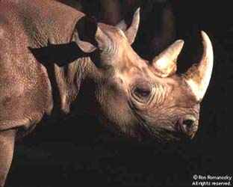
军舰鸟
黑犀牛

Slide 6
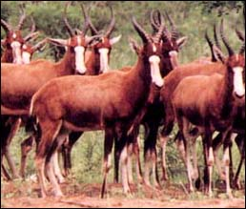
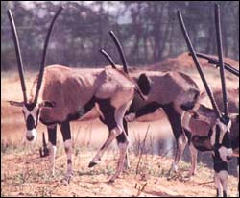
白脸牛羚
剑羚

Slide 7
They are endangered animals.
They are being hunted by some illegal
hunters for money.
They should be well protected now.
They are cute and beautiful.
……

Slide 8
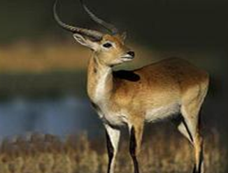
Prediction
What is the animal?
It is good at running and jumping.
It is one of the Beijing Olympic mascots.
Its name is closely connected with Hoh Xil Nature Reserve.
It mainly lives in Qinghai and Tibet.
Antelope

Slide 9
Watch a flash
And then tell your feelings about it.

Slide 10
While reading

Slide 11
Skimming
Read the passage quickly to solve the following questions.
(1)Why did the author come to Tibet?
(2)Why did the population of antelopes drop so badly in the 1980s
and 1990s?
(3)What was done to protect the Tibetan antelopes?
(4)Why should we continue the protection programs of the antelope?
(5)What can we do to save the planet according to the author?

Slide 12
Skimming
Read the passage quickly to solve the following questions.
(1)Why did the author come to Tibet?
To observe Tibetan antelopes.
(2)Why did the population of antelopes drop so badly in the 1980s and 1990s?
Because of being hunted and the loss of their habitats.
(3)What was done to protect the Tibetan antelopes?
Watching over them and adding some bridges and gates.

Slide 13
Skimming
(4)Why should we continue the protection programs of the antelope?
The threat to them has still existed.
(5)What can we do to save the planet according to the
author?
To live in harmony with nature.

Slide 14
Scanning
Read the passage and fill in the blanks.
Title: A DAY IN THE CLOUDS
Paragraph 1 | We come here to observe Tibetan (1) _________.
Paragraph 2 | I’m (2) ______by their beauty and also reminded of the danger they are in.
antelopes
struck

Slide 15
Title: A DAY IN THE CLOUDS
Paragraph 3 | My guide works at a nature reserve, which is a (3) ______for animals and plants.
Paragraph 4 | In 1980s and 1990s. the population (4) ________because of people’s activity.
shelter
dropped

Slide 16
Title: A DAY IN THE CLOUDS
Paragraphs 5、6 | The government placed it under national (5) _________and its population recovered. The protection programmes will continue.
Paragraph 7 | We must change our way of (6) ___. Only when we learn to (7) ____in harmony with nature can we stop being a (8) ______to wildlife and to our planet.
protection
life
exist
threat

Slide 17
Careful Reading
Read quickly and figure out the main idea of each paragraph.
Paragraph 1:
Paragraph 2:
Paragraph 3:
Paragraph 4:
Paragraph 5:
Paragraph 6:

Slide 18
Careful Reading
1.Read quickly and figure out the main idea of each paragraph.
Paragraph 1: The writer visited Changtang in order to observe Tibetan antelopes.
Paragraph 2: Tibetan antelopes are in danger.
Paragraph 3: His guide thinks that the land is sacred and protecting the wildlife is a way of life.
Paragraph 4: Bad times for the Tibetan antelope.
Paragraph 5: The Chinese government and volunteers took effective measures to protect the Tibetan antelope.
Paragraph 6: The effective measures have helped the population of Tibetan antelopes recover.
Paragraph 7: Human beings must change the way of life in order to save the planet.

Slide 19
Careful Reading
2. What does the author experience in the clouds?
Things the author sees:
snow-covered mountains disappearing into clouds
the antelopes moving slowly across the green grass
Things the author hears:
Changtang National Nature Reserve
bad times for the Tibetan antelope
measures to protect the Tibetan antelope
effects achieved after years of protection
Things the author feels or thinks:

Slide 20
Critical thinking

Slide 21
1.As students, what should we do to protect the wild animals?
2. What‘s the purpose of this article?

Slide 22
1.As students, what should we do to protect the wild animals?
Firstly, we should work hard to know some
knowledge of the protection of wild animals. Secondly,
we should protect the environment and save energy.
Thirdly, we should spread the importance and
knowledge of the protection of the wild animals

Slide 23
2.What‘s the purpose of this article?
The author intends to tell us that although the Tibetan antelope has been removed from the endangered species list, the threats to them have not yet disappeared. We must change our way of life and learn to exist in harmony with nature.

Slide 24
Summary
The outline of the passage
Introduce the topic：
Protecting the Tibetan Antelopes.
Hunters were shooting them to make profits.
They were endangered.
Their habitats were getting smaller.
why
The Chinese government placed it under national protection.
Bridges and gates were added to let them move easily and safely.
Volunteers watched them over day and night.
We must change our way of life.
We have to learn to live in harmony with nature.
how
Results
The population is recovering.
They are no longer endangered animals.

Slide 25
Homework
Please prepare a short speech:
Tell us the dangers antelopes are facing.
Call on our classmates to protect these animals.

Slide 26
人教版必修第二册

