Slide 1

Unit 4
Where's my schoolbag?
Section B (1a-1e)
人教版七年级(初中)英语上册
0

Slide 2
Learning objectives
1）To learn the key words and expressions: radio;clock; tape; player; model; plane;tape player; model plane.
2）To learn the following sentence patterns:
① —Where are your English books? —They’re on the chair.
② —Where’s his tape? —It’s in the tape player.
③ Meet you at one at your school.
3）To learn to ask and answer the location of things around the house.
0

Slide 3


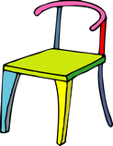
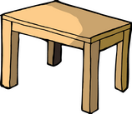
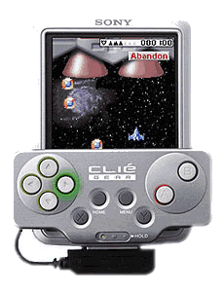
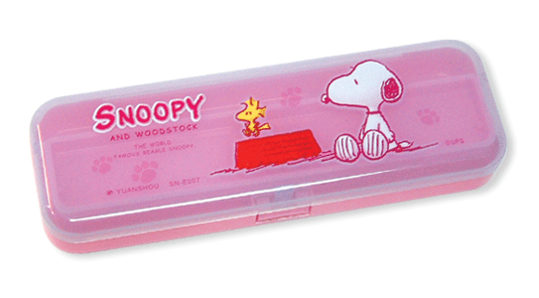


Lead in
A: Where's the… ?
B: It's in/on/under…

Slide 4
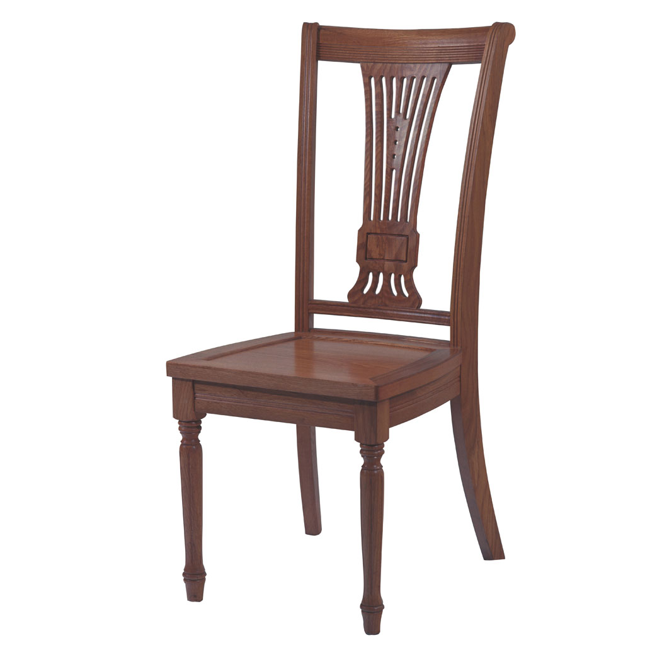
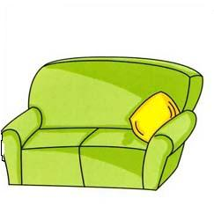
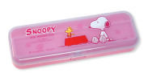
Lead in
A:Where are the… ?
B:They're in/on/under…

Slide 5



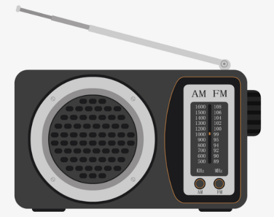

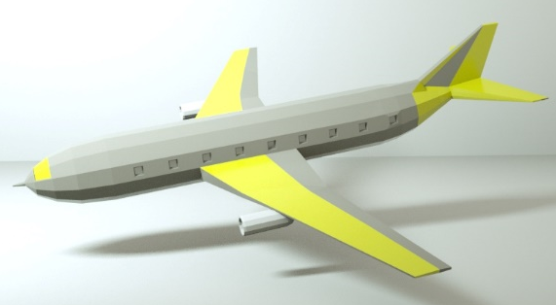

Presentation
—What’s this in English?
— It’s a/an…
plane /pleɪn/ n.飞机
tape /teɪp/ n.磁带；录音带；录像带
radio /ˈreɪdiəʊ/
n.收音机； 无线电广播
clock /klɒk/,/klɑːk/ n. 时钟
model plane飞机模型
tape player /ˈpleɪə(r)/ n.磁带播放机

Slide 6
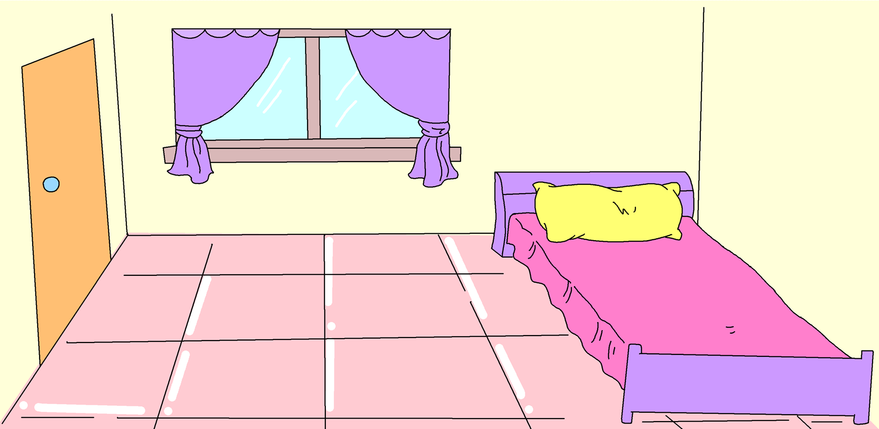
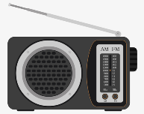

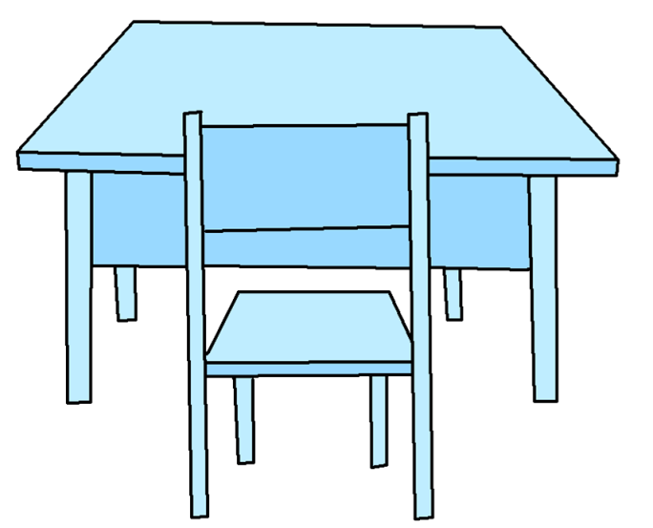
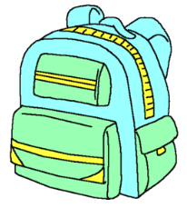




Presentation
Where’s / Where are the ______?
It’s / They’re _______________.

Slide 7
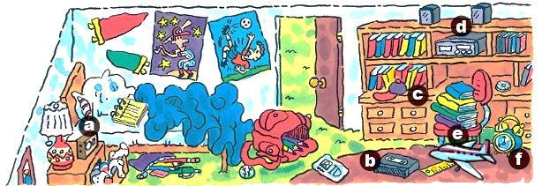
Presentation
1a Match the words with the things in the picture.
d
b
radio 3. tape player _____ 5. tape _______
2. clock ______ 4. model plane _____ 6. hat ______
a
f
e
c

Slide 8
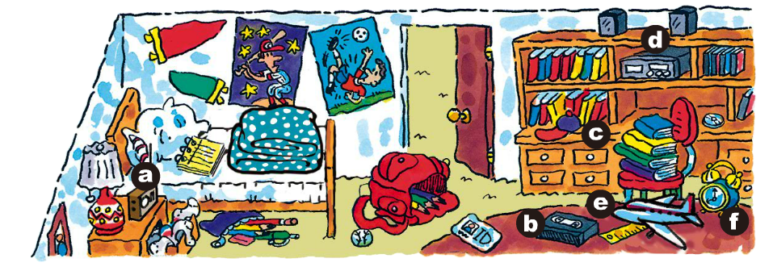
Presentation
1b Look at the picture in 1a for three minutes. Then close your books and write down all the things you remember.

Slide 9
Presentation
Memory challenge
The schoolbag is ____________.
The pencils are ________________.
The quilt is ____________.
The tape player is ______________.
on the floor
in the schoolbag
on the bed
in the bookcase

Slide 10
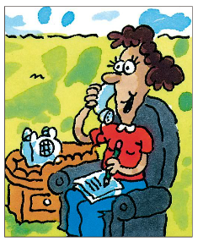
Presentation
1c Listen and circle the things Tom wants from his room.
English books tape player clock ruler notebook tape model plane radio

Slide 11
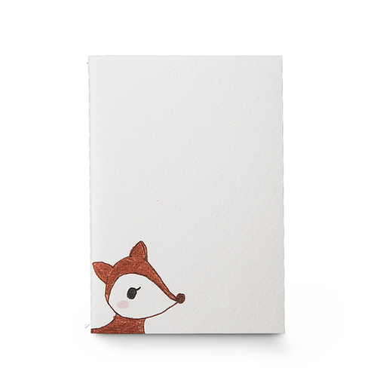

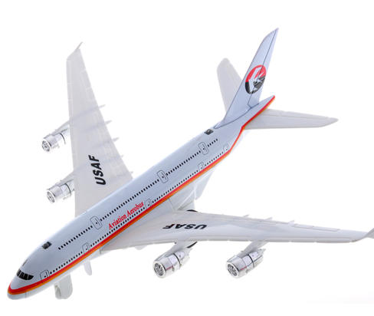
Presentation
Listen and number the things you hear.
2
5
3
4
6
1

Slide 12
Presentation
Listen and fill in the table.
Things
Position
English books
under the radio
ruler
on the bed
notebook
under the model plane in the bookcase
tape
in the tape player

Slide 13
Presentation
Write down where Tom’s things are.
_____________________________________
_____________________________________
_____________________________________
_____________________________________
The English books are under the radio.
The ruler is on the bed.
The notebook is under the model plane.
The tape is in the tape player.

Slide 14

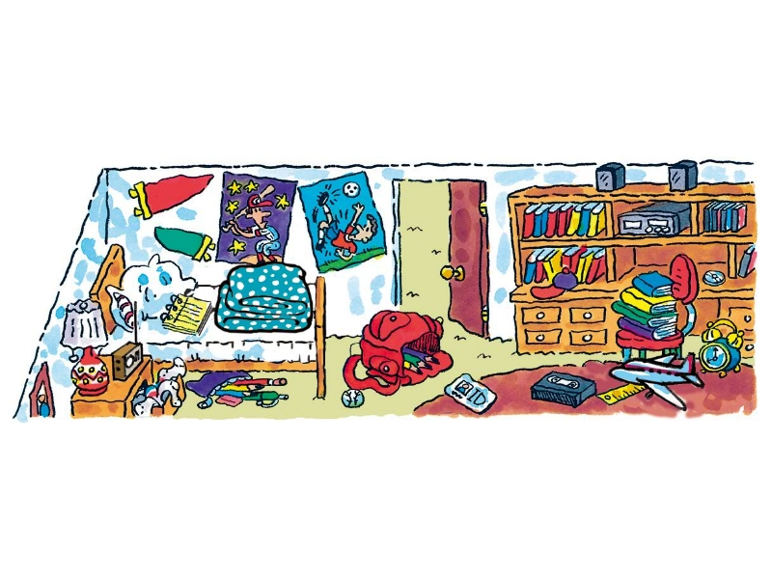
Presentation
1e Ask and answer questions about the things in Tom’s room.
d
c
a
b
e
f

Slide 15
Language points
介词in的用法：
(1)表示方位，意为“在……里面”。He is in the classroom.
(2)表示“在（某一时间）”，用于年、月、日、世纪、年代、早上、上午、下午、晚上等名词前。in 2000 在2000年
(3)表示“在（某一地点）”，用于地点名称前。In Wuhan 在武汉
(4) 表示“用（某种语言）”。 in English 用英语
(5) 表示“穿着（某种衣服）”。 in a red dress 穿着红色的裙子

Slide 16
Exercise
一、用所给词的适当形式填空。
1. This is________ (they) classroom.
2. Where _____(be) your parents?
3. These are my __________(eraser).
4. The computer is not ______(my).
5. Excuse _____(I), can you spell this word,please?
their
are
erasers
mine
me

Slide 17
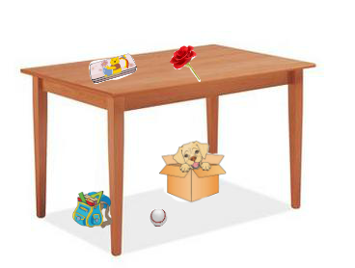
Exercise
二、根据图片提示，用合适的介词完成句子。
1. The pencil box is ____the table.
2. The ruler is ____the schoolbag.
3. The baseball is _______the table.
4. The flower (花) is ____the table.
5. The dog is ____the box and the box is _______the table.
on
in
under
on
in
under

Slide 18
Homework
1. Review the key words and phrases in 1a.
2. Write five sentences to describe where things are according to the picture in 1a.

