Slide 1
Unit 1
My name’s Gina.
Section B (2a-2c)
人教版七年级(初中)英语上册
0

Slide 2
Learning objectives
1）Key words & phrase: zero, one, two, three, four, five, six, seven, eight, nine, ten,
telephone/phone number, family name, last name, first name, China.
2）To learn to recognize the first names and last names.
3）Emotional Goals：To get personal information from the reading material.
To improve reading stradgies and skills from reading material.
0

Slide 3
Lead in
Let's review the English numbers from 0-10.
zero
one
two
three
four
five
six
seven
eight
nine
ten

Slide 4
Lead in
Can you read these English numbers quickly.
19187459820
15924768591
13114763973
15109876543
13312387301
13882348760

Slide 5
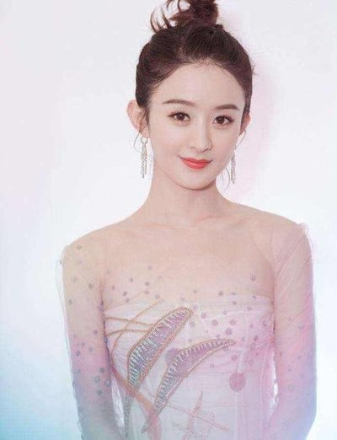
Presentation
Let's talk about stars:
—What’s her name?
—Her name is Zhao Liying.
full name全名
last name/family name
姓
first name/given name
名
—What’s her telephone number?
—...is 19187459820.

Slide 6
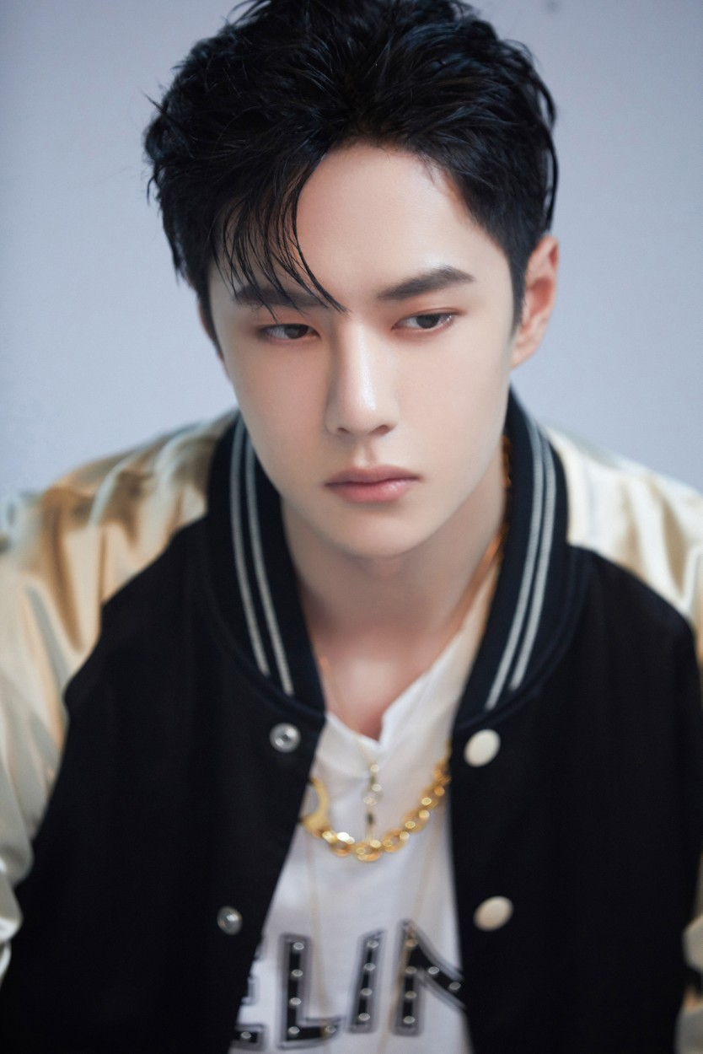
Presentation
Let's talk about stars:
—What’s his name?
—His name is Wang Yibo.
full name全名
last name/family name
姓
first name/given name
名
—What’s his telephone number?
—...is 13312387301.

Slide 7
Presentation
Let's talk about ourselves:
—What’s your name?
—My name is ... .
—What’s your family/last name/given/first name?
—My family/last/given/first name is ...
—What’s your telephone number?
—My telephone number is ... .

Slide 8
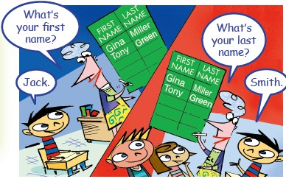
Presentation
2a Read the list of names.Write F for the first name and L for the last name.
1.Alan 6.Jack
2.Green 7.Smith
3.Miller 8.Brown
4.Mingming 9.Zhang
5.Gina 10.Mary
F
F
L
L
L
L
F
L
F
F

Slide 9
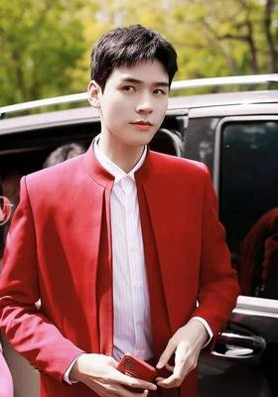
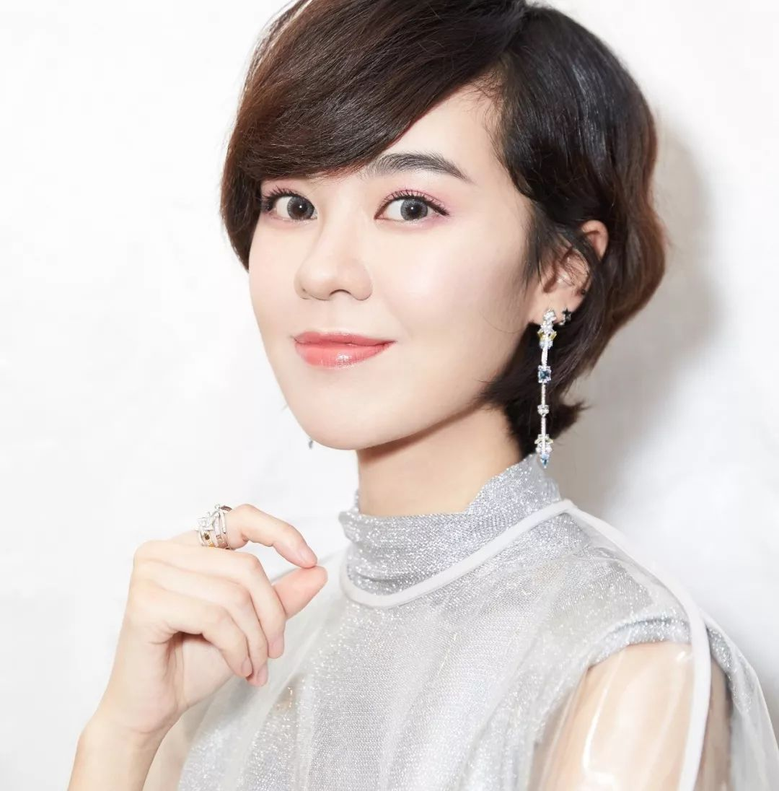
Presentation
Development: try to describe these people.
His/ Her full name is ....
His/Her first name’s ... .
His/Her last name’s ... .
Guan Xiaotong
Gong Jun
Yu Kewei

Slide 10
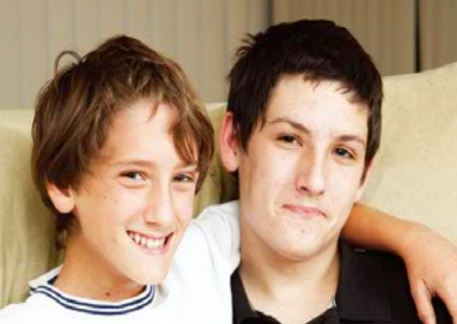
Presentation
2b Listen to the messages and match them with the pictures. Circle the first
names and underline the last names.
A
B
C

Slide 11
Presentation
My name is Jenny Green. My phone number is 281-9176. My friend is Gina Smith. Her phone number is 232-4672.
I’m Dale Miller and my friend is Eric Brown. His telephone number is 357-5689. My telephone number is 358-6344.
My name is Mary Brown. My friend is in China. Her name is Zhang Mingming. My phone number is 257-8900 and her number is 929-3155.
B
C
A

Slide 12
Presentation
Read the messages and judge true(T) or false(F).
1. Jenny Green and Gina Smith are friends.
2. Gina’s phone number is 281-9176.
3. Dale is a last name.
4. Dale Miller and Eric Brown aren’t friends.
5. Mary is a first name.
6. Zhang Mingming is Mary’s friend.
7. Mary’s phone number is 257-8900.
T
232-4672
F
first
F
are
F
T
T
T

Slide 13
Presentation
2c Match the names with the telephone numbers. Then find
three pairs of friends in the name list.
Names
Eric Brown
Gina Smith
Dale Miller
Zhang Mingming
Jenny Green
Mary Brown
Telephone numbers
358-6344
929-3155
281-9176
257-8900
357-5689
232-4672
Friends
1. ______ and _______
2. ______ and _______
3. ______ and _______

Slide 14
Presentation
Make a report accroding to the infromation in 2c.
Eric Brown and Dale Smith are good friends. Eric is his given name, .... His telephone number is ... .

Slide 15
Language points
1. What’s your first name? 你的名字叫什么？
first name=given name 名字；last name=family name 姓，
full name意为“全名”
作形容词，意为“第一”。其反义词为 last (最后的；末尾的)。
first
作副词，表示“最先；最早”。
作序数词，意为“第一”。

Slide 16
Language points
中西方姓名文化差异：
1) 中国人姓在前，名在后，姓和名分成两部分，两部分的首字母都要大写。
Zhao Liying
last name/family name 姓
first name/given name名
2) 西方人名在前，姓在后，名和姓首字母大写。英美人还有中间的名字（middle name）放在名和姓中间。
James Alan Green
first name
middle name
last name

Slide 17
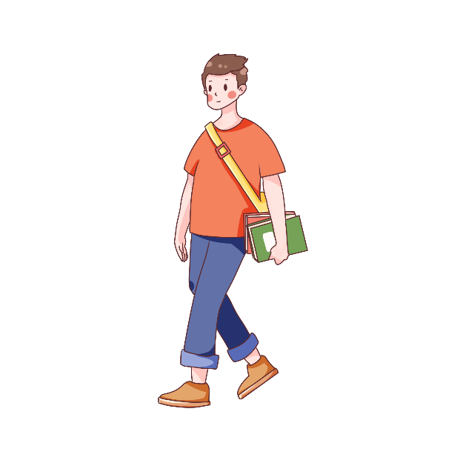
Exercise
一、分别写出图中人物的姓和名:
First name: ___________
Last name: ___________
Tao
Yang Tao
Yang
First name: ___________
Last name: ___________
Jim
Jim White
White

Slide 18
Exercise
二、选出正确选项:
1. I’m Gina Green. My last name is _____.
A. Gina B. Gina Green
C. Green D. Green Gina
2. — Hello! ________name’s Huanhuan. What’s_____name?
— Cindy Black.
A. I; you B. I; your C. My; your D. My; you

Slide 19
Exercise
二、选出正确选项:
3. — Is your telephone number 13139871349?
— Yes, ___________.
A. it is B. I am C. it’s D. I’m
4. Look! This is my good________. Her name’s Cindy.
A. number B. name C. friend D. school
5. —__________ — It’s 0877-65233710.
A. What color is it? B. Is it your phone number?
C. What’s your name? D. What’s your phone number?

Slide 20
Homework
1. Read and recite the new words and phrases of this period.
2. Do the exercises in students’ book.

