Slide 1
Unit 6
I’m going to study computer science.
Section A (1a-2c)

Slide 2
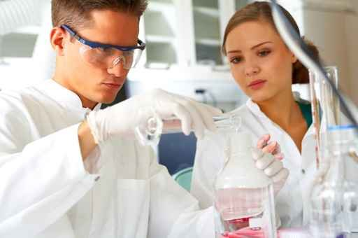
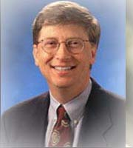
What are their jobs?(1a on P41)
scientist
computer programmer

Slide 3
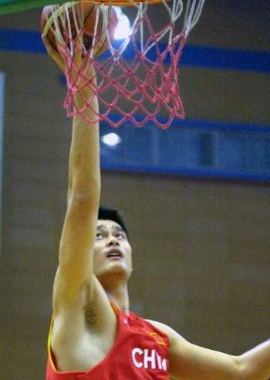
doctor
basketball player

Slide 4
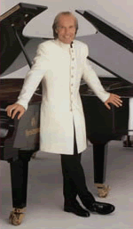
pianist
teacher

Slide 5
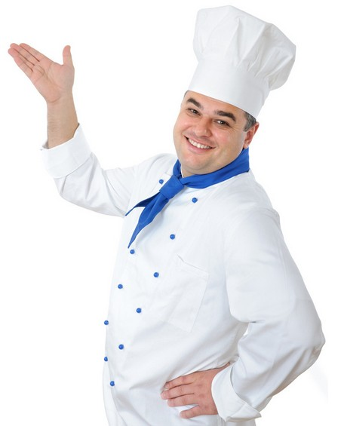
cook
engineer

Slide 6
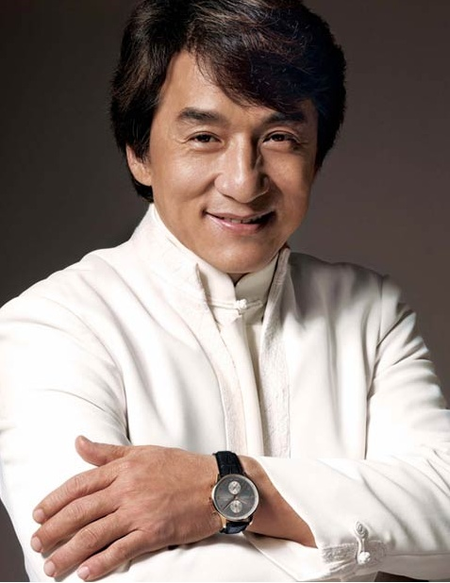
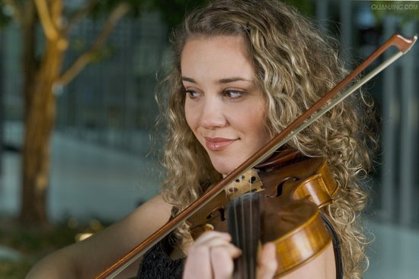
violinist
actor

Slide 7
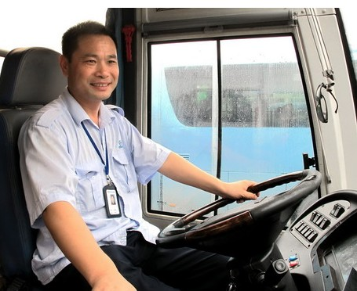
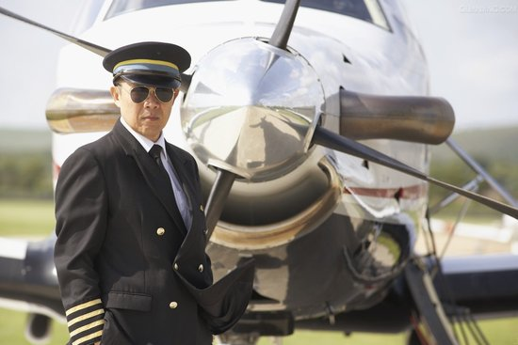
ABAB
ABAB
bus driver
pilot

Slide 8
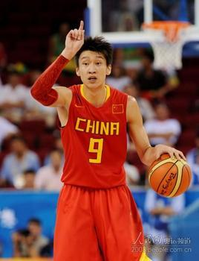
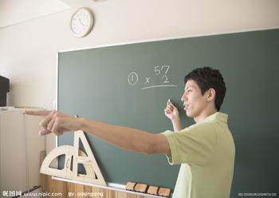
What do you want to be when you grow up?
I want to be a basketball player.
I want to be a teacher.

Slide 9
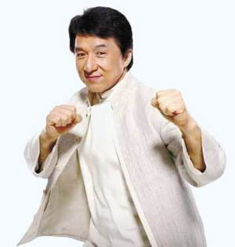
What do you want to be when you grow up?
I want to be an actor.
I want to be a scientist.

Slide 10
I want to be a pianist.
I want to be a computer programmer.

Slide 11
I want to be a pilot.
I want to be a violinist.

Slide 12
I want to be an engineer.
I want to be a bus driver.

Slide 13
Check the worksheet!

Slide 14
预习闯关（一）
1.电脑编程师 2.医生 3.工程师
4.手提琴手 5.厨师 6.巴士司机
7.篮球运动员 8. 老师 9. 飞行员
10.钢琴家 11. 演员 12. 科学家
computer programmer
doctor
engineer
violinist
cook
bus driver
basketball player
teacher
pilot
pianist
actor
scientist

Slide 15
预习闯关（二）
A: ______ do you _______ ______ ______ when
you ________ _______?
意思是：____________________________
B: I _______ _______ _____ a basketball
player.
意思是:______________________________
A: ______ _______ you ________ _________ do
that?
意思是:______________________________
B: ______ ______ _______ practice
basketball _________ ________.
意思是：_____________________________
What want to be
grow up
当你长大了你想当什么呢？
want to be
我想当篮球运动员。
How are going to
你打算如何做到呢？
I'm going to
every day
我打算每天练习篮球。

Slide 16
【探索闯关】
1. I’m going to practice basketball every
day. 此句是表示_________(一般现在时/过
去时/将来时)的时态。从该句子中可以得出表
将来时的结构是 ______________________.
e.g. 我打算去参观动物园。
I ______ ______ ______ visit the zoo.
将来时
be going to do sth.
am going to

Slide 17
Do you think these jobs are interesting? Rank them [1-12](1 is most interesting, 12 is least interesting).
1a
____ computer programmer ____ cook
____ doctor ____ engineer ____ teacher
____ violinist ____ bus driver ____ pilot
____ pianist ____ basketball ____ scientist
____ actor

Slide 18
Listening
1b
Listen and fill in the blanks. Then match the items.
1. computer programmer | a. take ________ lessons
2. basketball player | b. study _________ science
3. engineer | c. practice _________ every day
4. actor | d. study _______ really hard
acting
computer
basketball
math

Slide 19
Practice
—How are you going to do that?
—I am going to take acting lessons.
(上表演课)

Slide 20
—How are you going to do that?
—I am going to practice football every day.
(每天练习足球)

Slide 21
—How are you going to do that?
—I am going to study English really hard.
(非常努力学习英语)

Slide 22
—How are you going to do that?
—I am going to study computer science.
(学习电脑科学)

Slide 23
1c
Pair work
Practice the conversation in the picture. Then make conversations about the other jobs in 1a.
A: What do you want to be when you grow up?
B: I want to be a basketball player.
A: How are you going to do that?
B: I'm going to practice basketball every day.

Slide 24
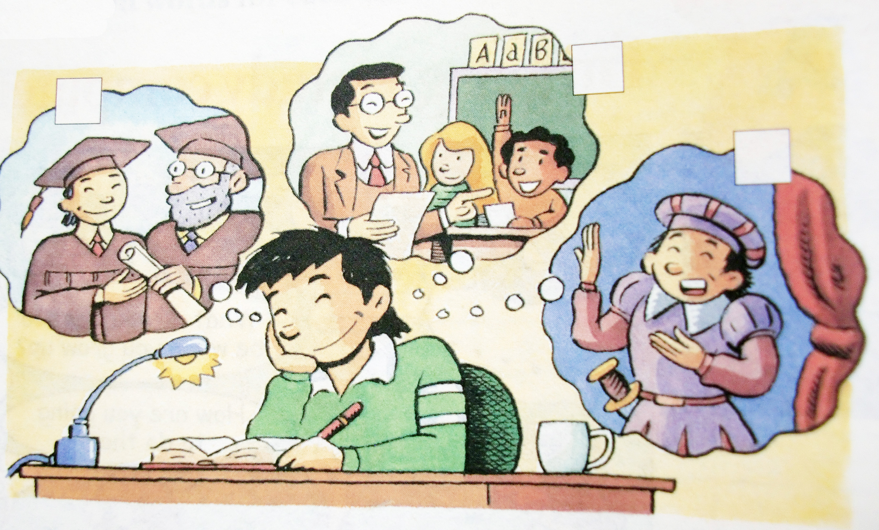
Listen. What is Cheng Han going to do? Check (√) the correct boxes in the picture.
Listening
2a

Slide 25
2b
Listen again. What are Cheng Han’s plans for the future? Complete the chart.
What
Where
How
When
Cheng Han is going to be a teacher.
He is going to move to Shanghai.
He is going to learn how to teach children.
He is going to finish high school and college first.

Slide 26
【课堂训练】一定留在课堂上做！
A: ________ do you want to be when you
______ ________, Cheng Han?
B: I ________ to be a teacher.
A: A re you _________ to _________ to Beijing?
B: No, I’m going to move to Shanghai.
A: And _______ are you going to ___________
a teacher?
B: Well, I’m going to ______ how to _________
children.
A: ________ are you going to ________?
B: I’m going to _______ ________ ___________
and college first.
What
grow up
want
going move
how
become
learn
teach
When
start
finish high school

Slide 27
2c Ask and answer questions.
A: What is Cheng Han going to be?
B: He is going to be a teacher.
A: Where is Cheng Han going to move?
B: He is going to move to Beijing.
A: What is Cheng Han going to do?
B: He is going to learn how to teach children.
A: When is Cheng Han going to start?
B: He is going to finish high school and
college first.

Slide 28
Exercises
写出下列单词。
1. My father is good at computer science. He works as a computer ___________ (程序师).
2. The boy likes planes very much and he wants to be a _______(飞行员) in the future.
3. Mary is a beautiful ________(小提琴手) from America.
4. Pedro’s dream is to be a famous _________ (工程师) in the future.
programmer
pilot
violinist
engineer

Slide 29
谢谢！

